Slide 1
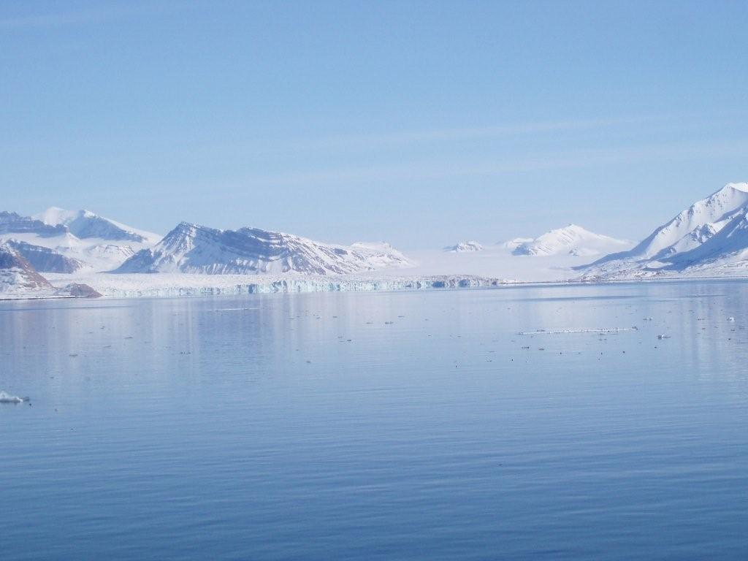
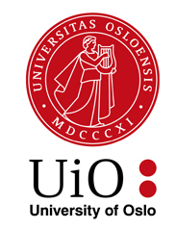
Klima og miljøgifter i
Arktis og Antarktis
Katrine Borgå
Akvatisk biologi og toksikologi
Institutt for biovitenskap
Norsk institutt for vannsforskning (NIVA)

Slide 2
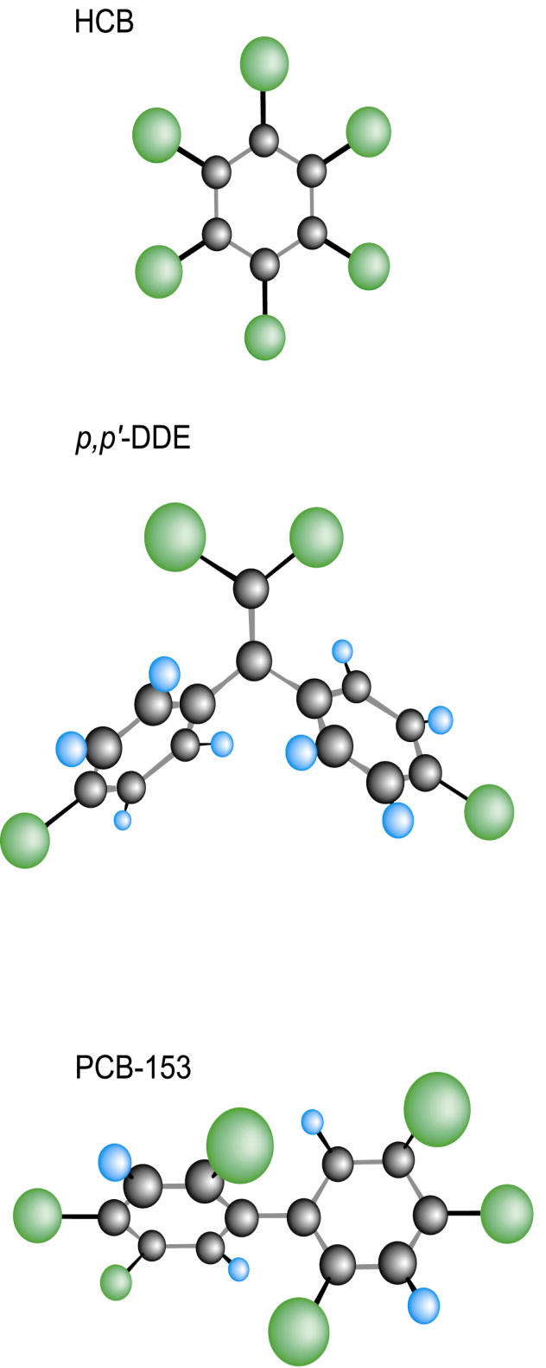
Forurensing: Miljøgifter
Persistente: lang halveringstid
Bioaccumulative: organiske –
hopes opp i fett
Toxic: giftige: pollutants
  Industrikjemikalier
  Jordbruk
  Veterinærmedisiner, medisiner
  Forbrukerartikler

Slide 3
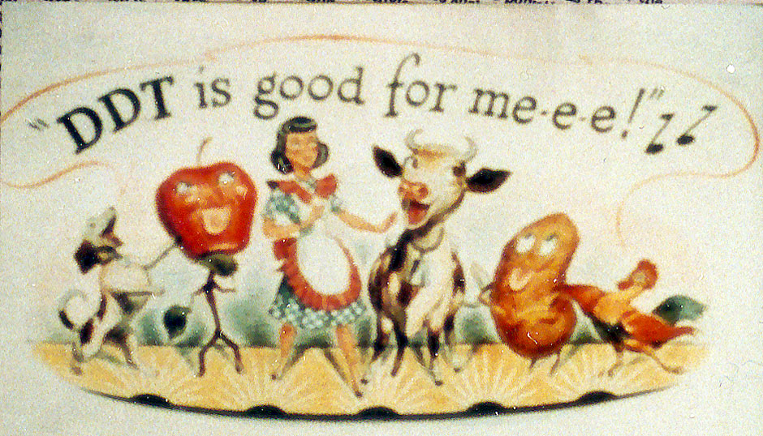
Smithsonian National Museum of American History in Washington DC.

Slide 4

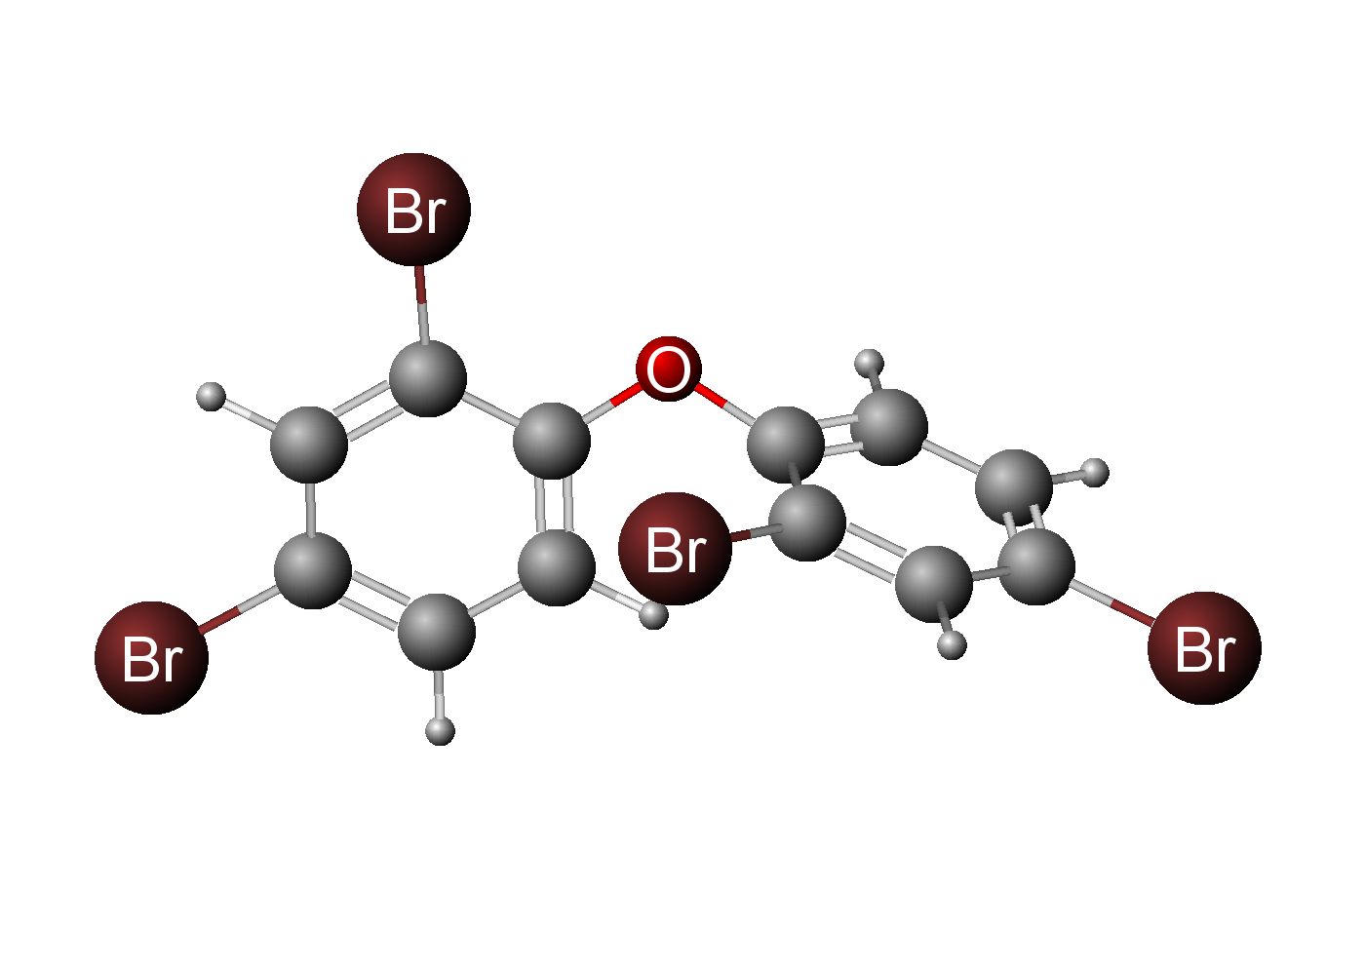
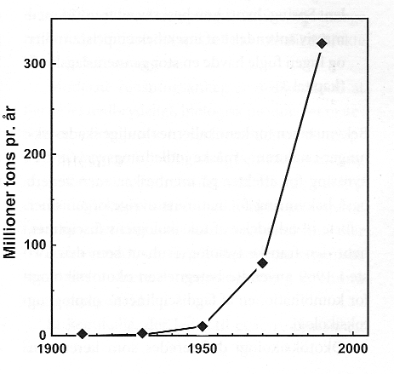
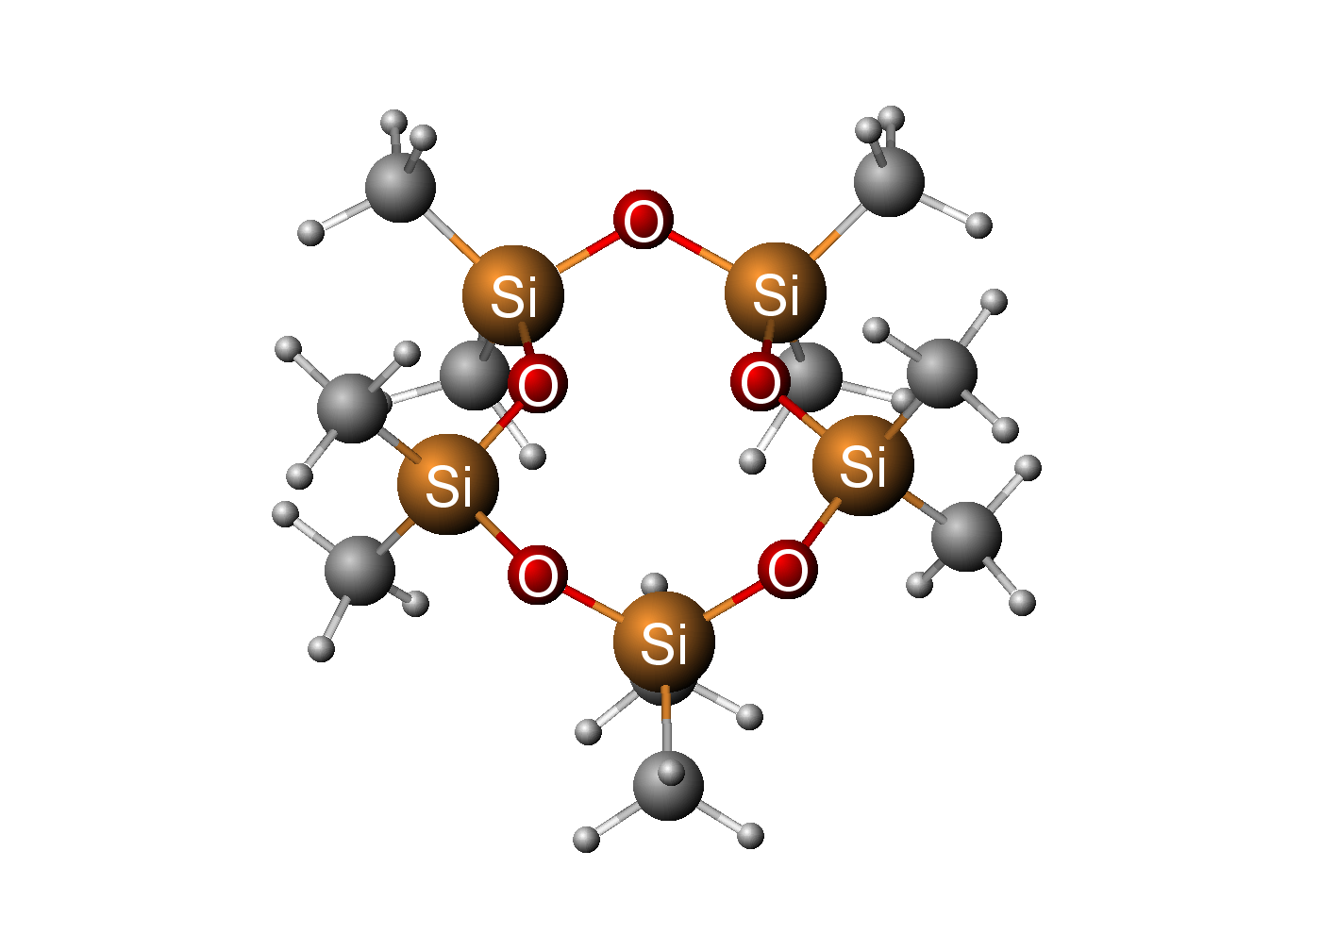

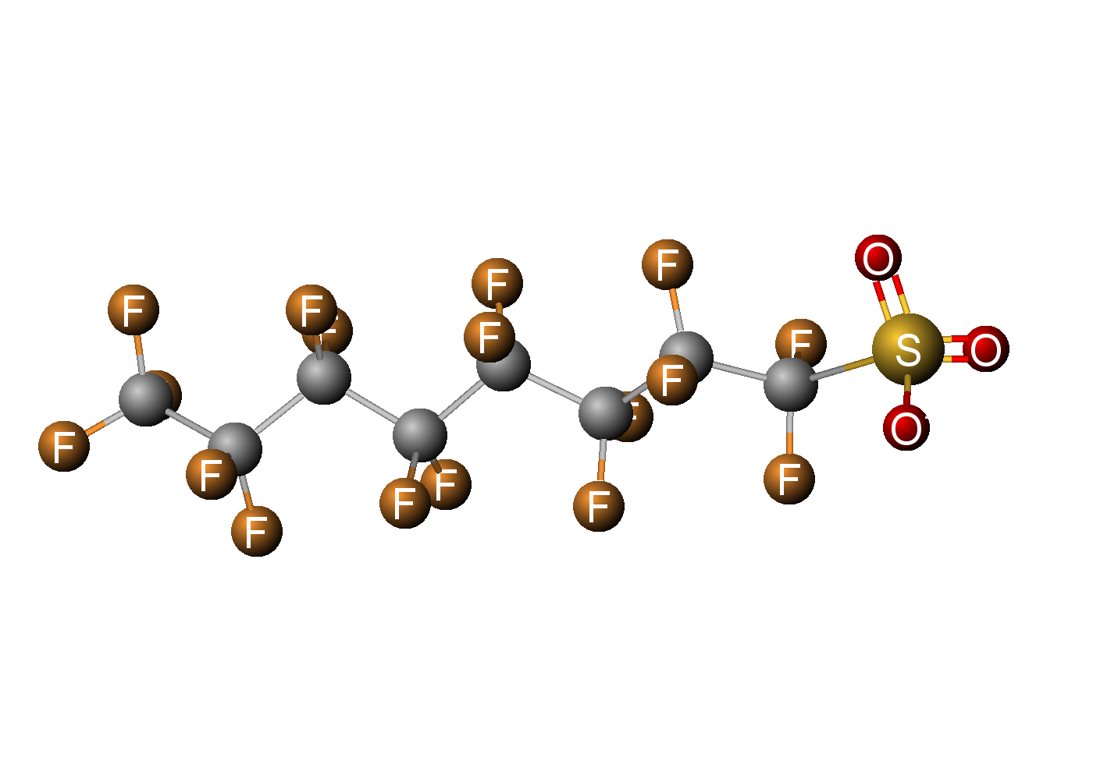
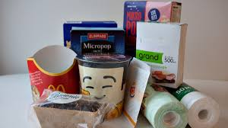
Brommerte flammehemmere
Siloksaner
PFAS (Perfluoralkylstoffer)

Slide 5
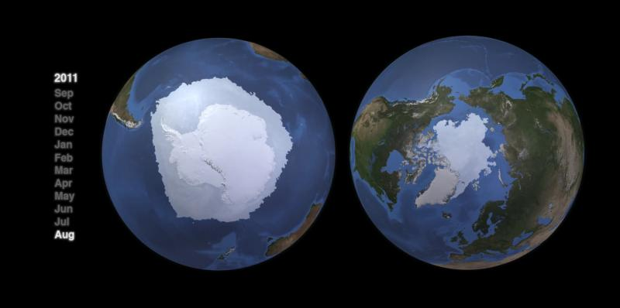
HVA HAR DETTE MED ARKTIS OG ANTARKTIS Å GJØRE?

Slide 6
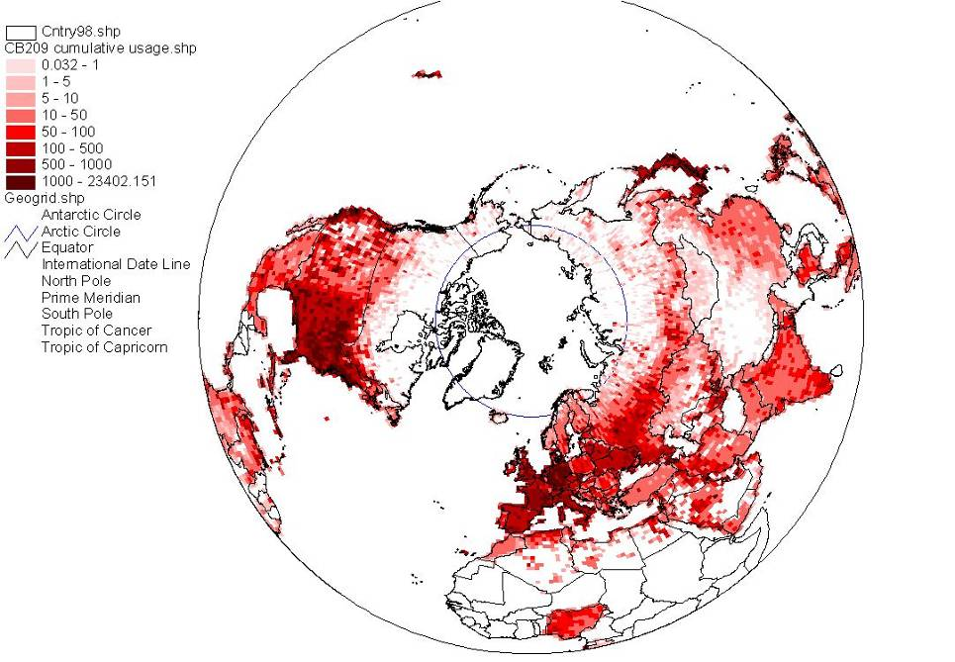
Circumpolar perspective on the historical use of PCBs provides an insight into sources and pathways of other industrial chemicals to the Arctic
Ocean currents
River inflow
Atmospheric circulation
Adapted from Breivik et al.
Sci Tot. Environ. 2002

Slide 7
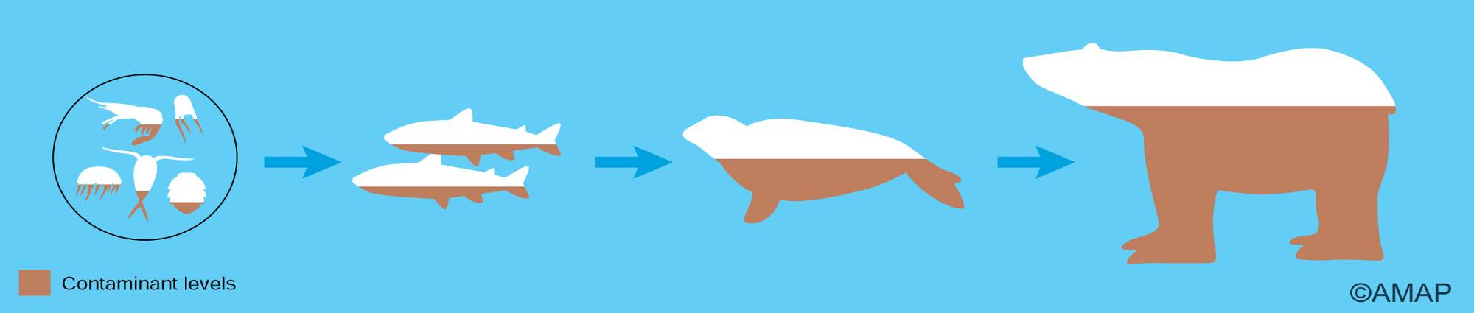
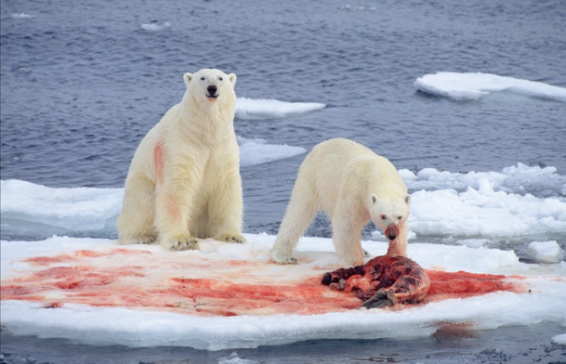
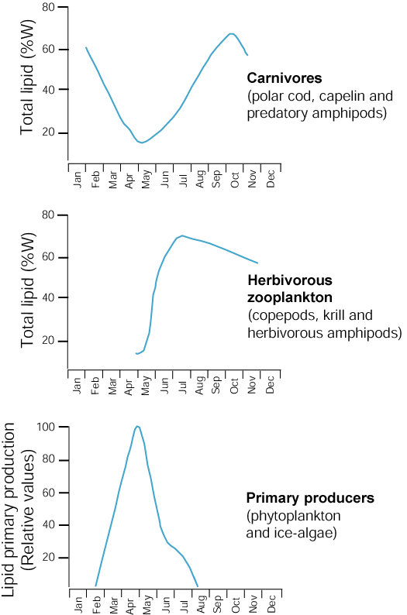
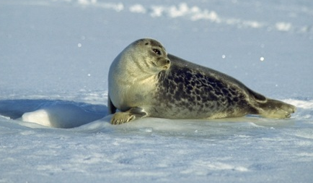
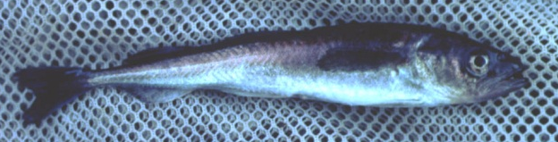
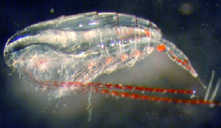

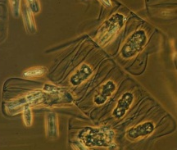
Organiske miljøgifter er fettløselige
Falk-Petersen et al., 1990; Borgå et al., 2004

Slide 8
Climate change
Temperature
Ocean acidification
Precipitation
Ice cover
Primary production
Species distribution
RCP 8.5 Change in average surface temperature
(1986-2005 to 2081-2100)

Slide 9

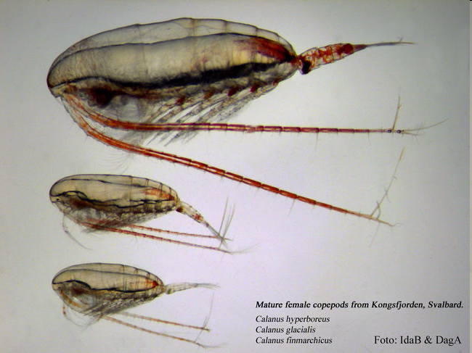
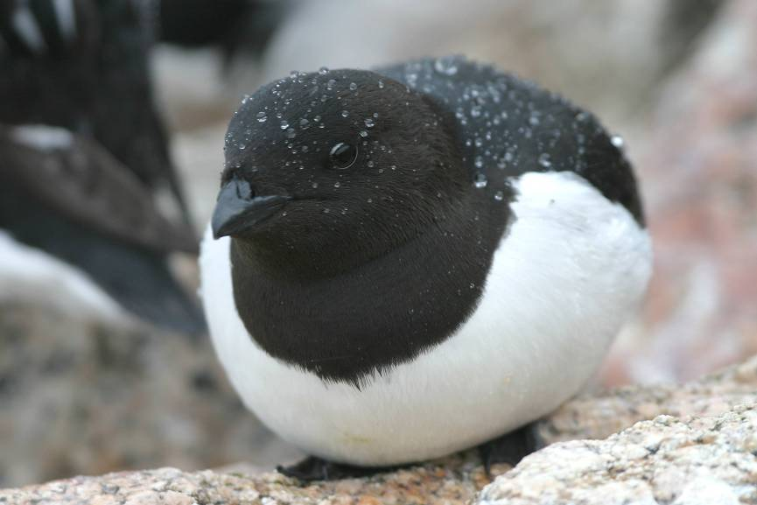
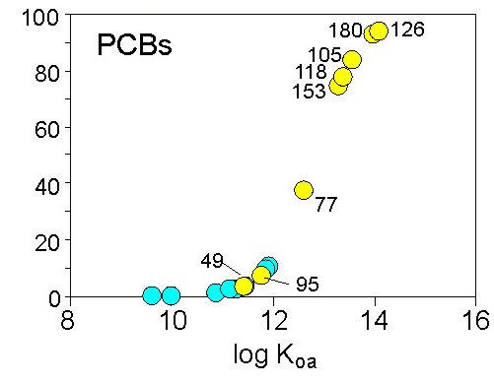
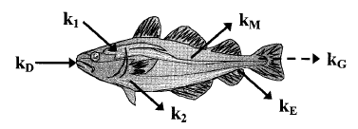
Environmental pollutants and climate change
From Breivik et al.
Sci Tot. Environ. 2002
% on particles
Macdonald et al., 2005
Notes:
Trying to allocate the variance in bioaccumulation caused by CC into different categories:
Altered transport (this is DMU and NILU part of project)
Changes in partitioning due to temperature differences, changes fraction that is bioavailable for uptake in the food web (we are adressing this in the project)
Changes in food web structure and function: alters not only flow of energy but also of contaminants (will be adressed in COPOL, and results combined with results from present project.)
Changes in bioaccumulation process rates such as respiration, growth, feeding rate etc. What is the magnitude and direction of these changes on overall bioaccumulation (we are adressing this in the present project)

Slide 10
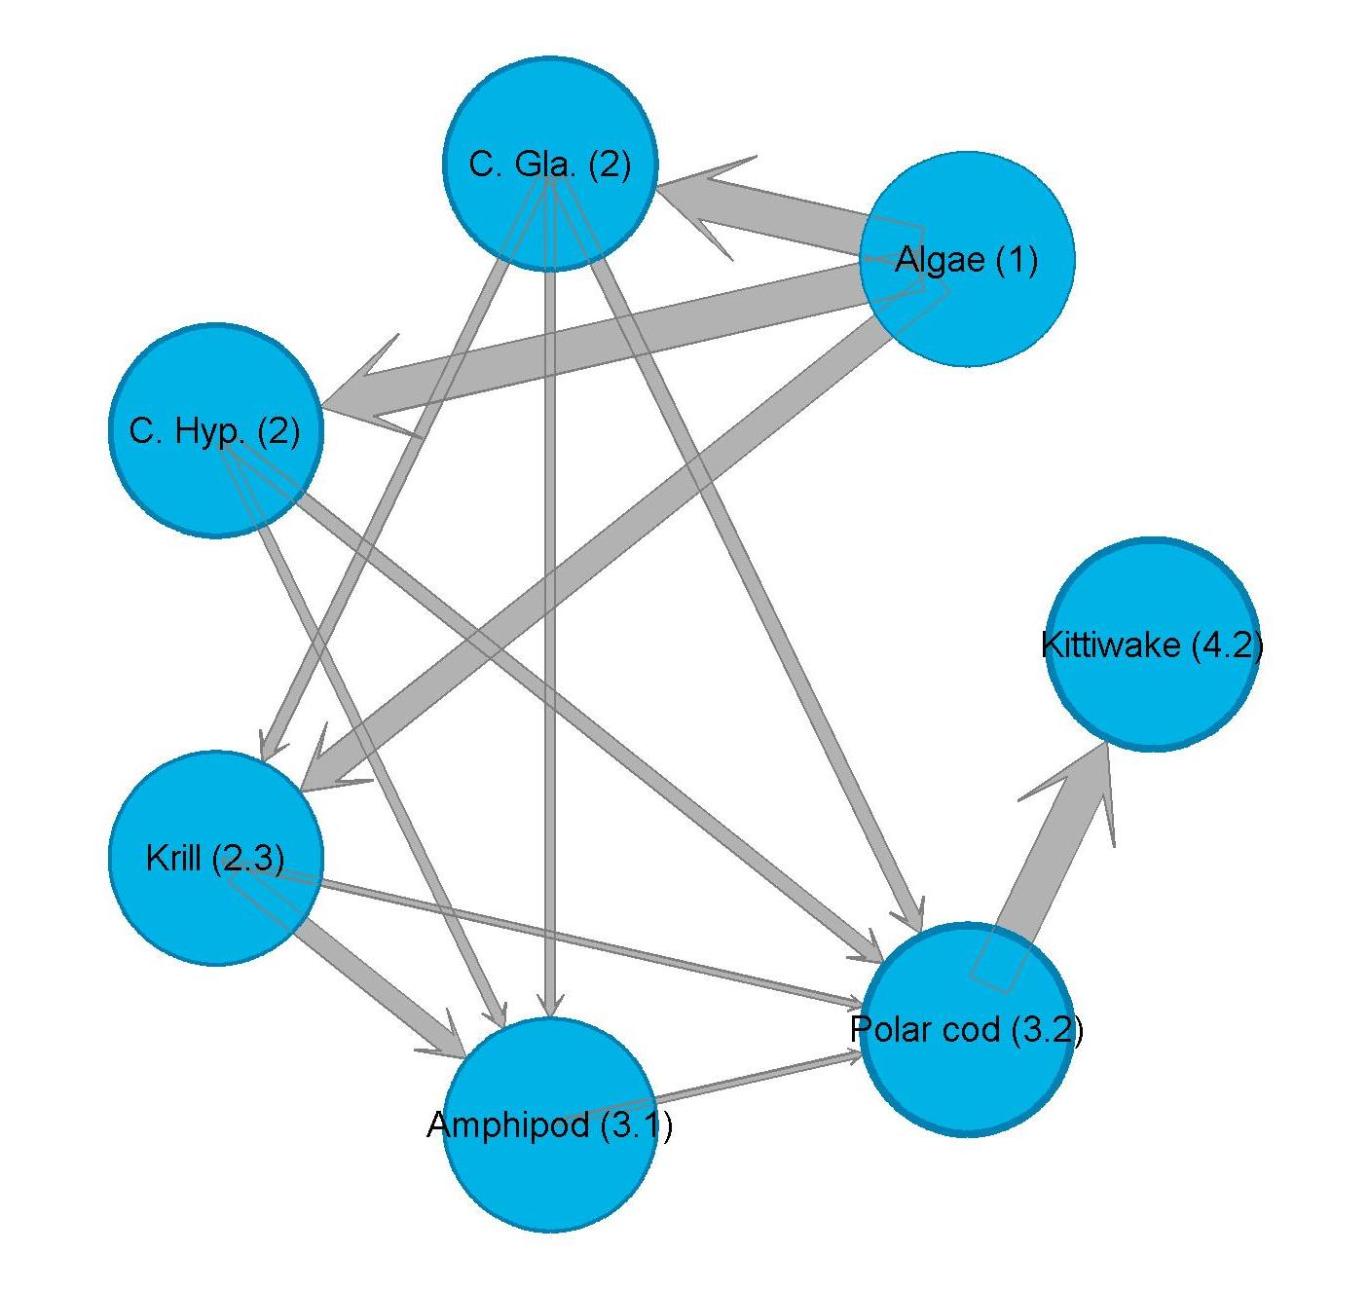
Δ Food web
Space for time
  COPOL: Contaminants in polar regions – comparing fjords on Svalbard
Predictive modelling
  Using IPCC predicted scenaria
Temporal trend studies
  King penguin
5
4
3
2
1

Slide 11
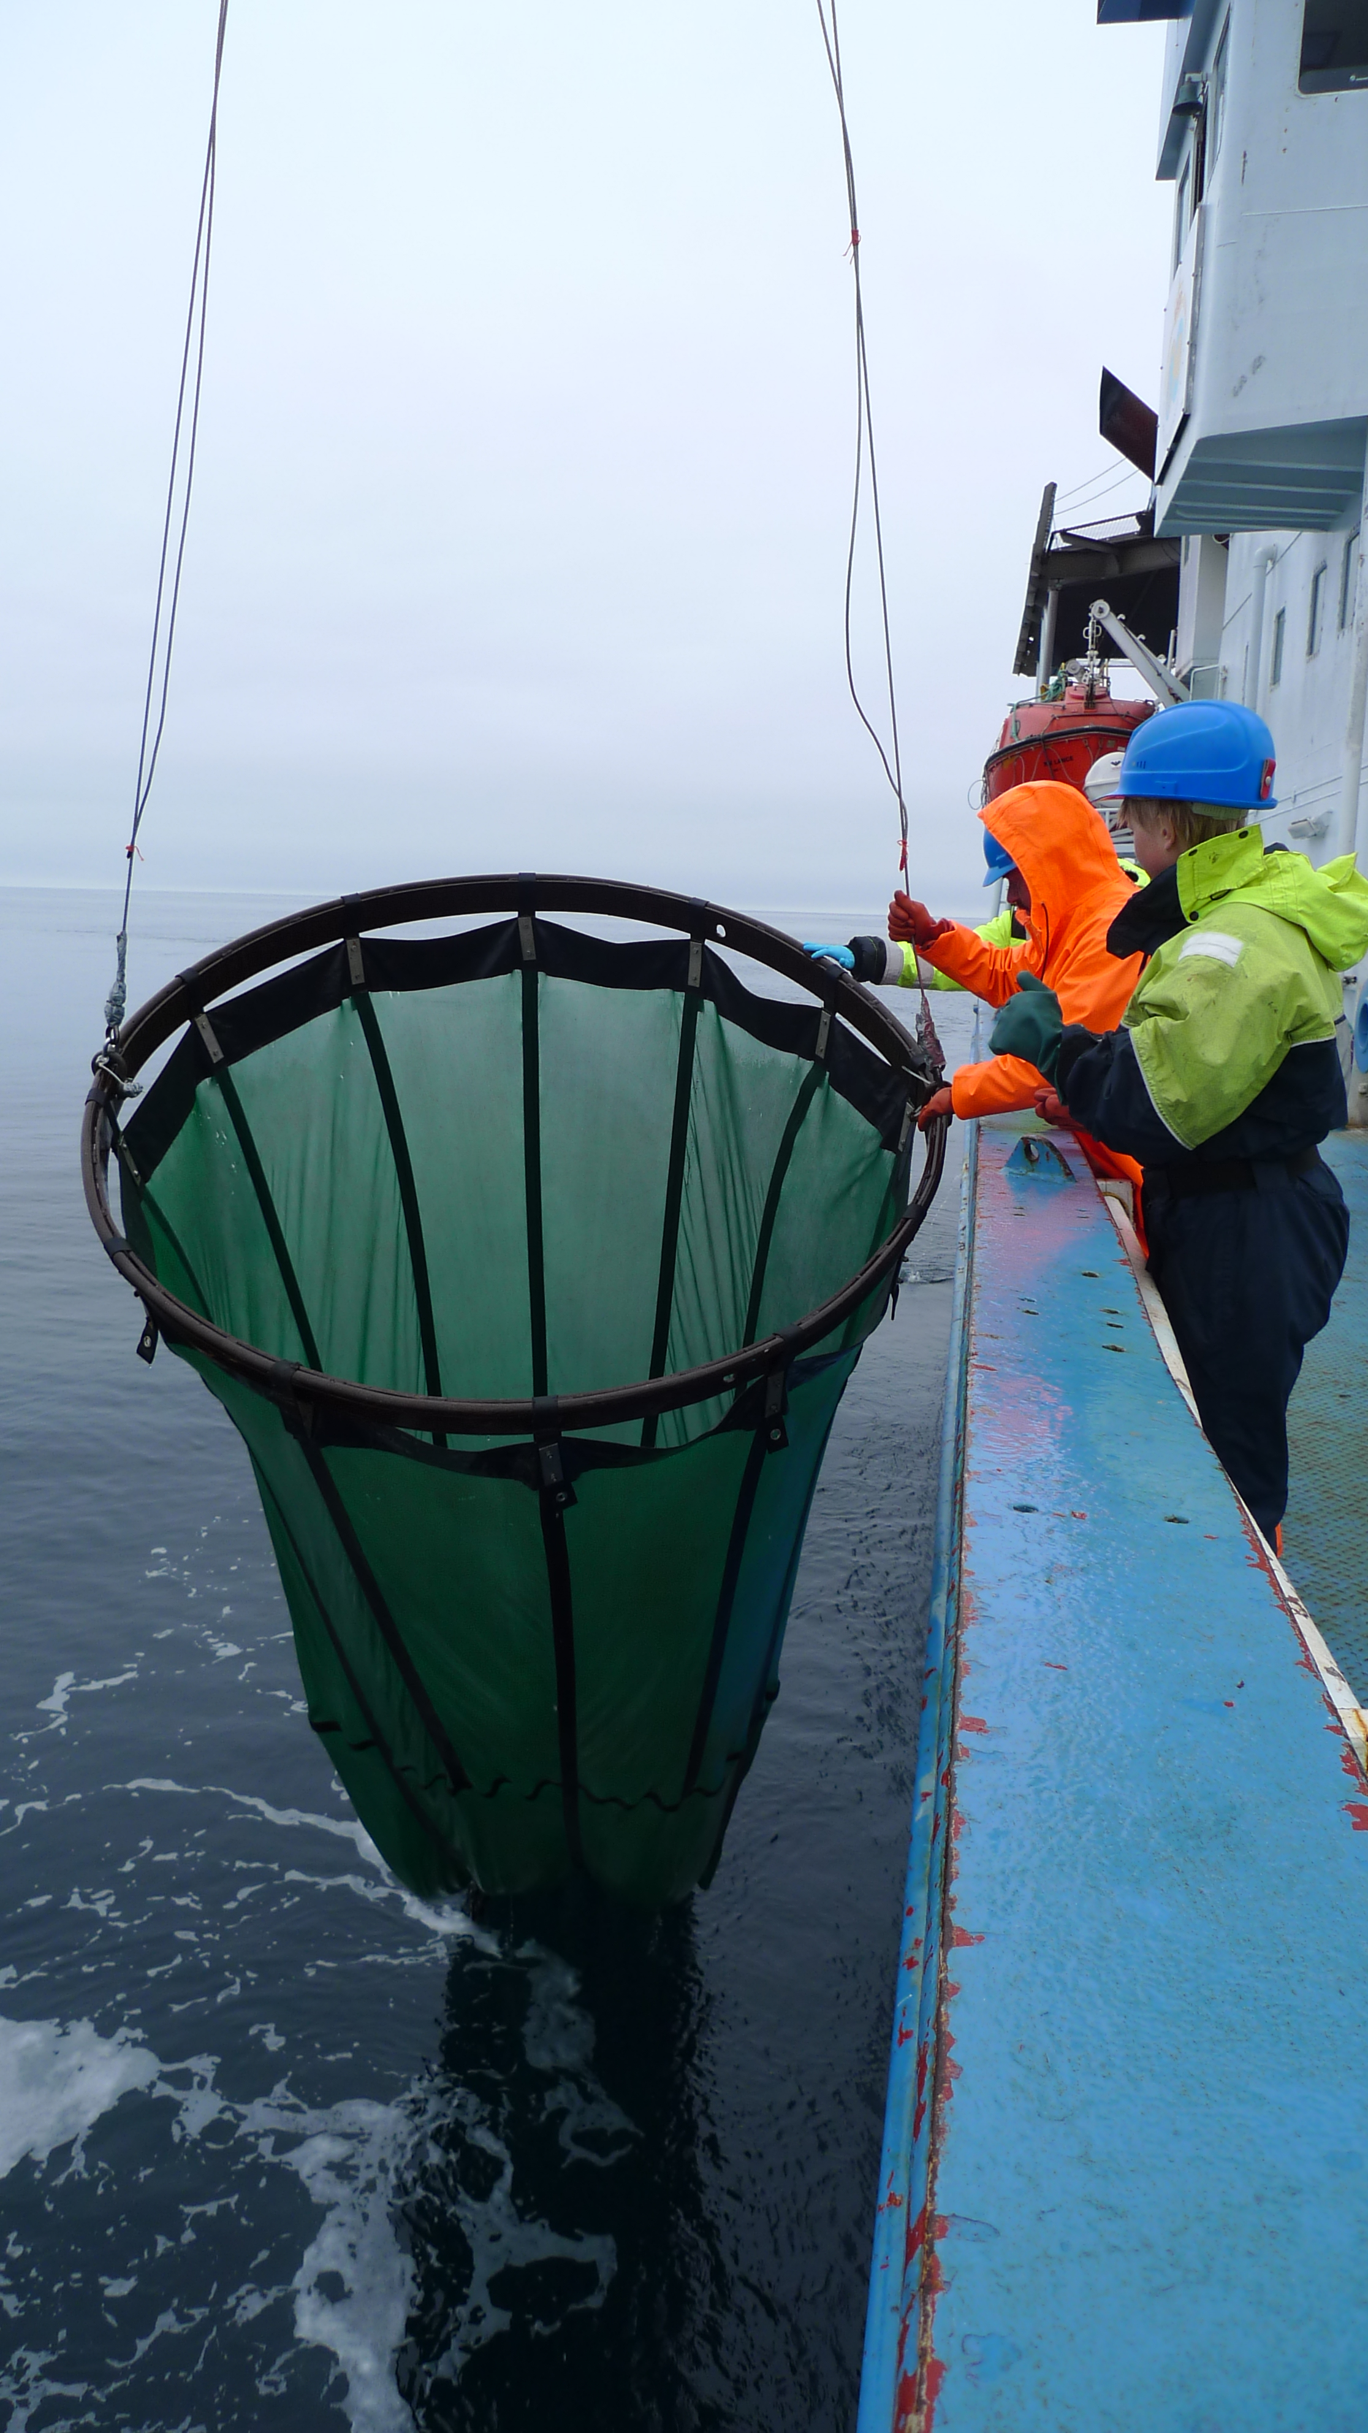


Contaminants in Polar Regions:
Dynamic range of contaminants in polar marine ecosystems

Slide 12
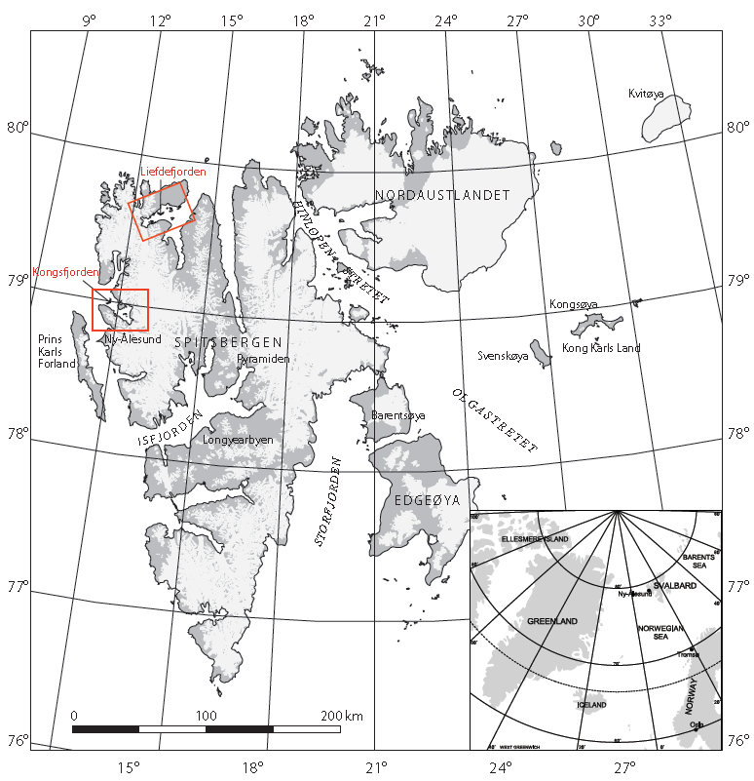
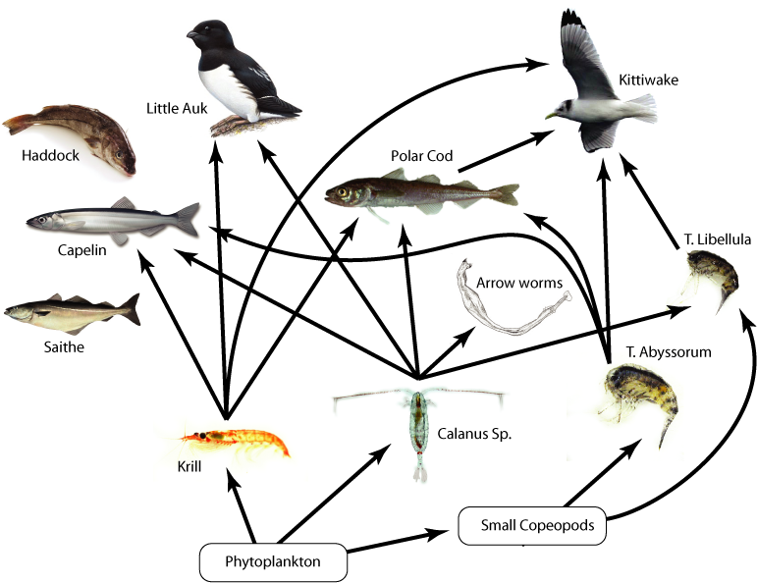
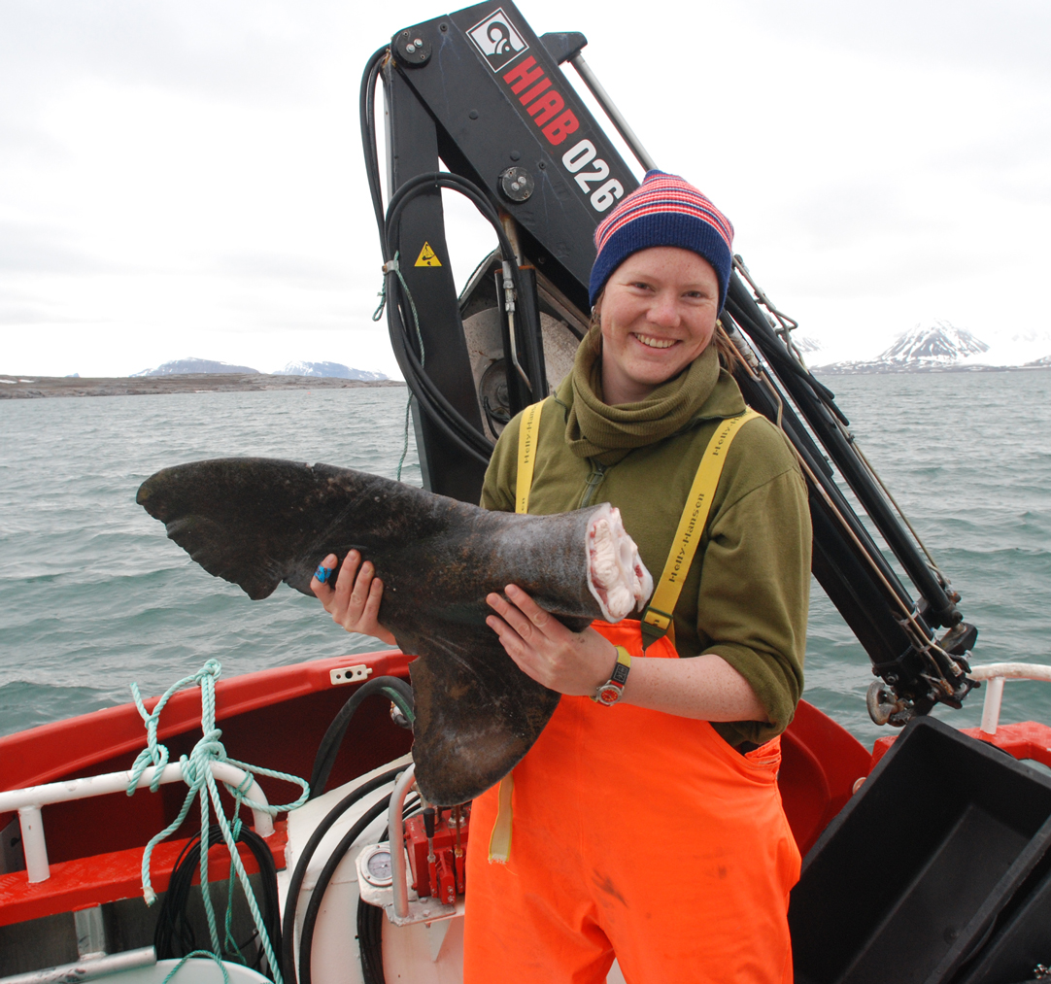
Ingeborg Hallanger UiT PhD
Hallanger et al., 2011 ETC

Slide 13
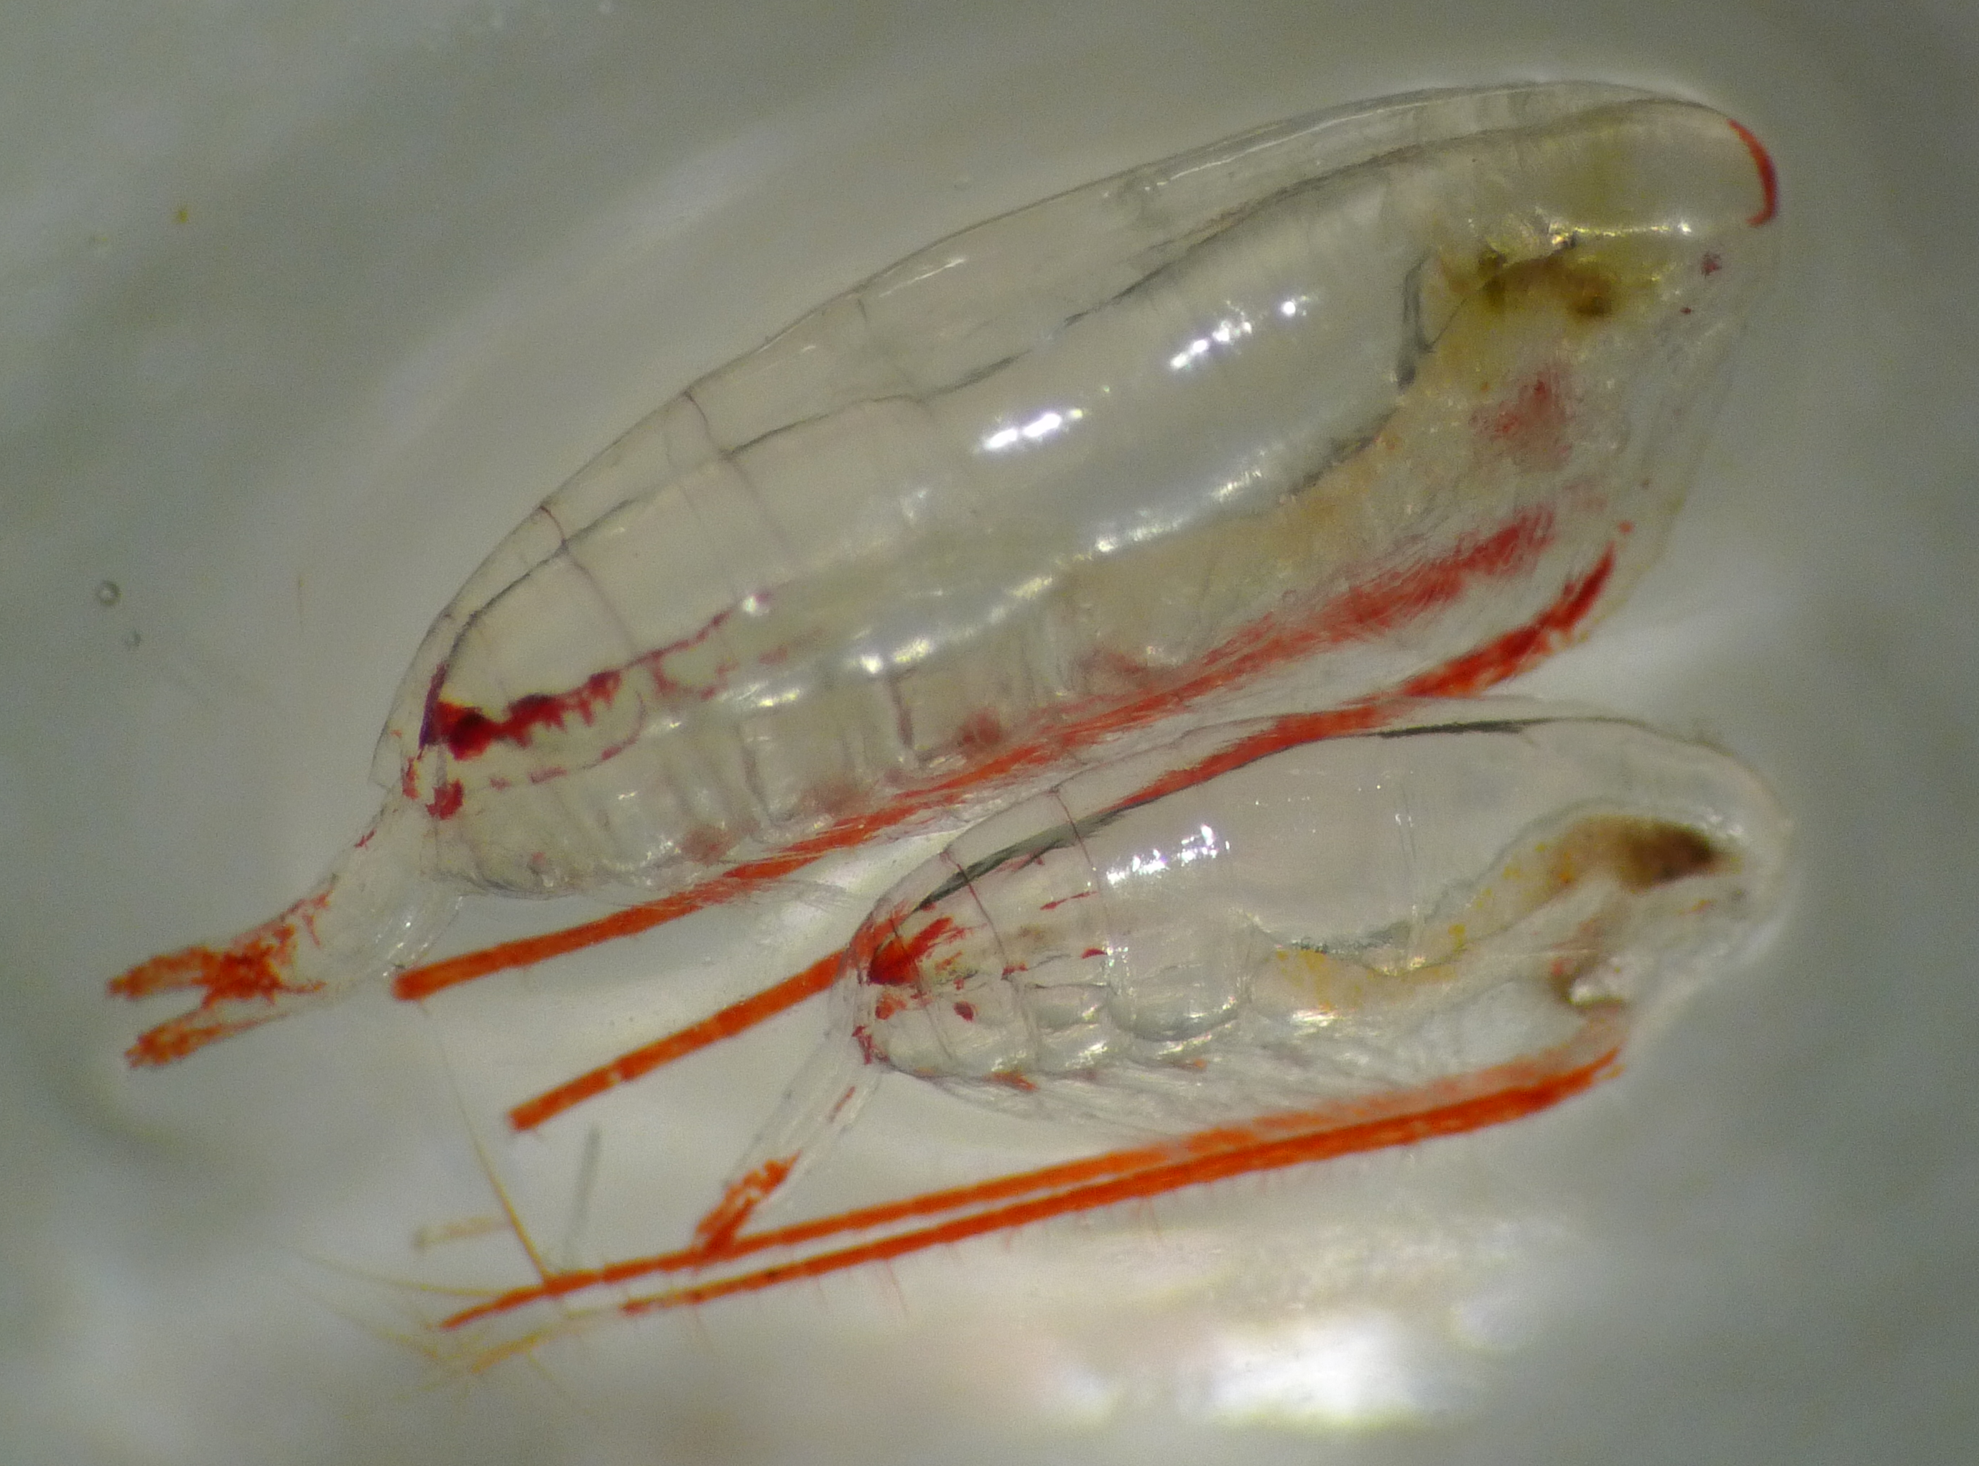
Forskjell mellom fjorder?
Kongsfjorden > Liefdefjorden
  Nivå
  Opphopning
BAF = POP_{dyr}
POP_{vann}
Ingeborg Hallanger UiT PhD

Slide 14
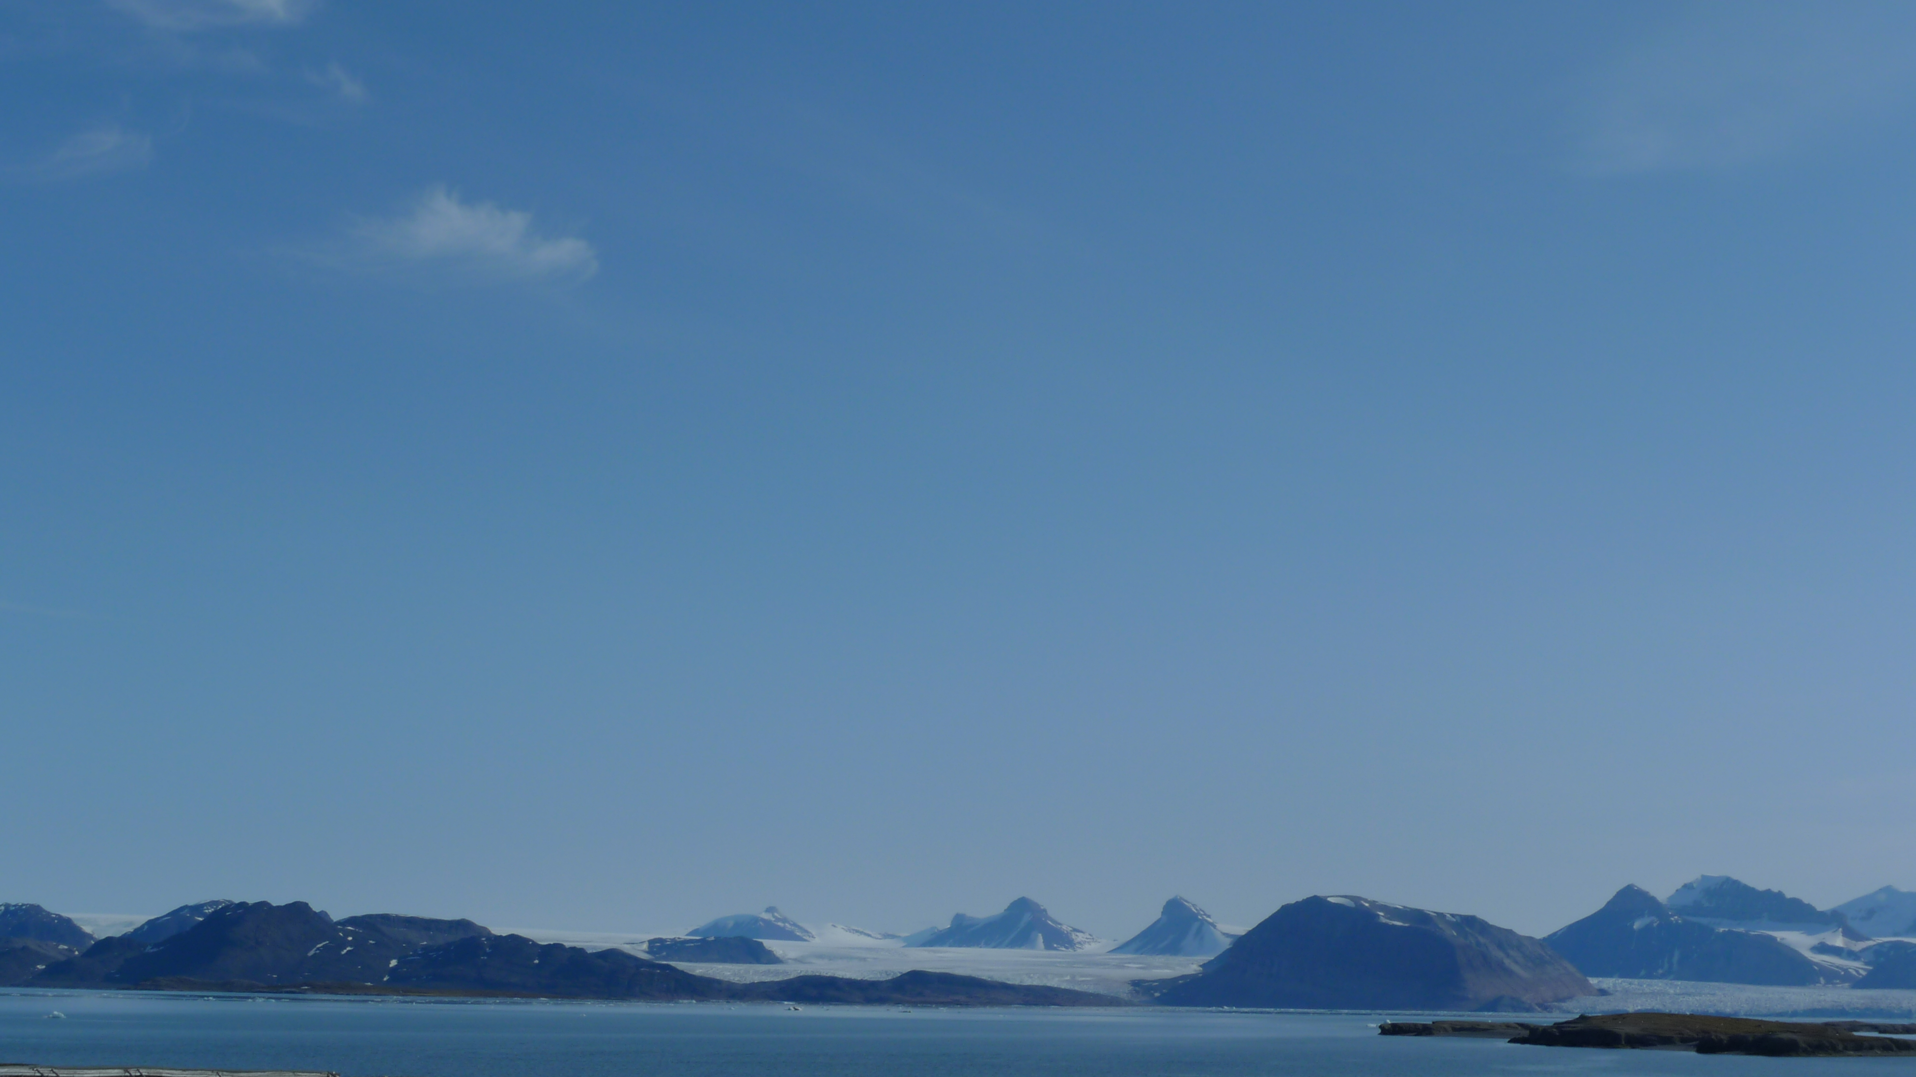
Modellering
Beregne effekter av forventet klimaendringer på opphopning av miljøgifter:
Størrelse og retning

Slide 15
Hvordan vil den forventede klimaendring påvirke anrikning av organiske miljøgifter i arktiske næringsnett?
  Økt temperature (+2ºC and +4ºC)
    Partitioning processes (abiotic)
    Bioaccumulation rates (biotic)
    Parameter values (e.g. lipid%)
  Økt primær produksjon (50% and 100% C_{POC})
    Partitioning processes
Arnot and Gobas 2004
Borgå et al., ETC 2010
Notes:
Kort intro om prosjektets plassering i AMAP-NMR climate-effect prosjektgruppe.

Slide 16
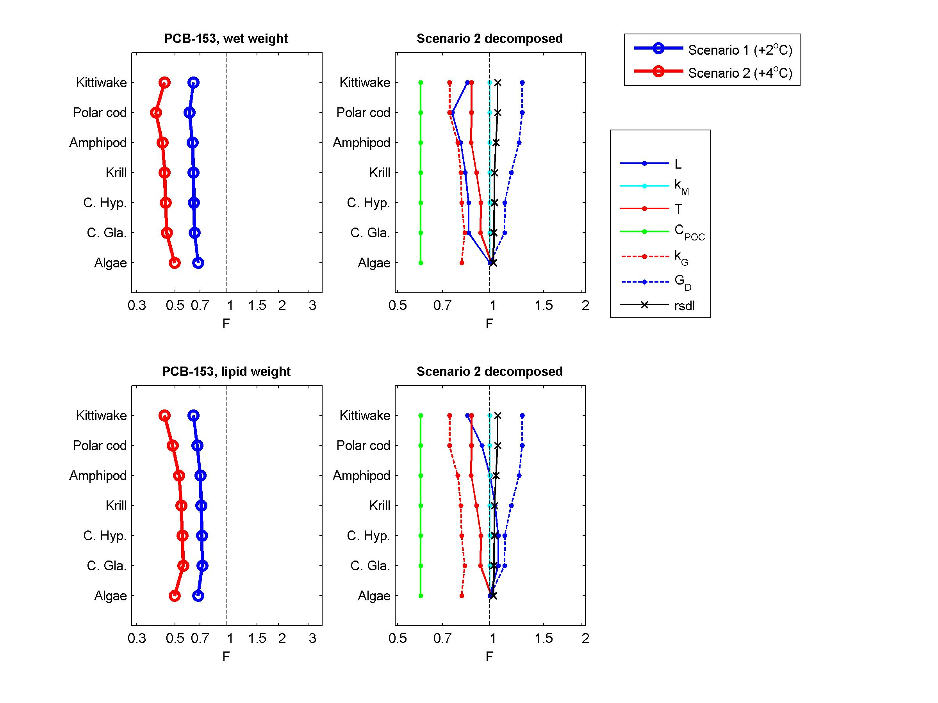
Factor of Change (F=Cons_{S}/Cons_{C})
S2
S1
C
Net accumulation
Larger change for Scenario 2
Reduced food web bioaccumulation with climate scenaria 1 and 2, given no change in C_{WT} and food web composition
Borgå et al., ETC 2010
Notes:
Factor of Change at Scenaria 2 (+4C).
An overall decrease in food web bioaccumulation, mainly due to decreased bioavailable fraction of contaminants in water.
L = Lipid
KM = biotransformation
T = temperature effect on partitioning
CPOC = phytoplankton concentration
KG = Growth dilution
GD = dietary uptake rate

Slide 17
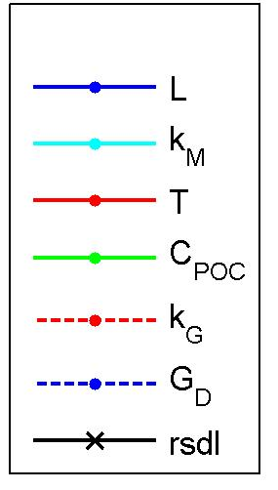
Factor of Change (F=Cons_{S}/Cons_{C})
S2
S1
C
Varierende resultater om primærproduksjon og planteplankton:
  Nedgang (Boyce et al., 2010 Nature)
  (But see: Rykaczewski et al., 2011 Nature; McQuatters-Gollop et al., 2011 Nature)
  Ingen endring, men tidligere oppblomstring (Kahru et al., 2010 Global Change Biology)
Reduced food web bioaccumulation with climate scenaria 1 and 2, given no change in C_{WT} and food web composition
Borgå et al., ETC 2010
Notes:
Factor of Change at Scenaria 2 (+4C).
An overall decrease in food web bioaccumulation, mainly due to decreased bioavailable fraction of contaminants in water.
L = Lipid
KM = biotransformation
T = temperature effect on partitioning
CPOC = phytoplankton concentration
KG = Growth dilution
GD = dietary uptake rate

Slide 18
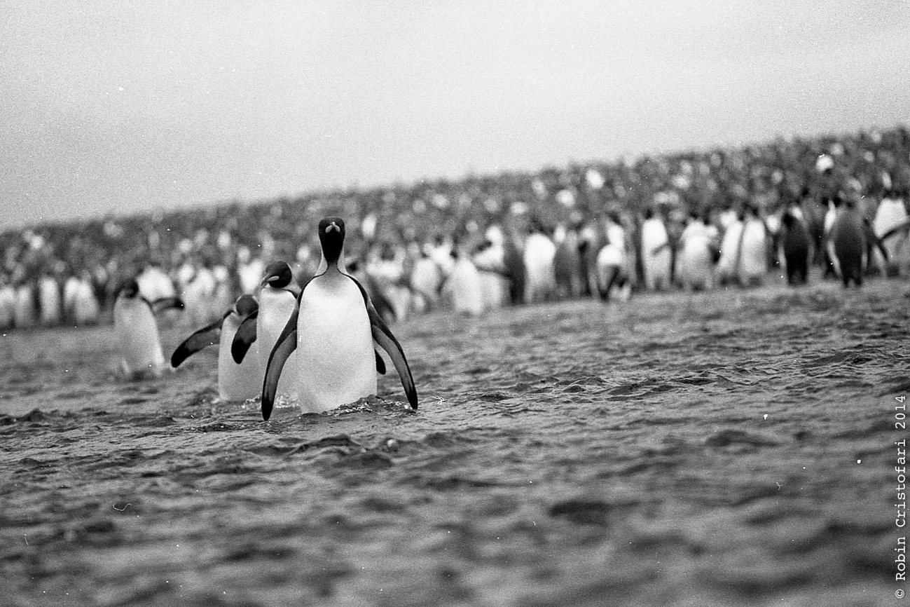




Tidstrender i indikatorarter: endret miljøgiftnivå eller økosystemendringer?
Photo: Robin Cristofari

Slide 19
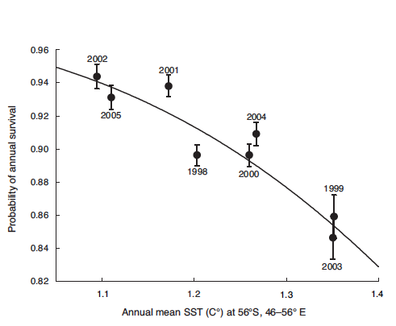
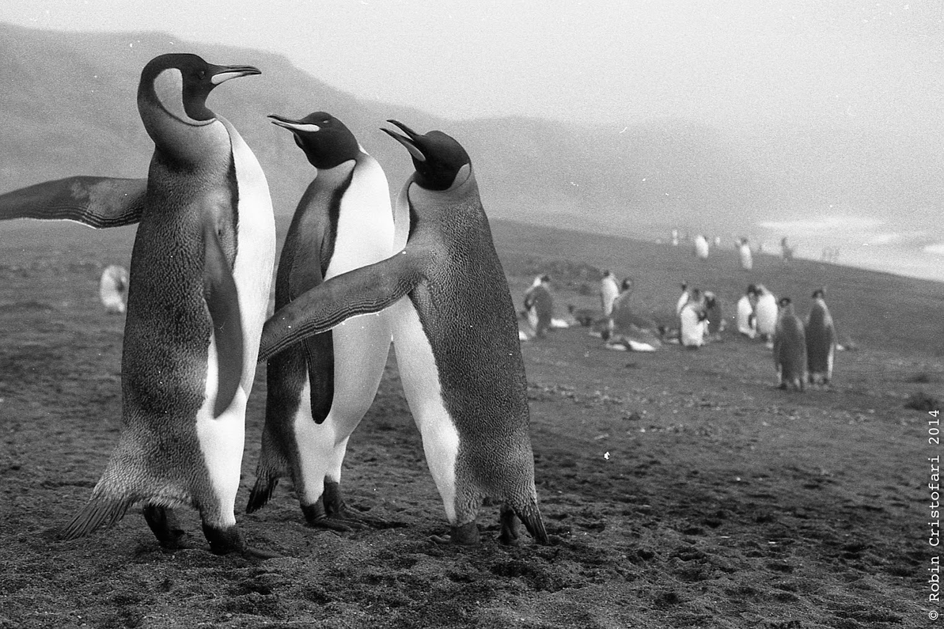
Kongepingvin
LeBohec et al., 2008 PNAS

Slide 20
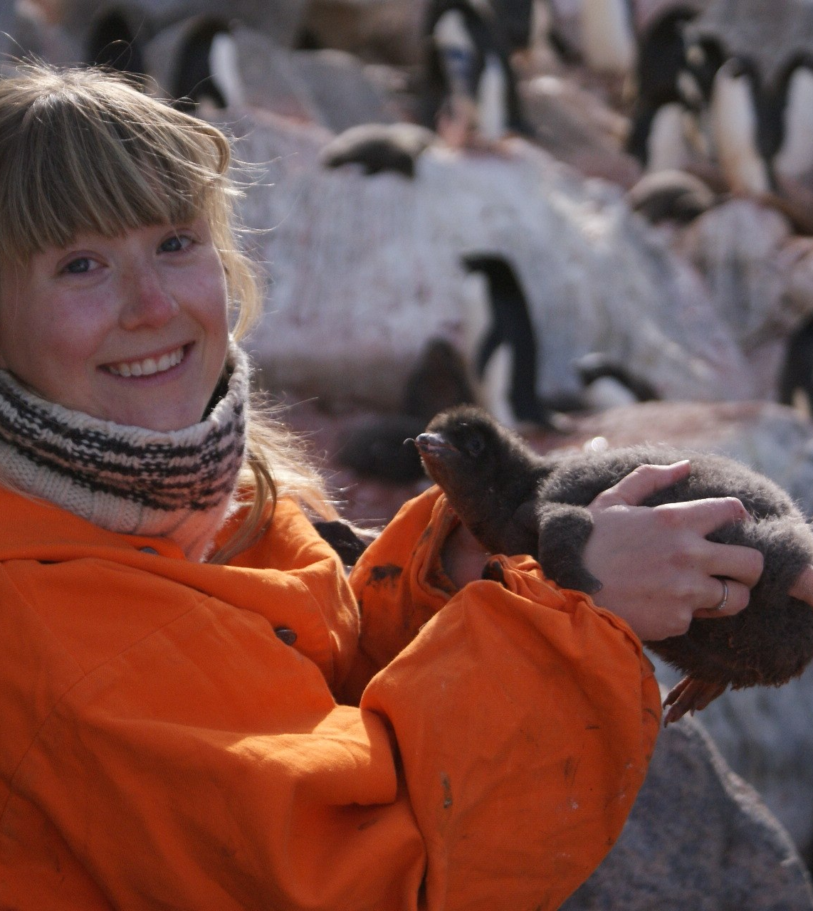
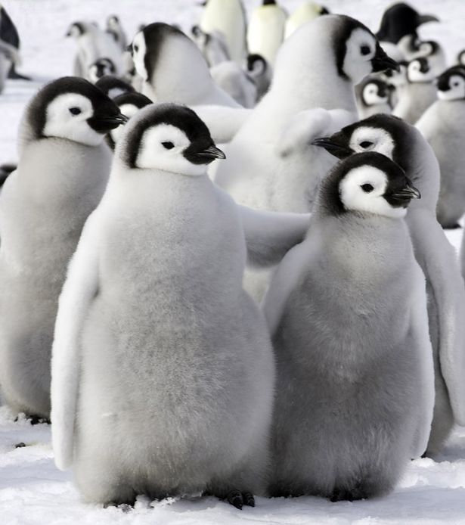
Method – PolarEcotox
1999-2015 – temporal trend:
  Crozét island – sub Antarctic
  King penguin blood samples
  Archived for retrospective analyses
  δ¹⁵N, δ¹³C,
  Legacy contaminants
  Climate variables
  Demographic variables
David C. Schultz/Barcroft Media

Slide 21
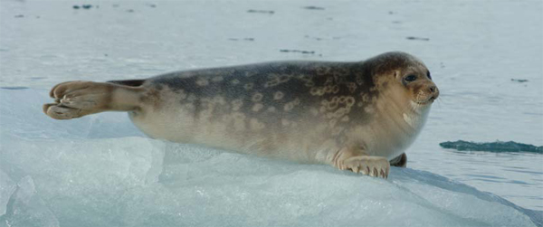
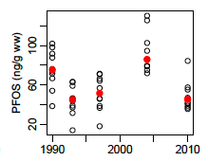
Ringsel - Arktis
Routti et al., Env Poll 2016

Slide 22
Klima og miljøgifter
Endret i miljøet
  Bruk og utslipp
  Klima; is, temperatur
  Økosystemet;
    Primærproduksjon
    Energiflyt
    Miljøgiftoverføring
Eksempler
  Sted for tid
  Modellering
  Retrospektiv tidstrendsanalyse

Slide 23
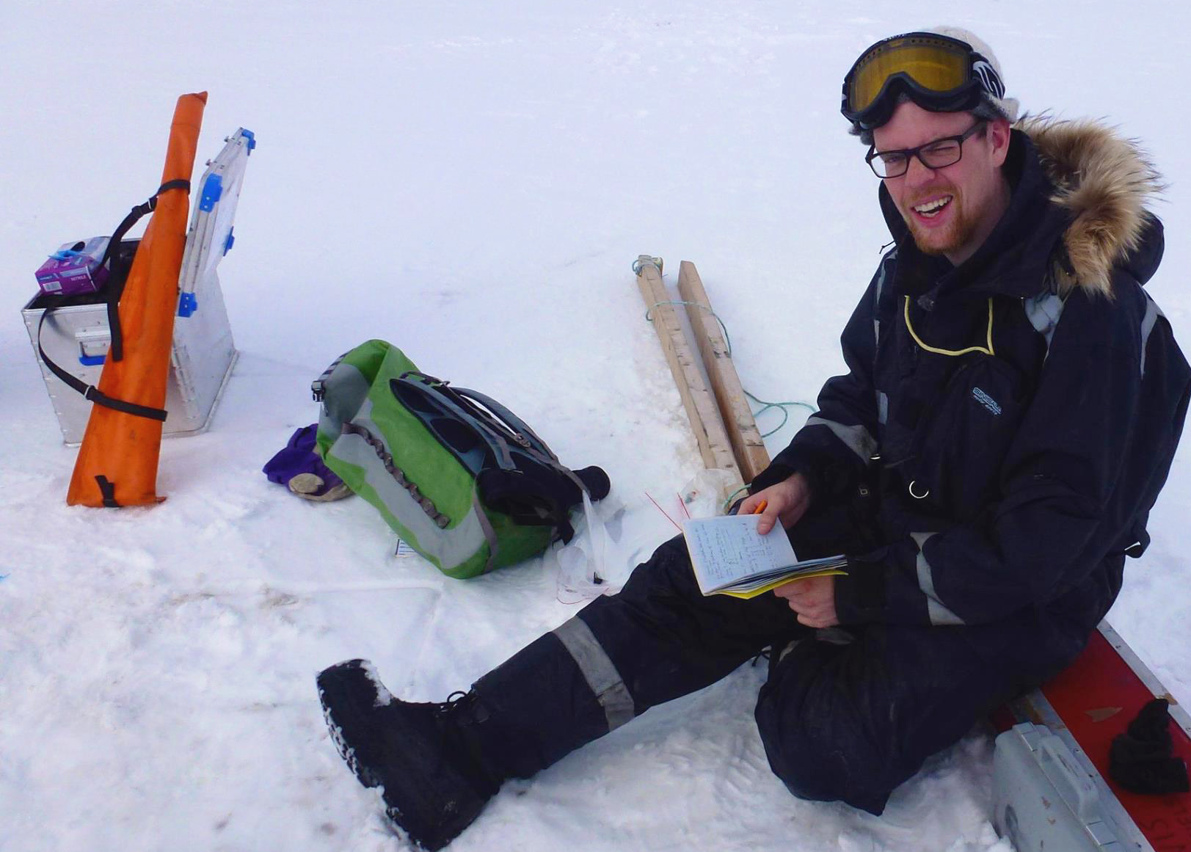

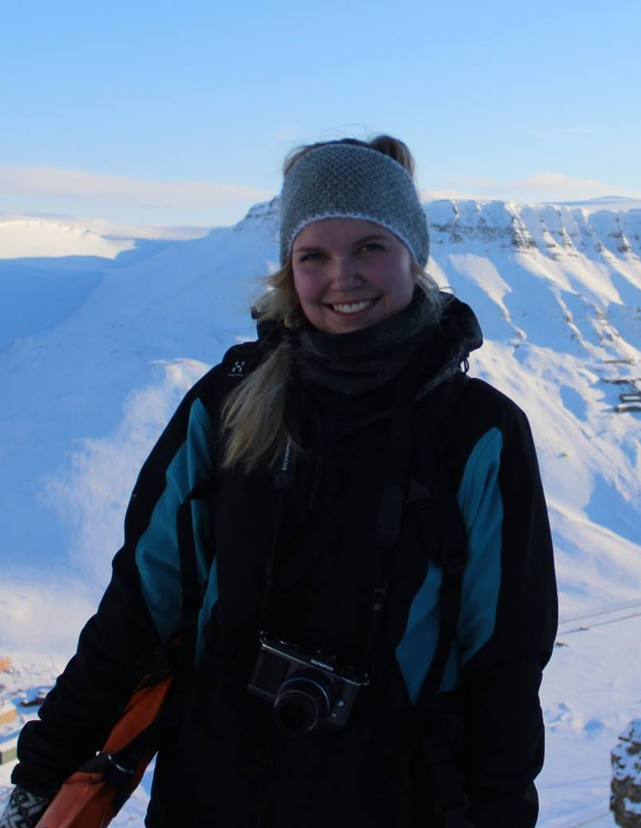
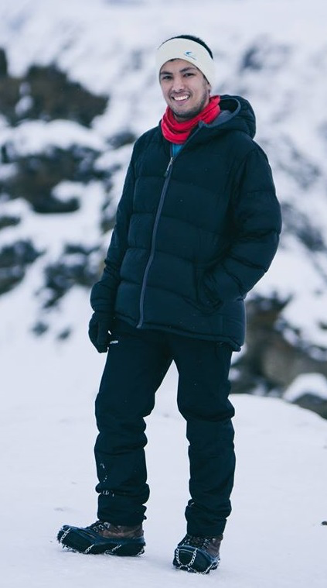
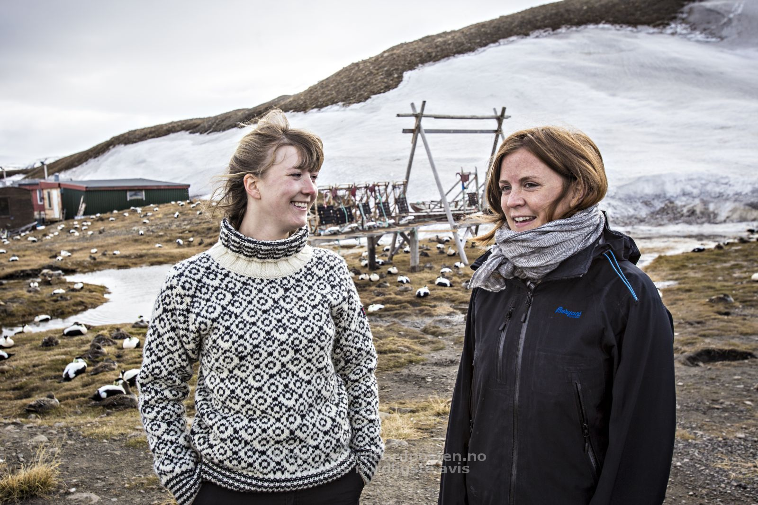
Studenter og Samarbeidspartnere
Finansiering
  Norwegian Research Council
    FORURENS
    HAVKYST
    MILJØ2015
    NORKLIMA
    INTERNASJONALT POLARÅR
    MILJØFORSK
  Arctic Monitoring and Assessment Programme
  Nordisk ministerråd
  ConocoPhilips
katrine.borga@ibv.uio.no

