Slide 1
Meeting the requirements of Open Science at UiO
Alexander Refsum Jensenius

Slide 2
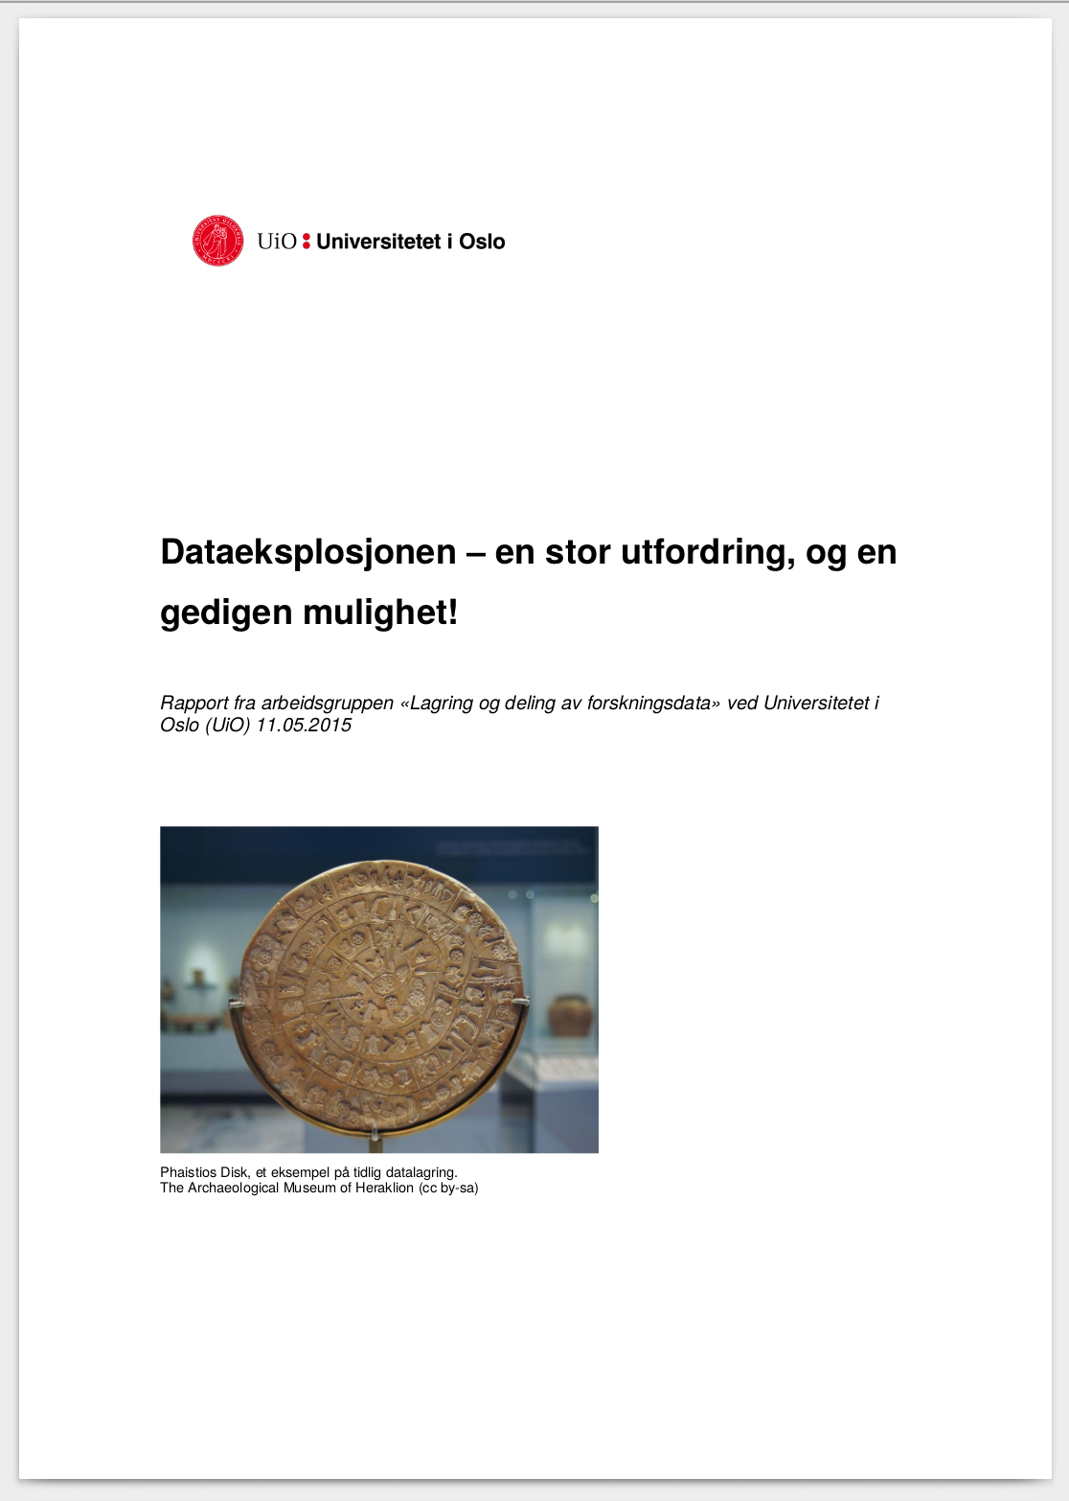
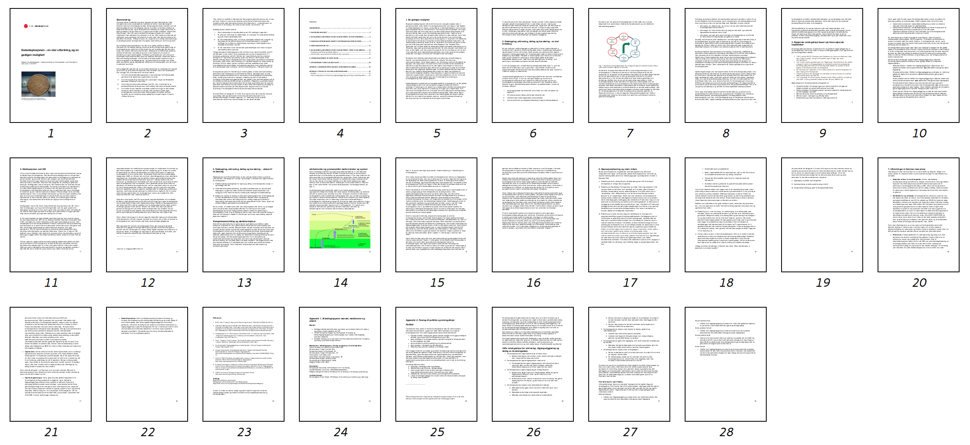
Medlemmer i arbeidsgruppen:
Leder Prodekan for forskning Svein Stølen, MN
Senioringeniør Torben Leifsen, MN
Førsteamanuensis Tor Endestad, SV
Senioringeniør Torgeir Christiansen, UV
Overingeniør Tore Miøen, OD
Instituttleder Alexander Refsum Jensenius, HF
Senioringeniør Espen Uleberg, KHM
Forskningssjef Fridtjof Mehlum, NHM
Rådgiver Katrine Ore, MED
Sekretariat:
Seksjonssjef Hans Eide, USIT(Seksjon for IT i forskning)
Hovedbibliotekar Live Kvale, UB(Realfagsbiblioteket)
Rådgiver Margaret Fotland, AF(Seksjon for forvaltning av forskning og utdanning)
Juridisk bistand:
Seniorrådgiver Einar Noreik, AF(Seksjon for forvaltning av forskning og utdanning)

Slide 3
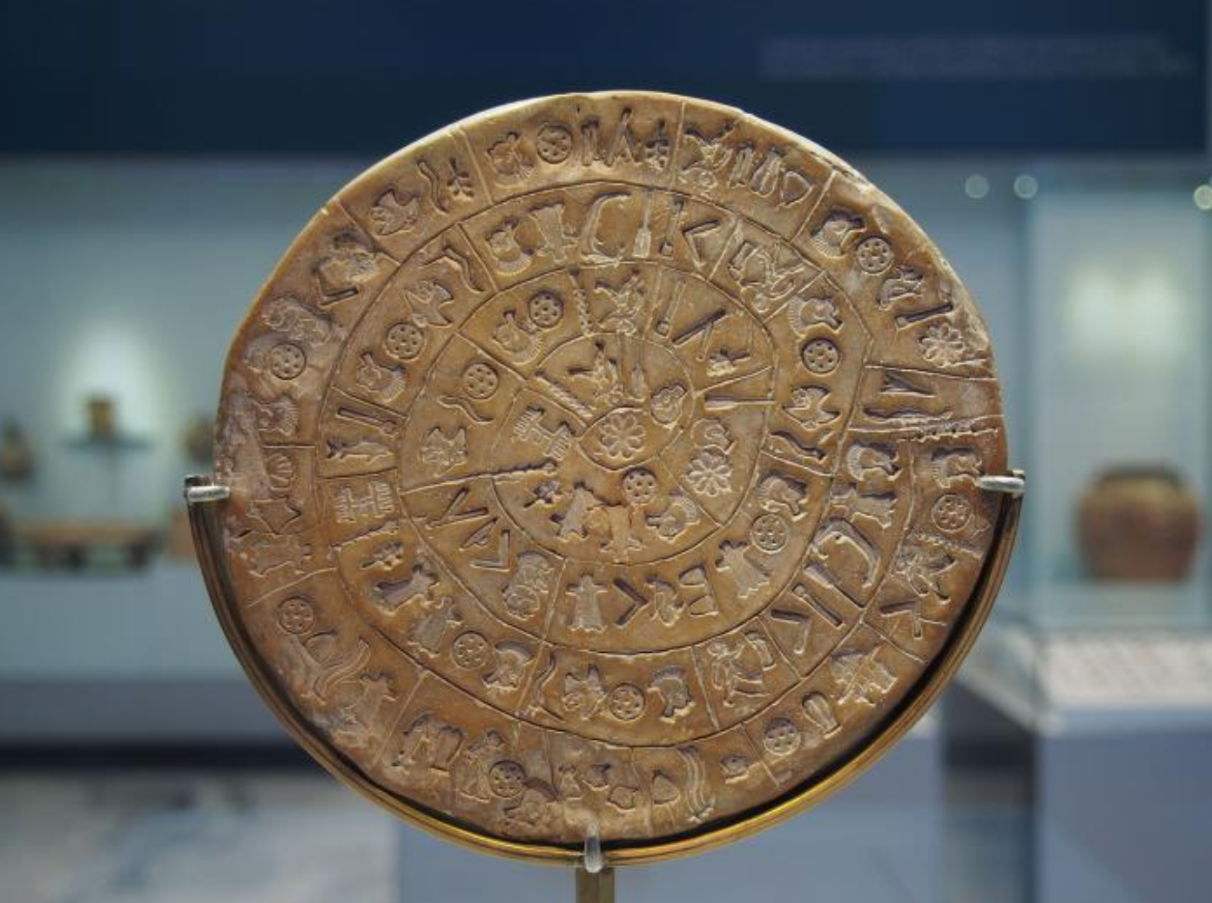
Phaistios Disc
early example of data storage
(Archaeological Museum of Heraklion)
14/03/16
3
Notes:
3

Slide 4
Status…?

Slide 5
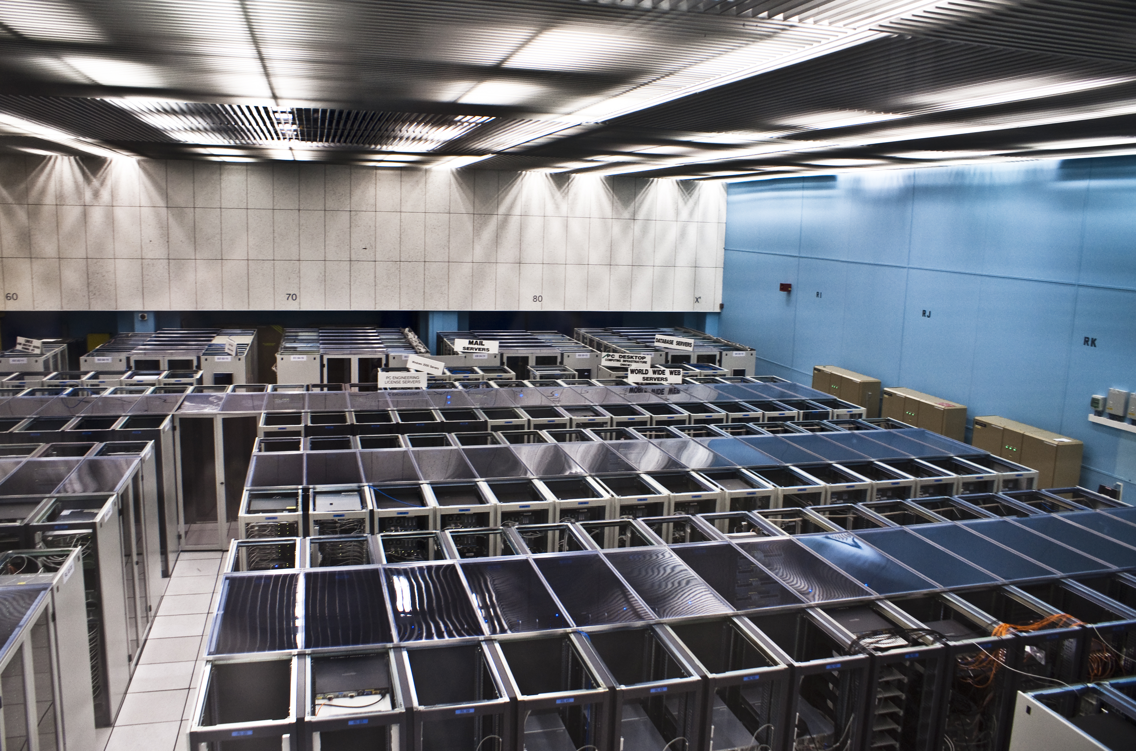
CERN data storage
(Florian Hirzinger)

Slide 6
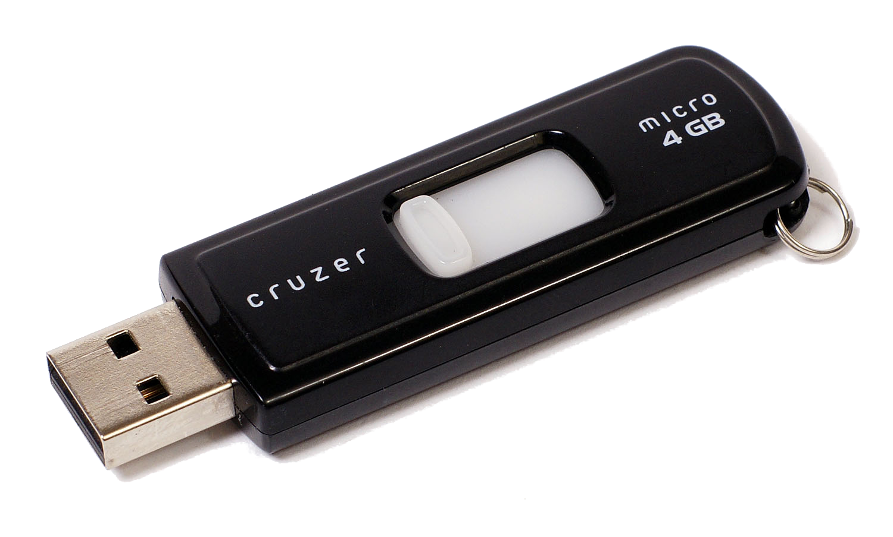
Status…?

Slide 7
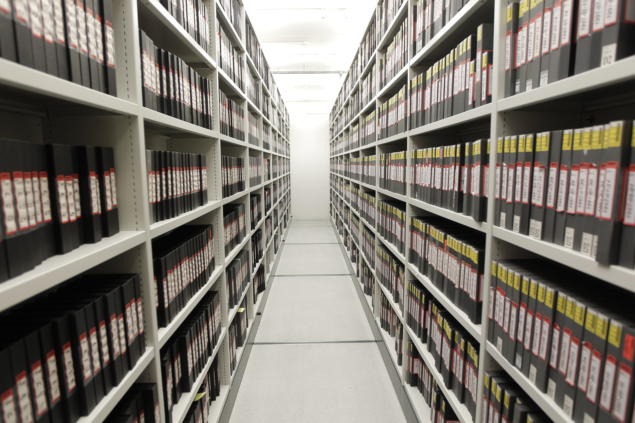
Status…?
Notes:
https://www.flickr.com/photos/kulturarvsprojektet/6498637005

Slide 8
Guiding principles for solutions:
1. Need to think about the whole cycle from data generation to storage and retrieval
2. Need to think globally, UiO researchers interact with researchers from all over the world
3. Not all problems can be solved at UiO, important with collaboration with others
4. Solutions need to be created so that they encourage researchers to store and share their data.

Slide 9
Action points:
1. Guidelines for data management at UiO
2. Pilot project for increasing the knowledge about data management in the organisation and secure good support services
3. Clear division of labour between instituions, nationally and internationally
4. UiO needs to take part in solving some national challenges

Slide 10
Guidelines:
1. Data needs to be handled securely
2. Data shall be made available for reuse
3. Data should ideally be made available as early as possible
4. Data need to be stored with standardised metadata
5. Data should have licenses for reuse and redistribution
6. Data should be made freely available, but distribution costs should be covered
7. Data should have a longterm curatorial plan

Slide 11
Solutions!

Slide 12
Knowledge!

Slide 13
Data scientists!

Slide 14
Education!

Slide 15
Meeting the requirements of Open Science at UiO
Alexander Refsum Jensenius

