Slide 1
Research Funders Policies on Access to Research Data
Open Data Skills, UiO, 14 March 2016
Roar Skålin, The Research Council of Norway

Slide 2



RCN’s Policy for Open Access to data
Covers research data generated through
research partially funded by the Research
Council of Norway.
Open by default, exceptions for:
  security and confidentiality obligations;
  protection of personal data;
  other legal requirements;
  commercial use by companies, where this is
  part of the contract with RCN;
  data where the cost outperforms the value of
  open access.
Carrot rather than stick:
  Principle and guidelines formulated as
  recommendations and best practices, not
  absolute requirements.
  Partly due to lack of infrastructure, standards
  and system for citation.
  Would like to strengthen the positive attitude
Photo: Shutterstock
Photo: Photodisc

Slide 3

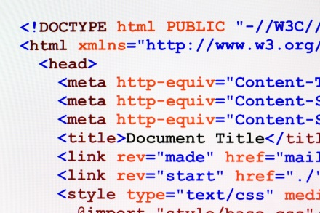

Elements from the guidelines
Research data should be:
archived at established data centres;
  Examples: NorStore, NSD, Elixir
available on equal terms for all users, unless they are restricted by legal, ethical or security aspects;
available as early as possible, allowing an embargo period for publishing results;
equipped with metadata, based on international standards;
equipped with internationally recognised licenses, giving as few restrictions as possible for use, reuse and redistribution;
available at lowest possible cost, maximally the actual cost of dissemination;
equipped with a long-term plan for data curation;
Photo: Shutterstock/Marynchenko Oleksandr
Photo: Shutterstock/Alexey V Smirnov
Illustration: Creative Commons

Slide 4



RCN measures for implementing the Open Data policy
Mandatory rules:
  The Project Owner shall ensure that all research-generated data, including all data that forms the basis for publications, is stored in a secure digital archive.
  Request Data Management Plans (DMPs) (To be decided and implemented).
Incentive mechanisms:
  Costs relating to archiving and publishing Open Data may be included in applications for funding.
Enablers:
  Fund research infrastructure that facilitates open access to publicly-funded research data and safeguards important Norwegian data series.
    Approximately 30 infrastructures funded to date, mainly in geosciences, life sciences, social sciences and humanities.
  Establish an arena for dialog and learning between service providers / data archives (To be implemented).
  Engage in (international) efforts to establish rewards, incentives, standards, infrastructures etc.
DMP
Photo: Shutterstock
Photo: Digital Vision

Slide 5
Data management plans
Elements in DMPs:
Data collection;
  What data will you collect or create?
  How will the data be collected or created?
Documentation and metadata;
Ethical issues and Intellectual Property Rights (IPR);
Storage and backup;
Access and security;
Long-term preservation plan for dataset(s);
  Which data should be retained and/or preserved?
  Which data should be shared or restricted?
Necessary resources required to deliver the plan.
A tool for writing DMPs:
  Digital Curation Centre's DMP Online tool
  Recommended by RCN and Horizon 2020.
  Will be translated and adapted for use in Norway.

Slide 6
Horizon 2020 Pilot on Open Research Data
Source: Guidelines on Data Management in Horizon 2020
Participating projects in the pilot must develop a Data Management Plan (DMP) specifying which data will be openly accessible (deliverable within the first six months).
Types of data concerned
  Data (including associated metadata) needed to validate the results presented in scientific publications ("underlying data").
  Other data (including associated metadata) as specified in data management plan.
Beneficiaries participating in the Pilot will
  Deposit this data in a research data repository of their choice.
  Take measures to make it possible to access, mine, exploit, reproduce and disseminate free of charge (using e.g. Creative Commons licences).
  Provide information about tools and instruments at the disposal of the beneficiaries and necessary for validating the results (where possible, provide the tools and instruments themselves).
Costs relating to the implementation of the pilot will be eligible as part of the grant.

Slide 7
Horizon 2020 Pilot on Open Research Data
Projects can opt out of the pilot at any stage if:
  participation is incompatible with the Horizon 2020 obligation to protect results that can reasonably be expected to be commercially or industrially exploited;
  participation is incompatible with the need for confidentiality in connection with security issues;
  participation is incompatible with rules on protecting personal data;
  participation would mean that the project's main aim might not be achieved;
  the project will not generate / collect any research data, or;
  there are other legitimate reasons not to take part in the Pilot.
During the lifetime of a project an opt out remains possible for any of the reasons above.
Participation in the pilot is not a part of the evaluation.
Specific technical and professional support services are also available through OpenAIRE2020 and EUDAT2020 projects.

Slide 8
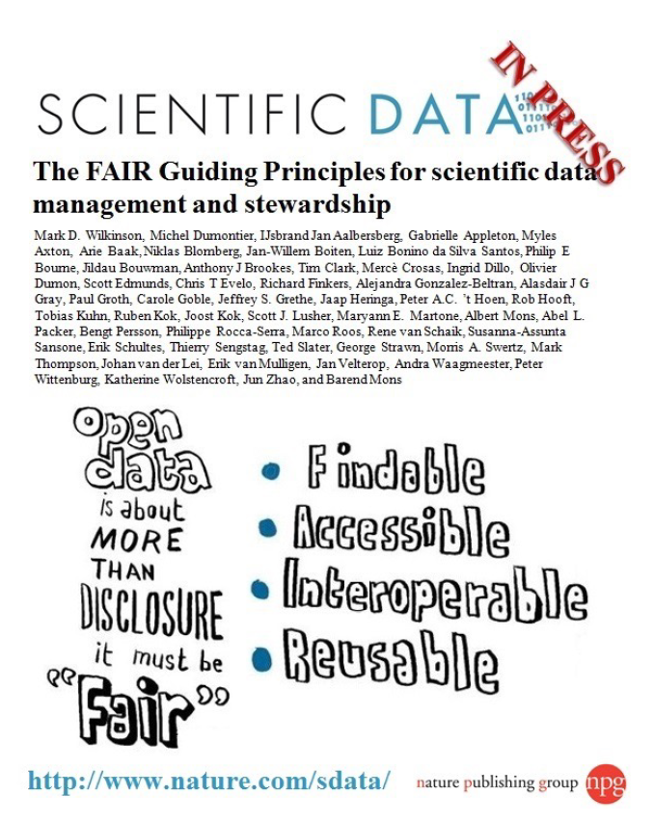
Open Access to Data is a Moving Target

Slide 9
