Slide 1
The Zinchel Project
October 2015
Pål Rongved
Antibiotikaresistens og nye antibiotika - er
det mulig å tenke nytt?
Engelsk:
The ZinChel Project - Overcoming β-Lactam Resistance

Slide 2
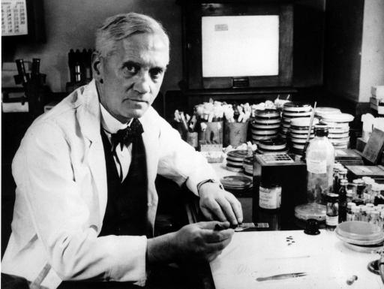
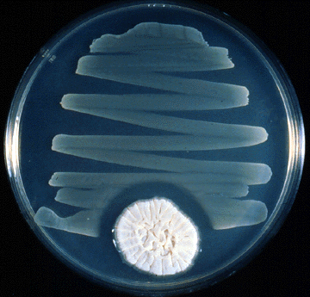
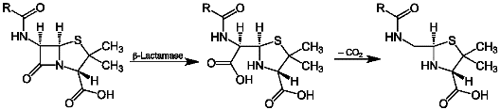
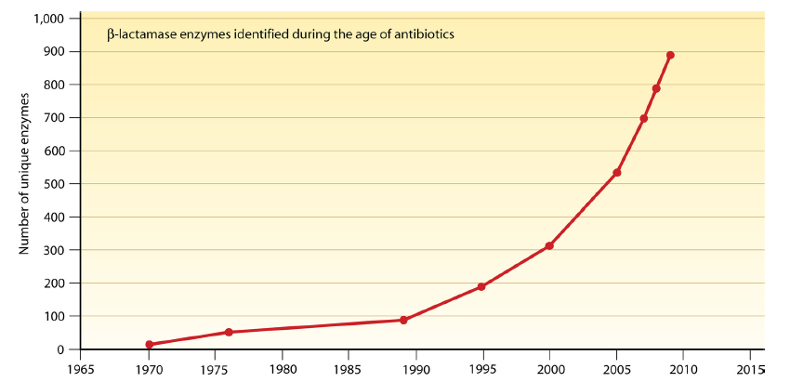
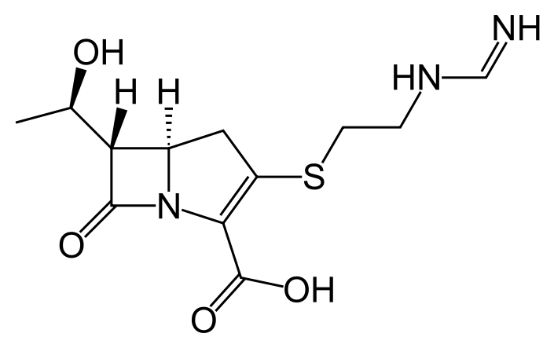
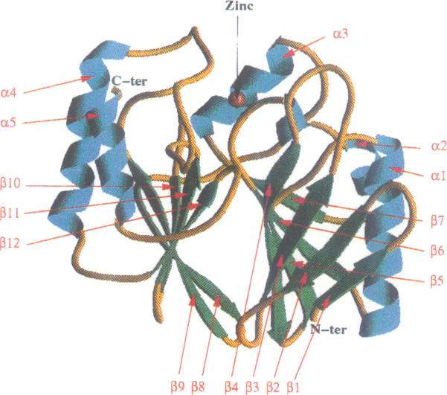
Drug Discovery within Antibiotics (AB)
Alexander Fleming: penicillin G in 1928
- the 1945 Nobel Price in medicine
Penicillinase:
bacterial weapon destroying the AB
1940 – first penicillinase discovered
1942 – first penicillin became «available»
Metallo-β-lactamases (MBL): new, more efficient new penicillinases: first crystal structure solved in 1995
Carbapenems:
One of the last resort AB’s today
The first one, Imipenem. FDA approved 1985.

Slide 3
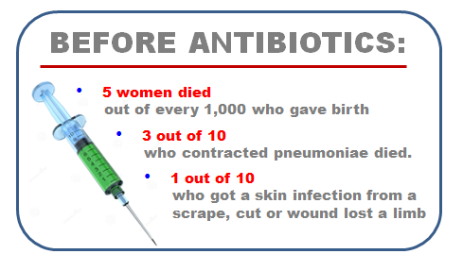
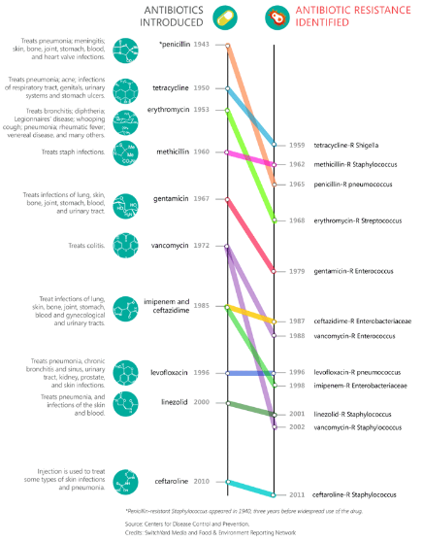
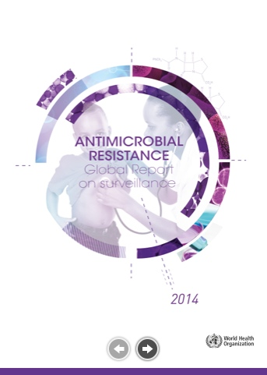
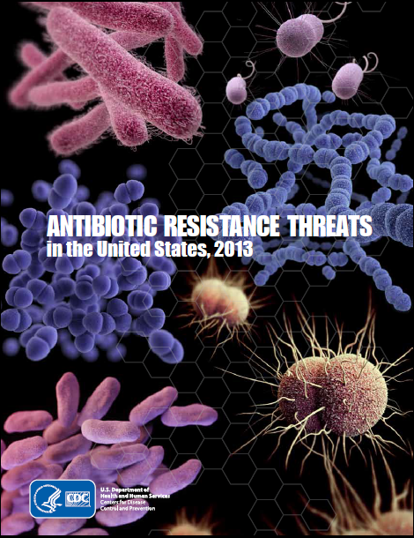
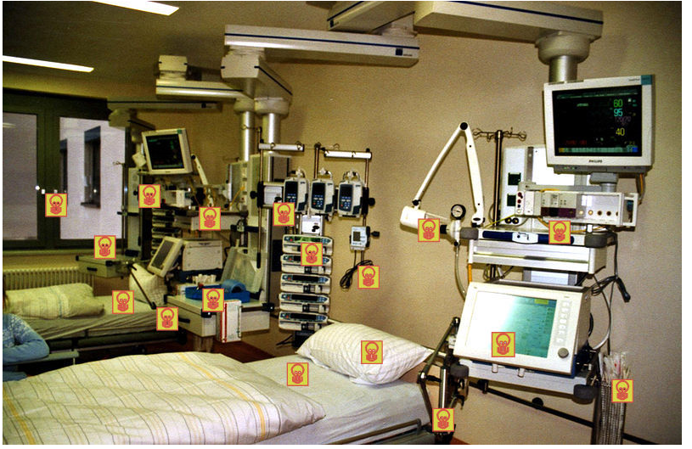
Source: M. McKenna, 2013, Fern’s AG Insider
Global red alert
Hospitals – immuno deficiency…
Source: M. McKenna, 2013, Fern’s AG Insider

Slide 4
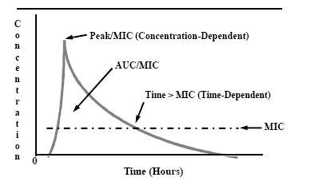
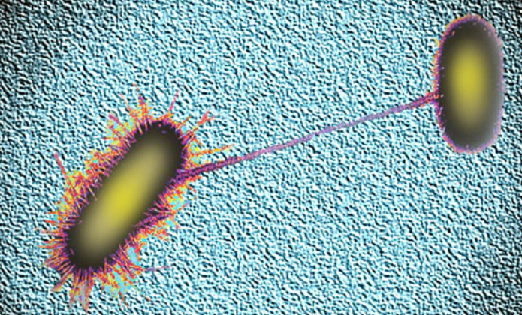
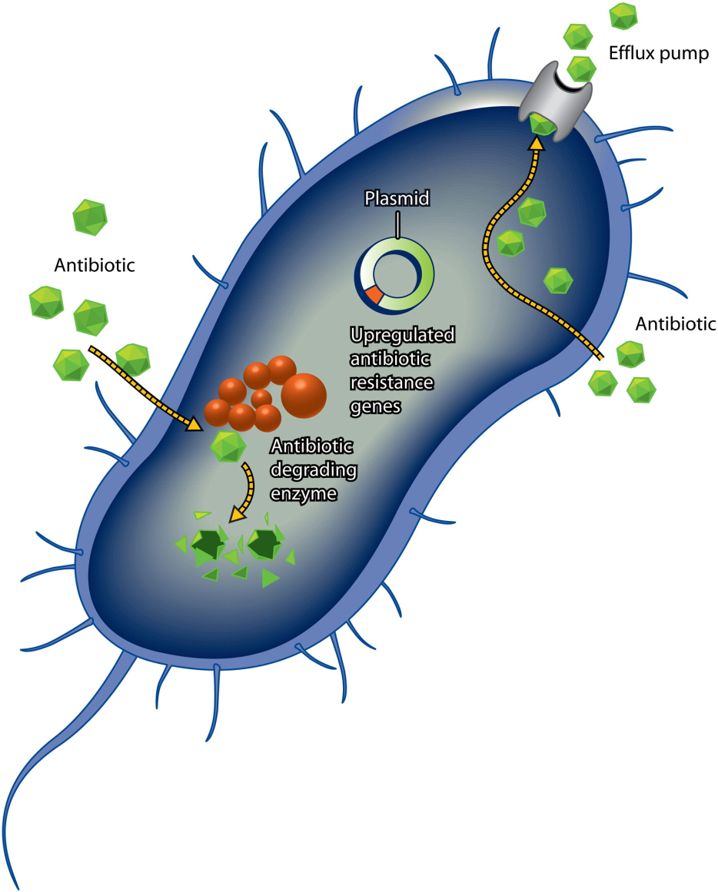
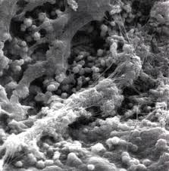
What is antibiotic resistance?
Selection
Selection
Resistant
1st dose
2nd dose
3rd dose
High
Level of resistance:
Medium
MIC: minimum effective concentration
Low
Enzymes, efflux pumps, gene transfer
Biofilm
Horizontal gene transfer between different species

Slide 5
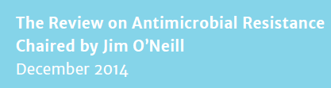
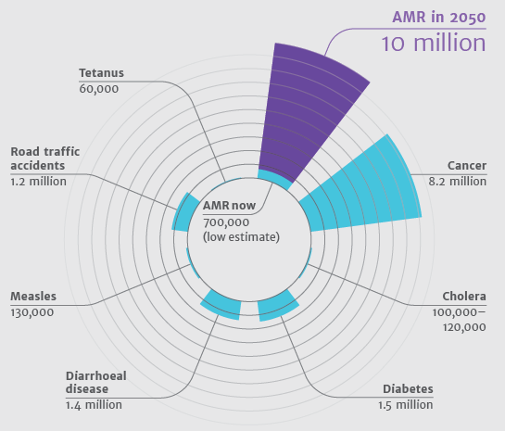
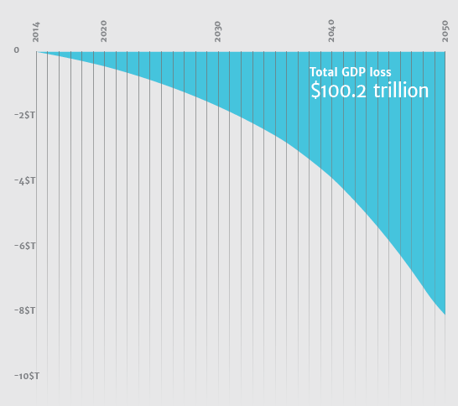
If no new antibiotics..

Slide 6
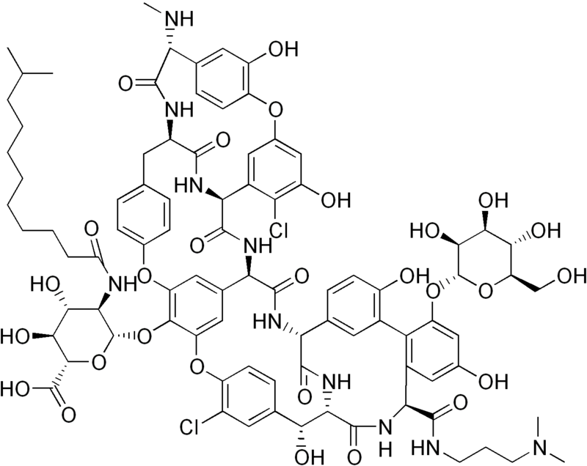
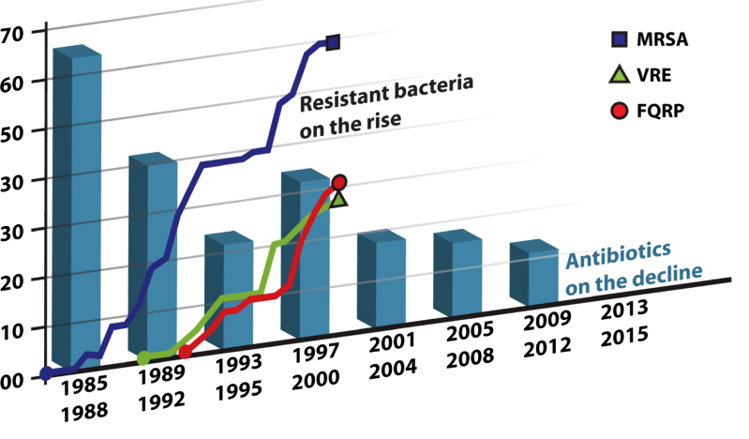
What new Antibiotics (AB) marketed?
The most threatening bacteria today: the gram negatives
In 20 years: only three genuinely first-in-class AB to the market (US)
None against gram negatives
Dalbavancin
(EU: Xydalba, Actavis)

Slide 7
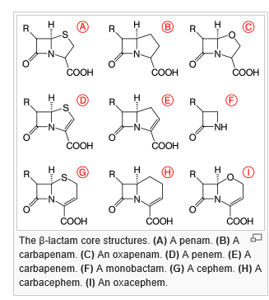
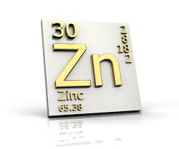
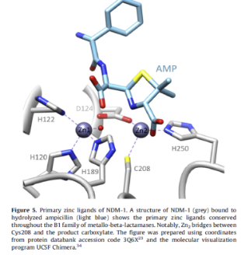
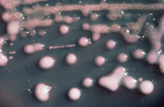
β-Lactamases
β-lactam antibiotics
β-lactamases: enzymes cleaving all β-lactam antibiotics.
The new AB weapon: Metallo-β-lactamases (MBL): zinc is essential for catalytic activity.
2015: no clinical inhibitor of metallo-β-lactamase on the market.
ESBL
2008 – New Dehli metallo-β-lactamase (NDM-1) discovered in Sweden.
Active against all β-lactam antibiotics on the market.
First patient with NDM-1-related in 2010.
Klebsiella pneumoniae harboring NDM-1

Slide 8
ZinChel project – a new strategy against resistant bacteria
Based on chemistry – rational design
How penicillins work: Mechanism of action (MOA) β-lactams
Our approach:
General binding to penicillin-binding proteins (PBPs)?
Structure gram negative bacteria are ongoing. They revealed the necessity of all the elements A, L and B in the general structure below, exemplified by the lead candidate ZN17.

Slide 9
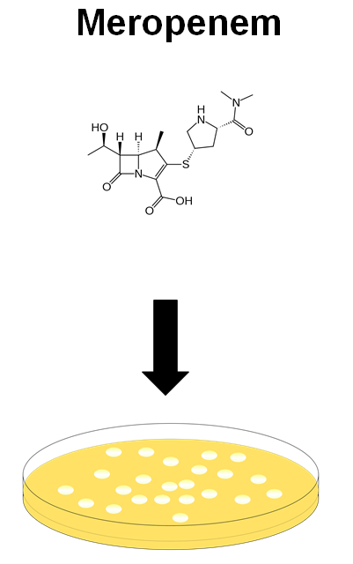
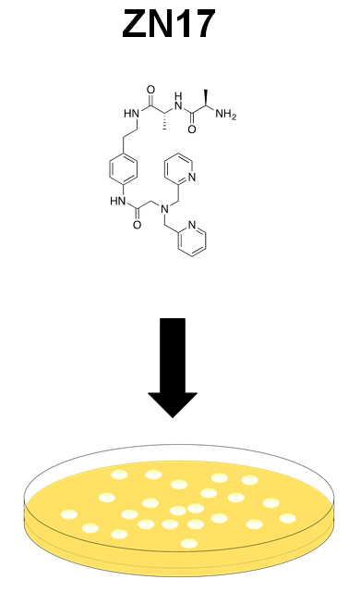
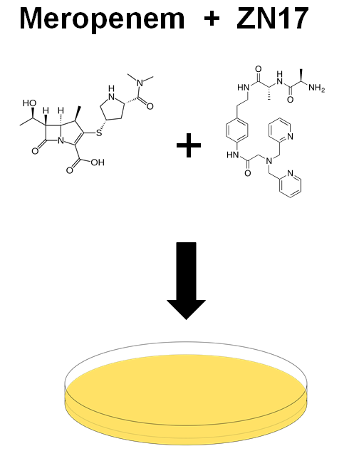
Results –
Testing Clinically Relevant Resistant Bacteria

Slide 10
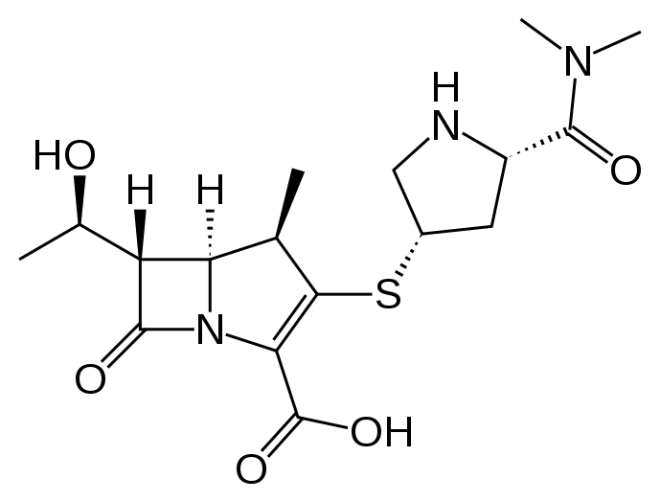
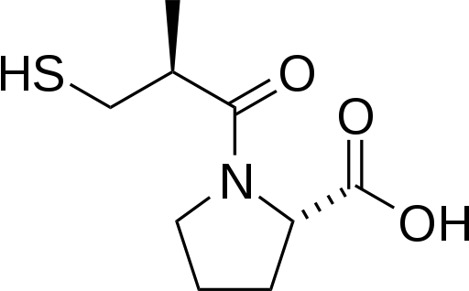
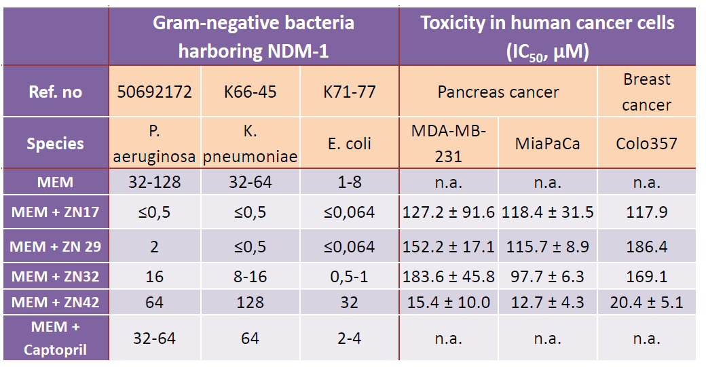
Results – Clinical Isolates
Ørjan Samuelsen, K-Res, UNN
Meropenem
Captopril

Slide 11
Results – Clinical Isolates
Ørjan Samuelsen, K-Res, UNN
Meropenem
Captopril

Slide 12
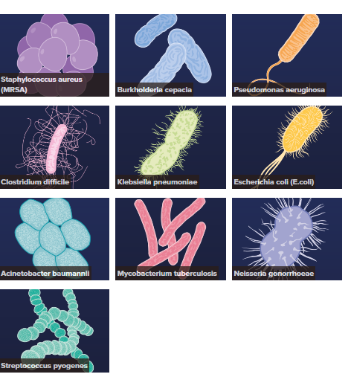
The most Threatening Resistant Bacteria
Zinchel: Bold Hypotheses:
Resistance seem to develop faster in mono-target antibacterial technologies.
Zinchel is a multi-target concept – data indicates PBP-binding.
ZinChel disturbs a basic physiological parameter – the zinc homeostasis.
In spite of 3., the compounds seem non-toxic to human cells – more data needed!
Investigation of resistance development potential key study in project plan
Source: Nesta, October 2015: http://www.nesta.org.uk/news/antibiotic-resistant-bacteria-10-most-dangerous

Slide 13
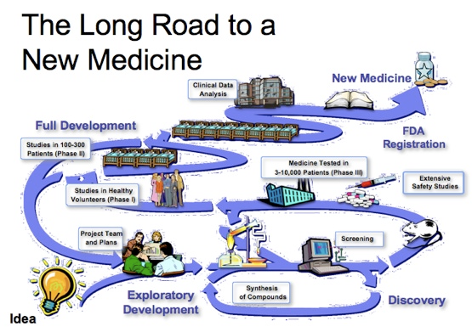

Slide 14
Summary
Only three genuinely new classes of antibiotics has been introduced to the market in 20 years (R.J. Anderson)
More people are going to die from infections than cancer in 2050 if no new technologies are brought to the market.
Industry is reluctant because of rapid development of resistance.
Health authorities/governements world wide must (and will) take action both financially and in other ways.
Our research group at School of Pharmacy/UiO has discovered a genuinely new adjuvant technology, dramatically reducing resistance towards carbapenems.
The scope of the ZinChel approach for other antibacterial drug classes is very wide.
The project is not based on natural products but on medicinal chemistry rational design.
The project has attracted attention and financing from both The NRC and two pharmaceutical companies.

Slide 15

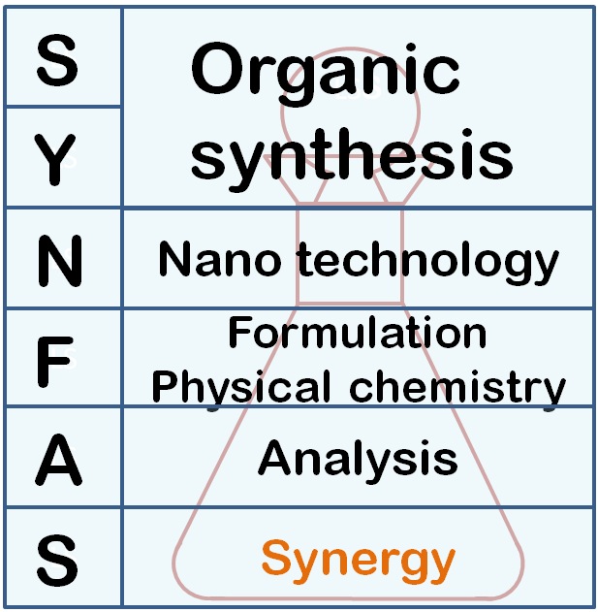
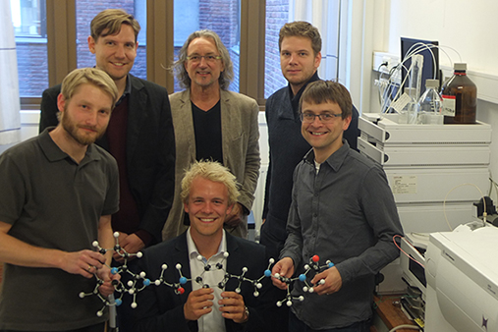


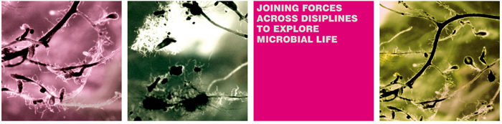





Acknowledgements - People
O. Alexander H. Åstrand
Scientist Geir Kildahl-Andersen
Scientist Christian Schnaars
PhD student Elvar Ø. Viktorsson
MSc student Ørjan Apeland
PhD student Anthony Prandina
Associate Professsor Lars Petter Jordheim
Dr Ørjan Samuelsen
Associate Professors
- Annette Bayer
- Dr Hanna-Kirsti Leiros
Funding:
Center for Integrative Microbial Evolution, UiO

Slide 16
Thank you for your attention…

