Slide 1



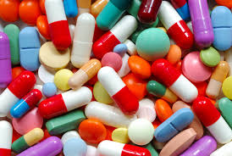
Normalflora som reservoar for antimikrobiell resistens
Notes:
I de senere år er man blitt mer og mer klar over at normalfloraen både hos mennesker og dyr, foruten miljøet (jord, vann, omgivelser) er et stort reservoar for allerede resistente bakterier.

Slide 2

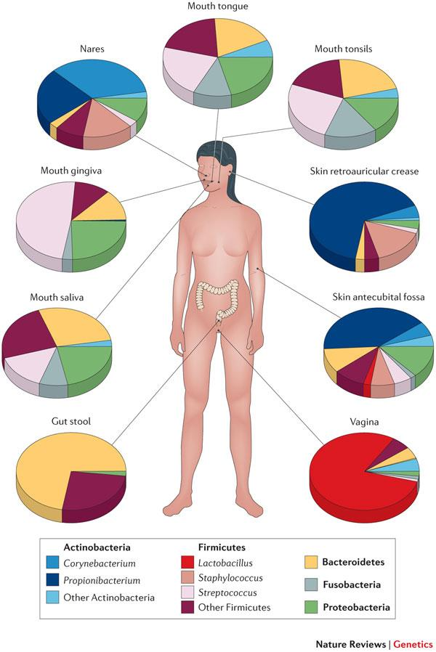

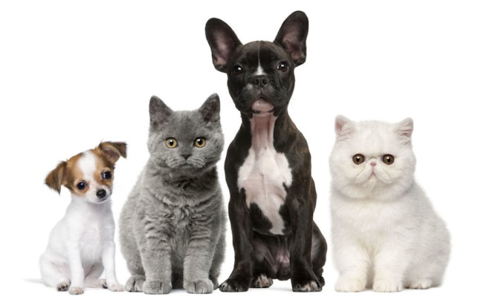


Normalflora

Slide 3
Hvorfor bry oss med bakterier som ikke gjør oss syke?

Slide 4
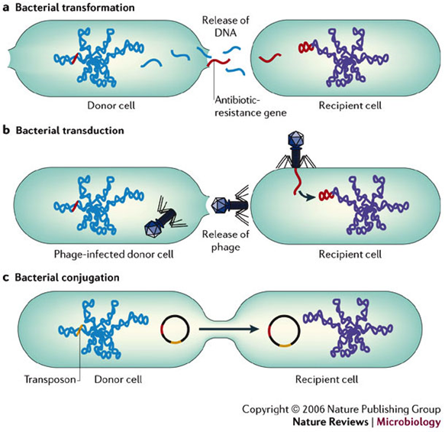
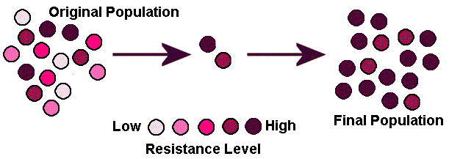
Seleksjon ved bruk av antibiotika
Horisontal genoverføring

Slide 5
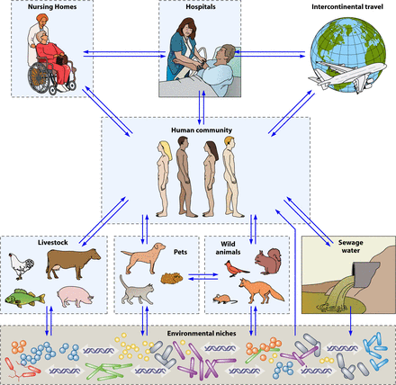
Spredning av resistens
Woerther P et al. Clin. Microbiol. Rev. 2013;26:744-758
Notes:
As you can see, this is a very complex pattern. Not only human use and spread between humans that are important.
One example where resistance genes have spread in all areas of this complex pattern is described in a study from in New Dehli in India –bacteria containing the NDM-1-enzyme (New Delhi Metallo-beta-lactamase, carbapenemase – last resort treatment in many cases) -positive bacteria were found in approximately 30 % of samples (100µl) taken from puddles in the street of New Dehli. Bacteria containing carbapenemases has been given the name «nightmare bacteria» by the head of Centers for Disease Control and Prevention (CDC) in the US, and is a hot topic in the American press after several outbrakes.

Slide 6
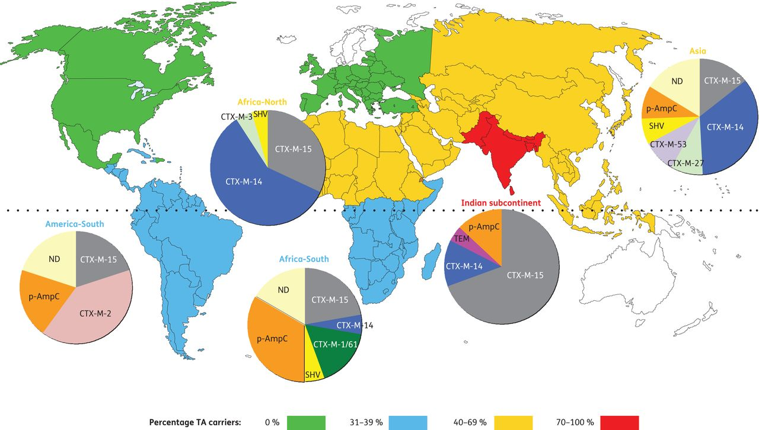
Travel-associated faecal colonization with ESBL-producing Enterobacteriaceae
Östholm-Balkhed Å et al. J. Antimicrob. Chemother. 2013;68:2144-2153

Slide 7
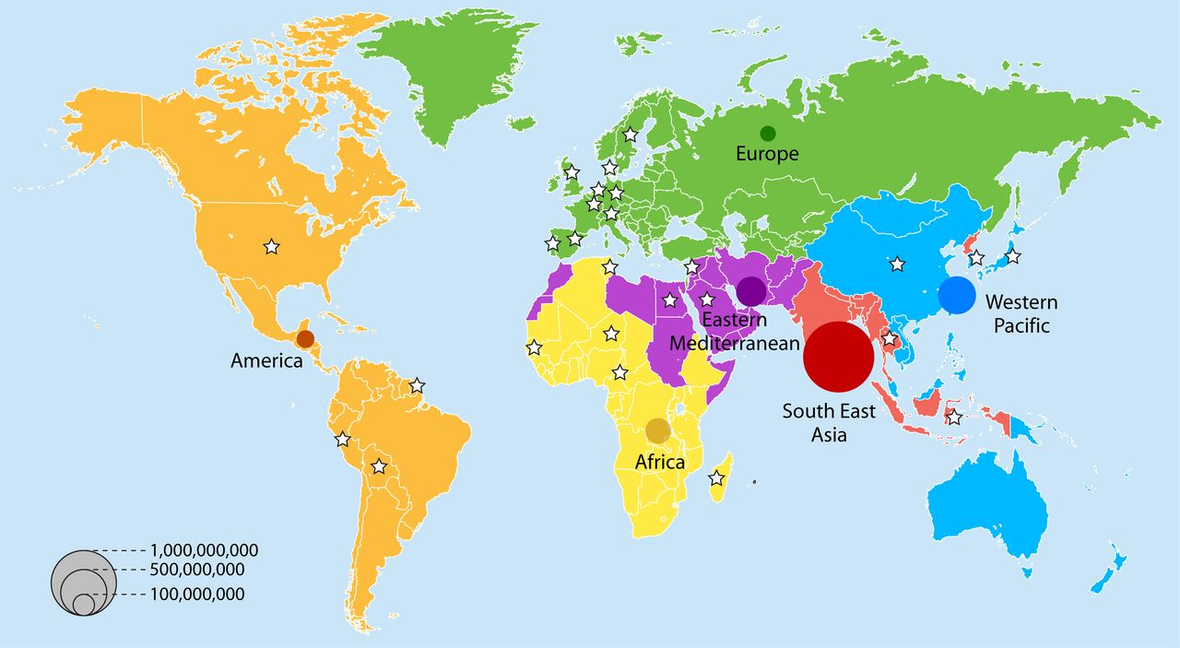
Trends in Human Fecal Carriage of Extended-Spectrum β-Lactamases in the Community: Toward the Globalization of CTX-M
Woerther P et al. Clin. Microbiol. Rev. 2013;26:744-758
Notes:
Number of ESBL carriers in the community in 2010, according to WHO region grouping. The 6 WHO regions are represented by different colors. WHO estimates of the population of each geographic area in 2010 (http://www.who.int/research; accessed 18 December 2012) were used to compute the number of ESBL-E carriers. ESBL carrier rates were established using the model presented in Fig. 1 for the year 2010. Stars represent countries with available data for modeling. Each bubble area is proportional to the estimated number of ESBL carriers in that region.

