Slide 1
BIG DATA

Slide 2

The best time to buy your airline ticket?
TUESDAY
flight fares between 10 months and 1 day in advance
1.3 billion air fares
https://viewfinder.expedia.com/img/STOR-23513_White_paper.pdf

Slide 3
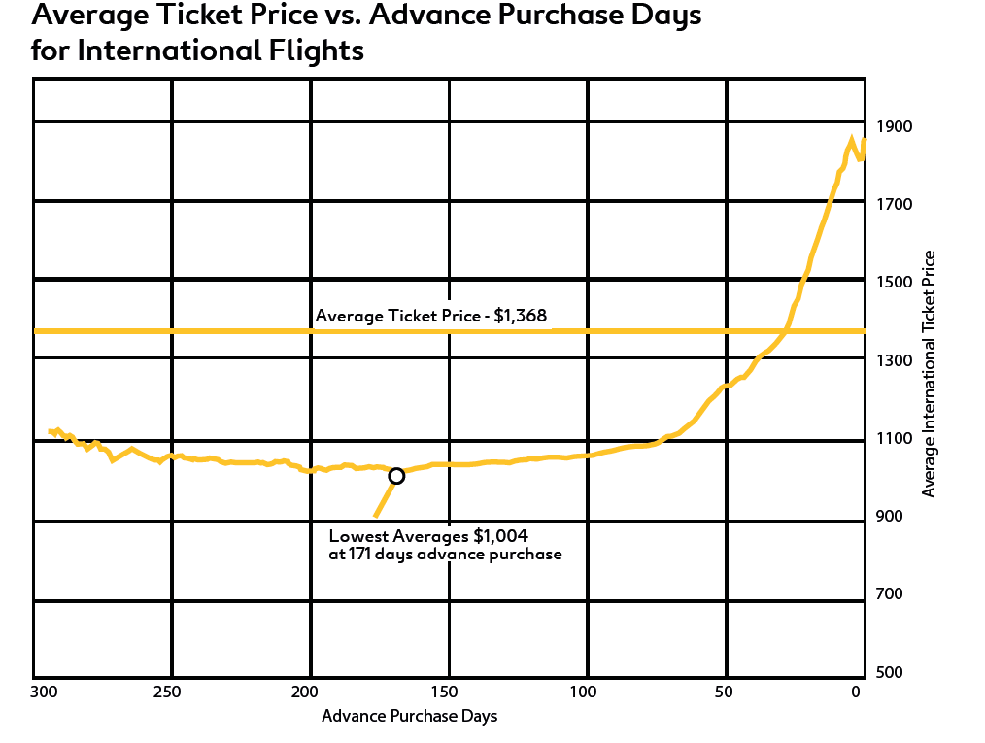

Slide 4
MASSIVE new health data
Electronic hospital health records
Genetics of every patient
Unstructured data: text, images, videos, sound
For what purpose?
Notes:
recent doubling in use of electronic health records

Slide 5
Generate knowledge, and fast.
The cost of answering questions by collecting structured data (surveys, trials, panels) is high and takes years.
Analyzing all existing data gives stronger answers and generalizability.
Patient safety
By automatic monitoring patients, propose actions to health care providers.
Personalised medicine
Integration of individual genetics, life style, wished life quality with bio-medical knowledge leads to personalized treatment.

Slide 6
How much data now?
Google processes 24 petabytes per day = US Library of Congress times 1000
Facebook uploads 10 million photos per hour and 3 billion “like” per day
YouTube adds one hour of video every second
Telenor Pakistan mobile phone data, 40 million SIMs, 1 month = 6 Terabytes data

Slide 7
HISTORY

Slide 8
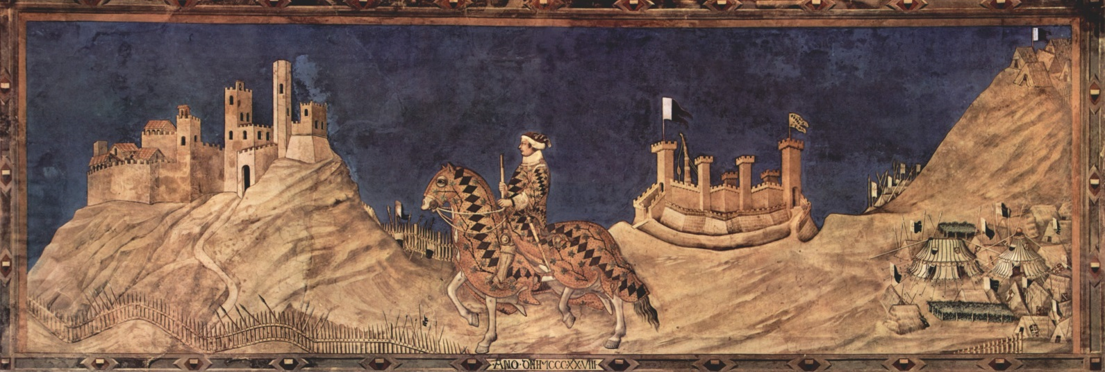
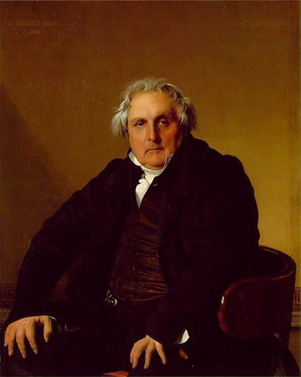
LEADERS of the world
Feudal society: medieval knights
Industrialised society: bourgeoisie
Information society: ?

Slide 9
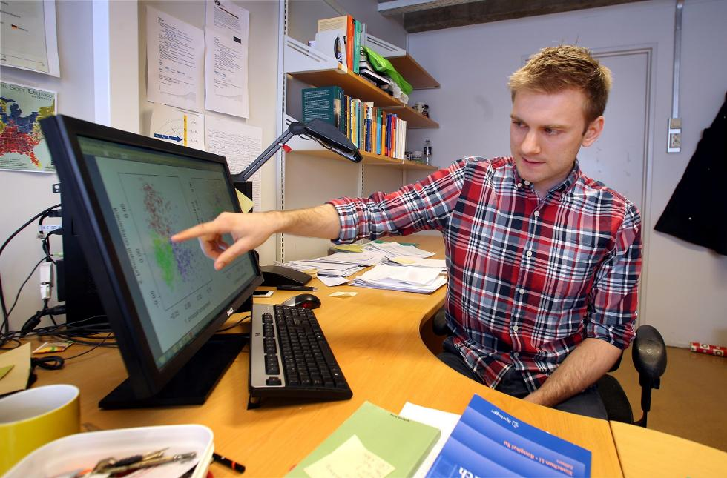
YOU !
The universal, educated and
connected human being
Notes:
Techno liberal I-shirted nerd, who put their private lofe online for everybody and for ever

Slide 10
HOW ?
Integrate data with data
Integrate data with knowledge
Melting pot of disciplines
DO STATISTICS

Slide 11
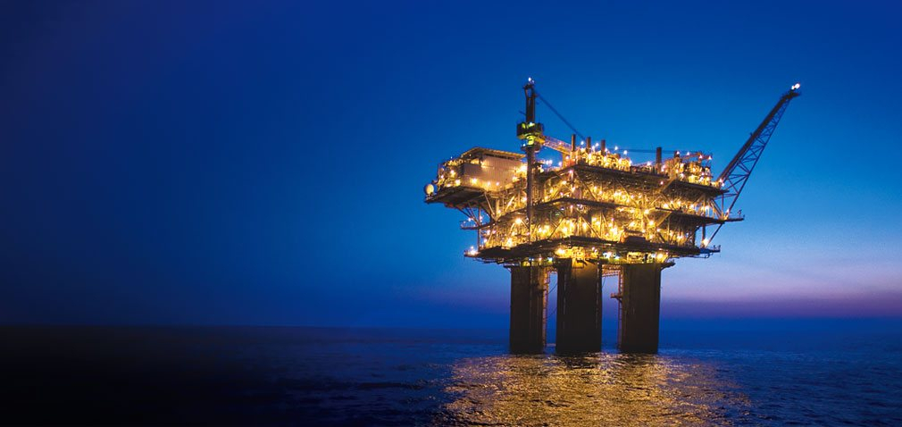
Norway’s success
(among others)
Petroleum
+
the capacity to get it out.

Slide 12
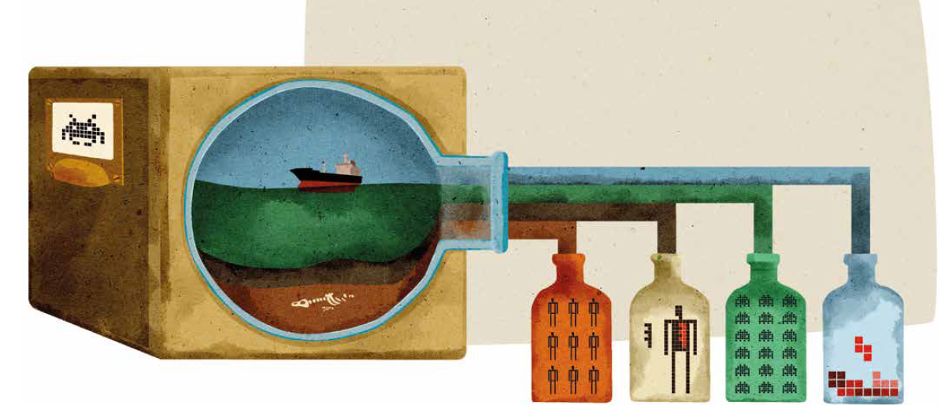
Next success
(among others)
Data
+
the capacity to get something out.

Slide 13
Next success
(among others)
Data
+
STATISTICS.

Slide 14
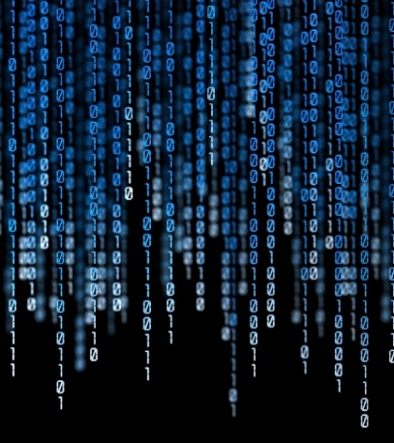

It is not enough to crunch data!

Slide 15
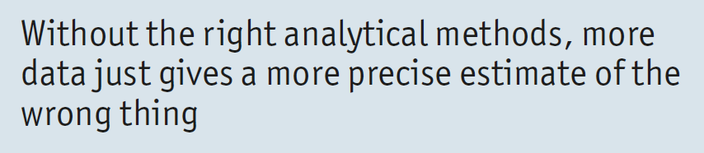
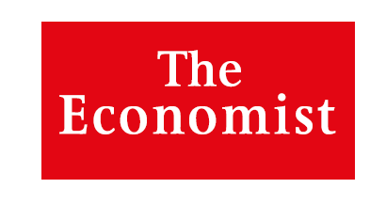


Slide 16
MODEL-BASED STATISTICS
Model-based methods exploit knowledge and structure in the new data,
to understand, discover, predict, control.

Slide 17
















Slide 18
Personalised solutions
Forecasting the transient

Slide 19
Personalised solutions
Given the genes of a patient, predict the success
of a drug, just for her!
Given all we know about a tax-payer, predict
if she underpays tax, exactly her!

Slide 20
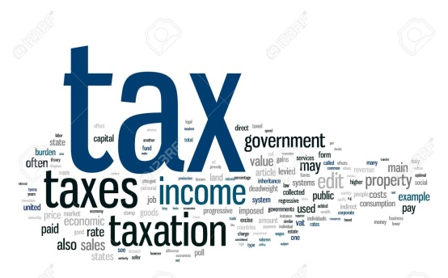
what we know
about people
tax
Angela
?

Slide 21
tax
y
n
We LEARN a RULE
y
y
Angela
Y
which we apply to ANGELA

Slide 22
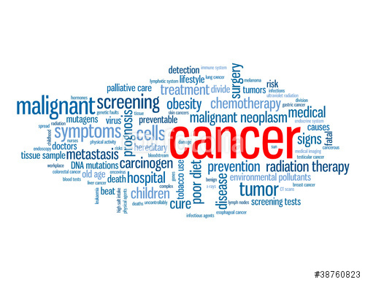
Therapy works
Angela
?

Slide 23
Therapy works
y
n
We LEARN a RULE
y
y
Angela
Y
which we apply to ANGELA

Slide 24
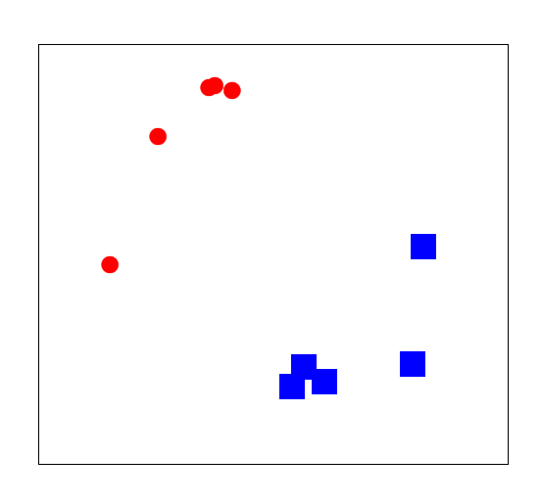
N
Angela
Y
People with outcome known.
Classification rule.

Slide 25
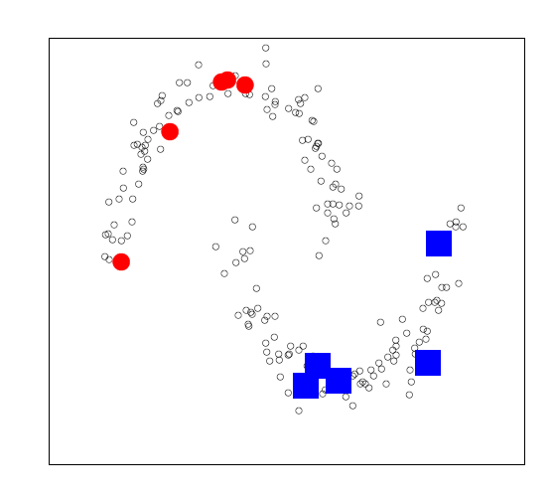
We can use all the people, also the ones
we do not know the outcome for, to
estimate the decision boundary accurately.
Angela
All people
Makes a much better rule (less false positives/negatives)

Slide 26
YOU
and
the data revolution
Notes:
Techno liberal I-shirted nerd, who put their private lofe online for everybody and for ever

Slide 27
The impact
of data and
data rich information technologies
is deep

Slide 28
we work less – the internet of things
less difference between work & free time,
weakening the power of salary
the sharing economy, escaping the
market rules, with collaborative production
less private property, open and free data
and information
networking people, puts power in the
hands of many

Slide 29

Product for all and for free
Produced in collaboration
no profit
208 employers
73.000 active contributors
if commercial: 3 billion USD revenue/year
but impossible for others to make profit in this area any more

Slide 30
Not easy!
Free-market economy builds walls:
with intellectual property regulations
restricting networks
making it possible to use your data against yourself
trying to keep data private, scarce and sellable
thus sharing responsibility for the underutilisation of data
against the public good, delaying progress!

Slide 31

We shall use
Telenor Pakistan mobile phone data to predict
the spread of dengue fever epidemics
DnB financial transaction data to spot white-washing
of illegal revenues
Gjensidige customers data-base to detect fraud in claim
and allow to reduce prices
ABB and DnV-GL’s data from hundreds of sensors on
ships to optimise energy consumptions en route.
Biobank data to design rules to optimise cancer
treatment at individual level.

Slide 32


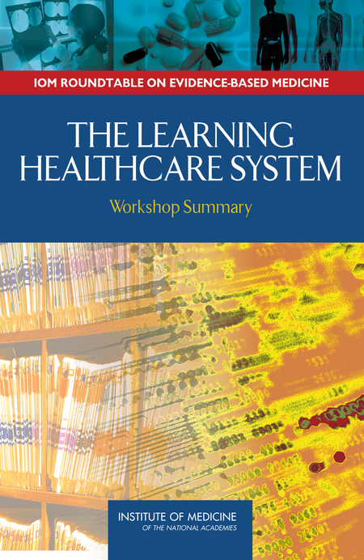

Slide 33
joins the voyage
to a better world

Slide 34
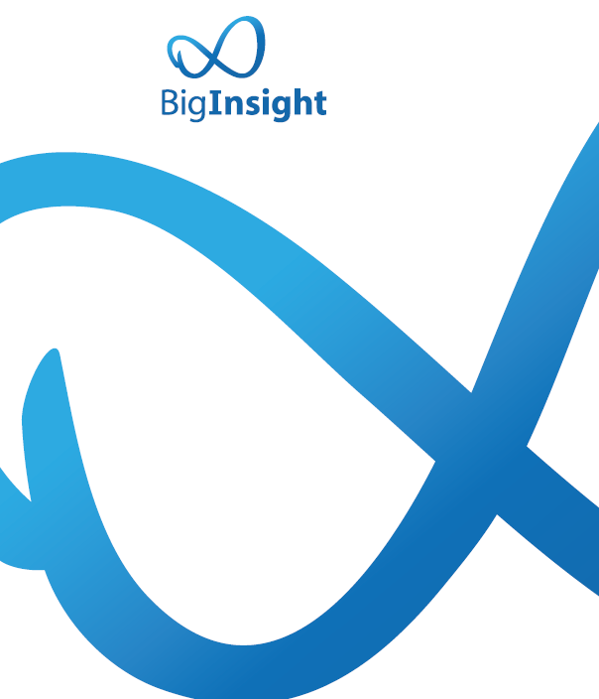
www.biginsight.no
frigessi@medisin.uio.no

