Slide 1


Viten
How do I get published in the mass media?

Slide 2
Viten
How do I get published in the mass media?
(And why should I even bother?)

Slide 3
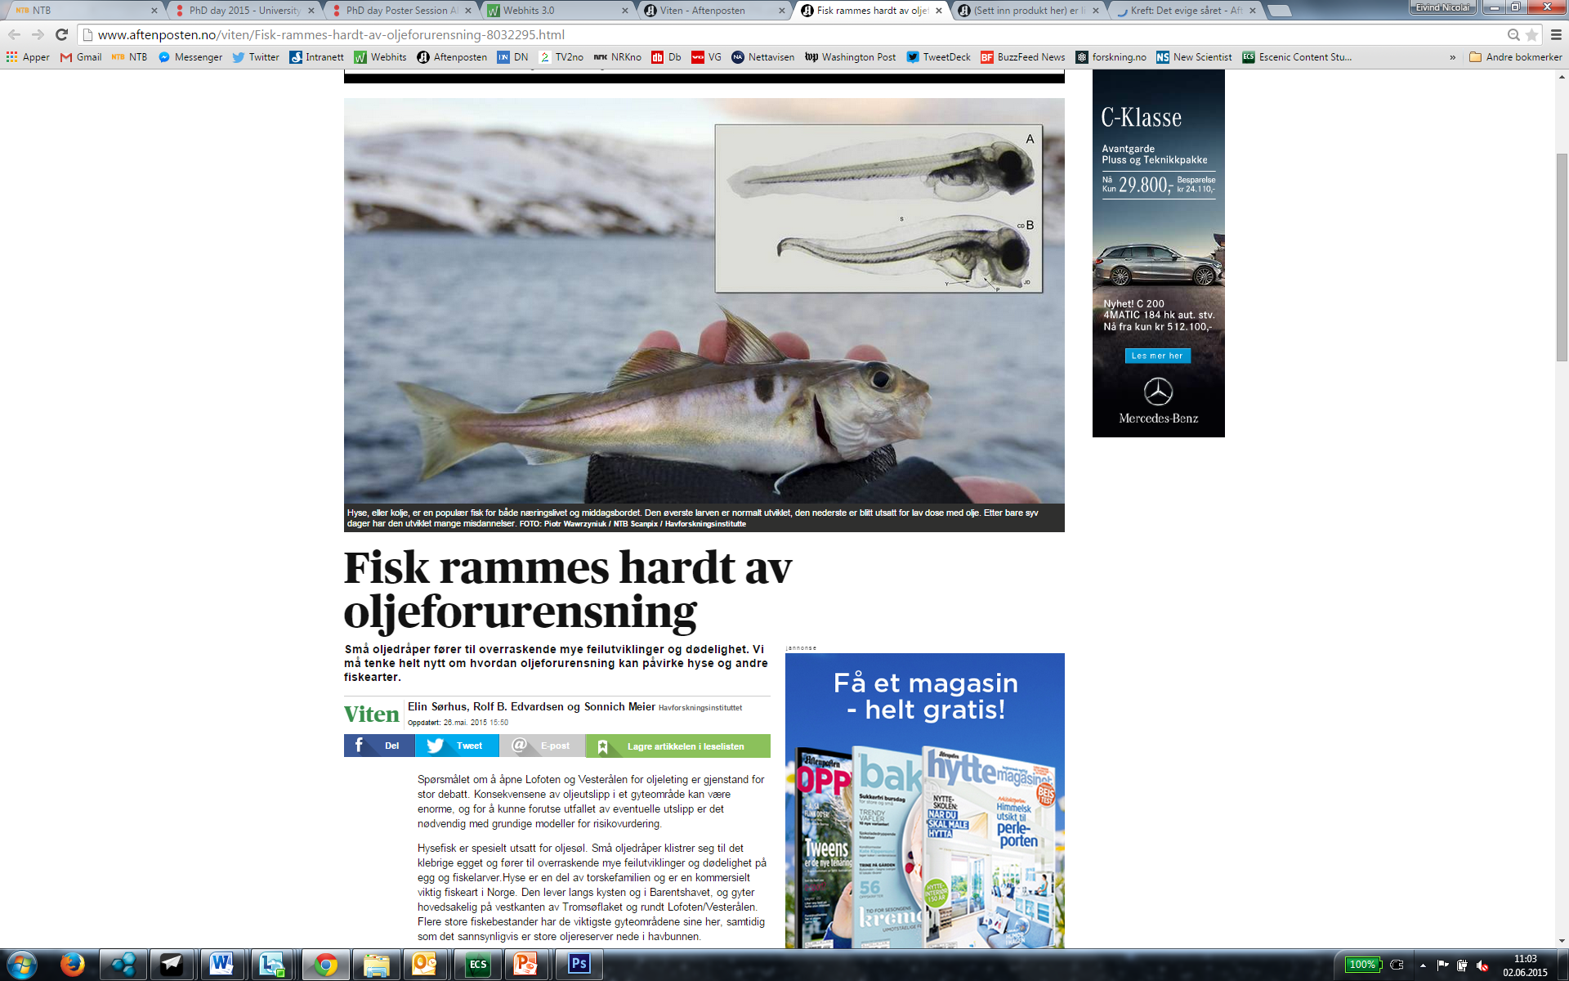
Notes:
På nett har Aftenposten 812.000 lesere, mens papiravisen har 658.000 lesere daglig.

Slide 4
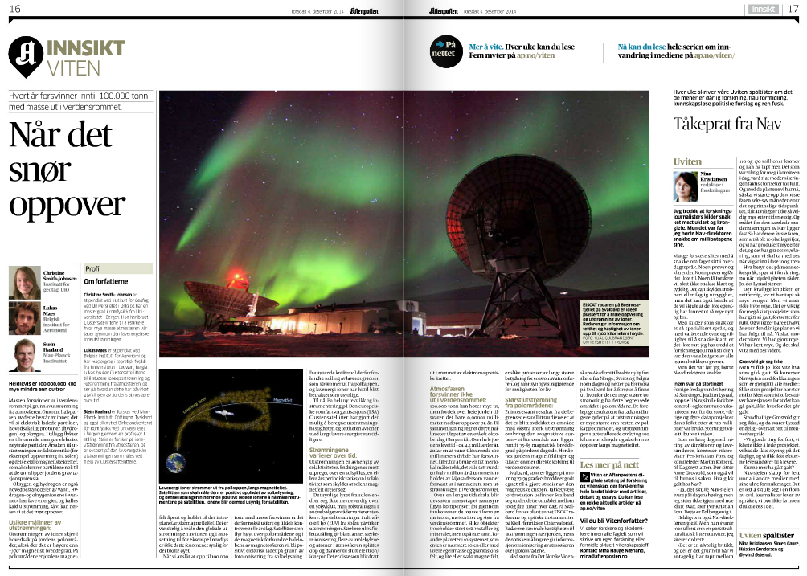

Slide 5
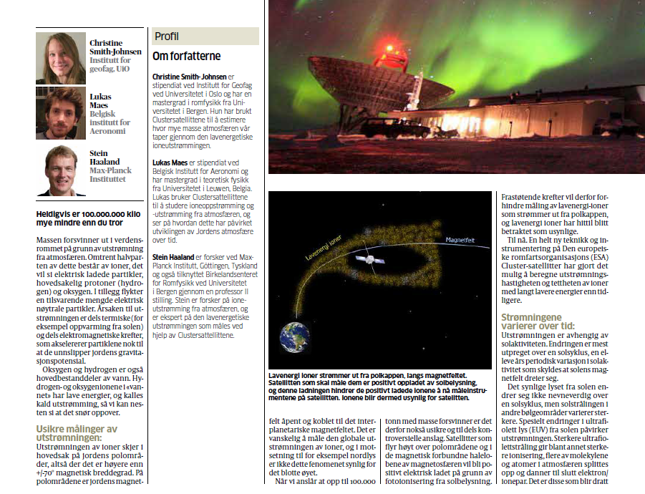

Slide 6
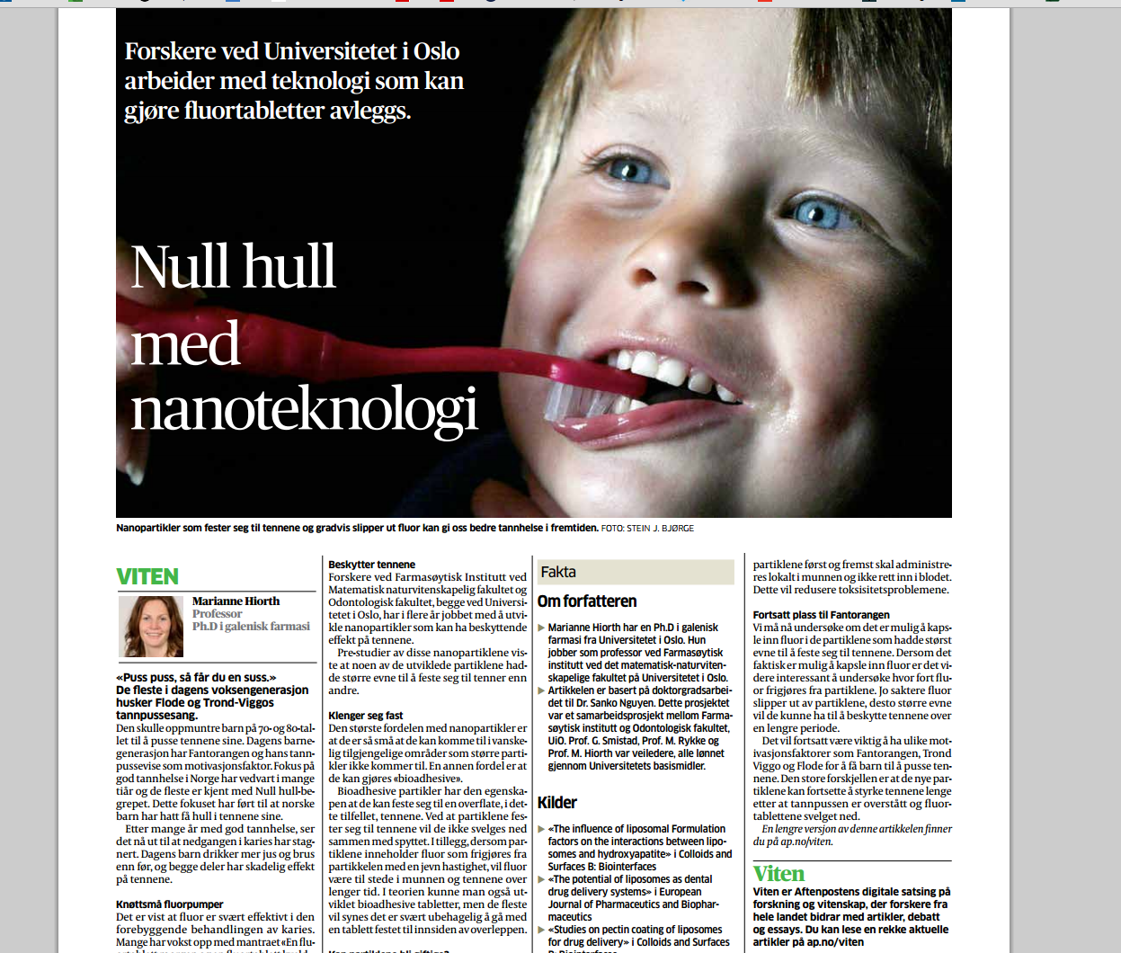

Slide 7
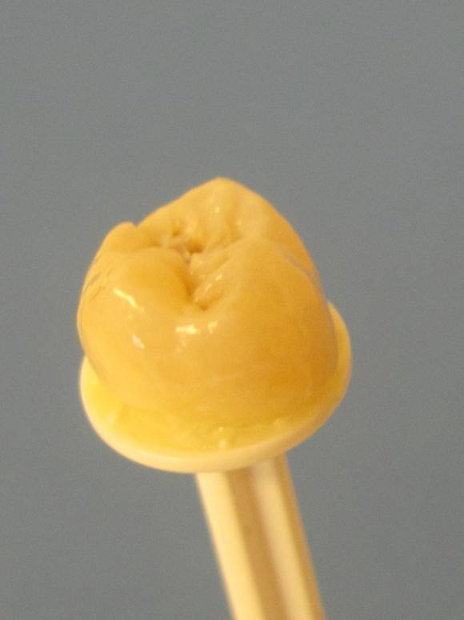

Slide 8
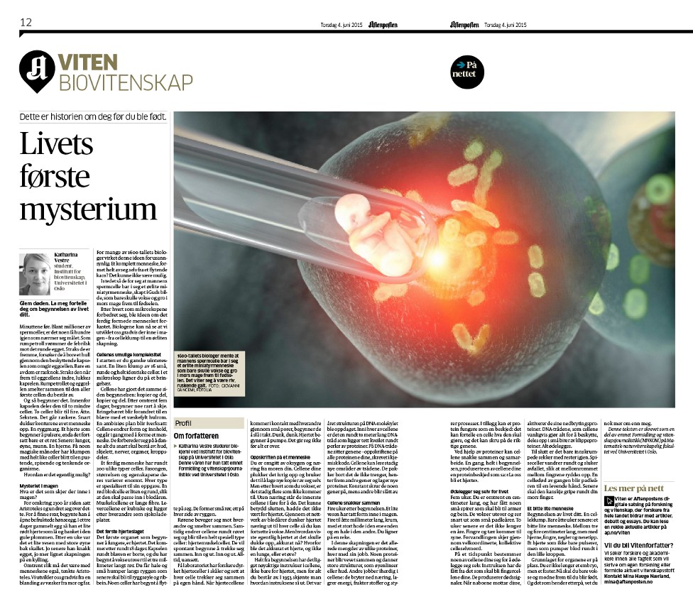

Slide 9
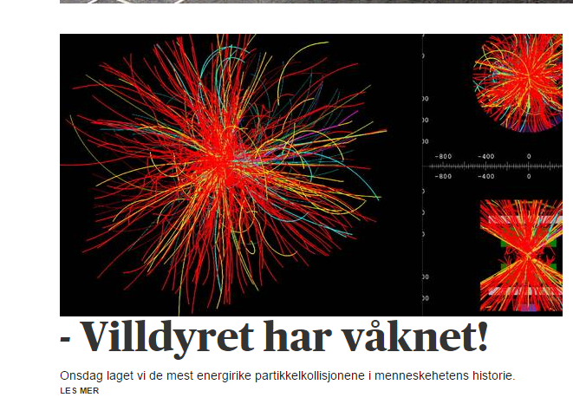

Slide 10
How?
Write something that’s worth reading

Slide 11
How?
Write something that’s worth reading
Know why you are writing.

Slide 12
How?
Write something that’s worth reading
Know why you are writing.
Know who you’re writing for.

Slide 13
How?
Write something that’s worth reading
Know why you are writing.
Know who you’re writing for. (It’s not the people you eat lunch with)

Slide 14
How?
Write something that’s worth reading
Know why you are writing.
Know who you’re writing for.
Know how you get people to read past the first paragraph.

Slide 15
Have a clear idea of what you want people to know after reading your article.

Slide 16
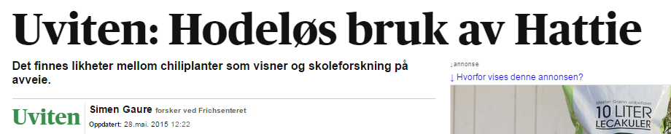
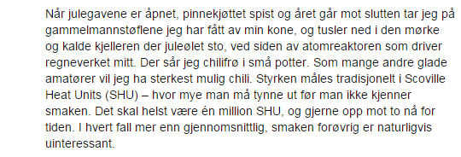

Slide 17
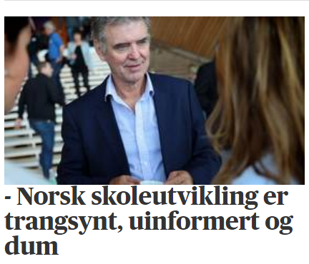

Slide 18
Avoid doing this:
“The move from a structuralist account in which capital is understood to structure social relations in relatively homologous ways to a view of hegemony in which power relations are subject to repetition, convergence, and rearticulation brought the question of temporality into the thinking of structure, and marked a shift from a form of Althusserian theory that takes structural totalities as theoretical objects to one in which the insights into the contingent possibility of structure inaugurate a renewed conception of hegemony as bound up with the contingent sites and strategies of the rearticulation of power.”
Judith Butler, philosopher “Further Reflections on Conversations of Our Time,” Diacritics 27 (Spring 1997): 13–15.

Slide 19
When you can do this:
“The move from a structuralist account in which capital is understood to structure social relations in relatively homologous ways to a view of hegemony in which power relations are subject to repetition, convergence, and rearticulation brought the question of temporality into the thinking of structure, and marked a shift from a form of Althusserian theory that takes structural totalities as theoretical objects to one in which the insights into the contingent possibility of structure inaugurate a renewed conception of hegemony as bound up with the contingent sites and strategies of the rearticulation of power.”
Judith Butler, philosopher “Further Reflections on Conversations of Our Time,” Diacritics 27 (Spring 1997): 13–15.
My interpretation: “We no longer think class systems are based purely on money, differences in political power and social status play a part. Also, and more importantly, my vocabulary is bigger than yours.”

Slide 20
2 + 2 = 4

Slide 21
4 = 2 + 2

Slide 22
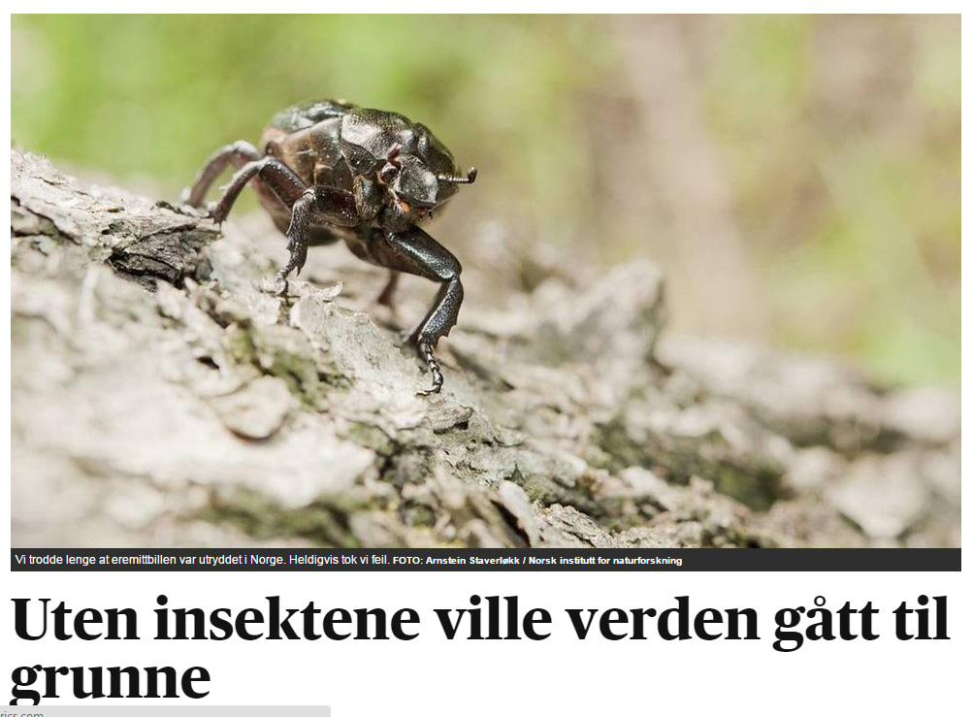

Slide 23
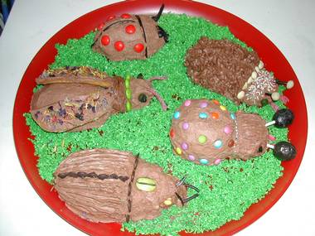

Slide 24
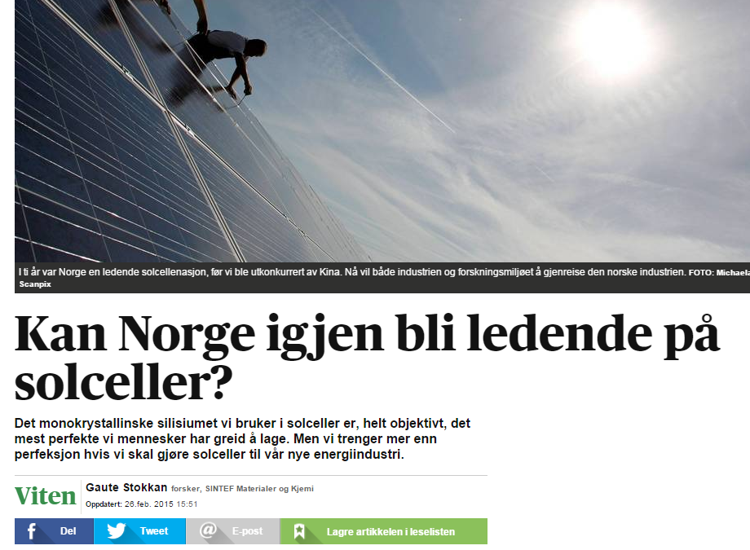

Slide 25
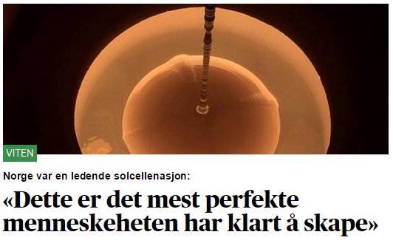

Slide 26
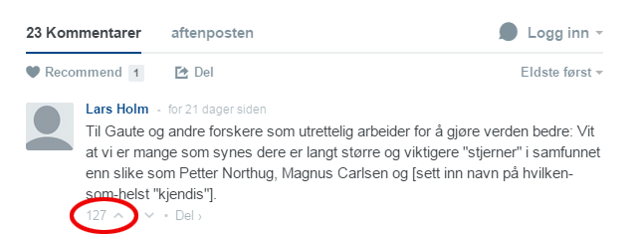

Slide 27
Cheatsheet for better writing:
Know what you want to write and why
Avoid academic tribespeak
Lead with the conclusion, then set the premise
Let your enthusiasm show
Don’t be afraid to use tabloid tricks

Slide 28
Cheatsheet for better writing:
Know what you want to write and why
Avoid academic tribespeak
Lead with the conclusion, then set the premise
Let your enthusiasm show
Don’t be afraid to use tabloid tricks
(Or just send me a draft at ENL@aftenposten.no and I’ll use them for you)

Slide 29
«Ok, fine,

Slide 30
«Ok, fine, I can do this,

Slide 31
«Ok, fine, I can do this, but why should I even bother?»

Slide 32
Why?

Slide 33
Why?
You know more about a subject than 99% of the population
You are wanted in the public debate
It’s your responsibility

Slide 34
Why?
You know more about a subject than 99% of the population
You are wanted in the public debate
It’s your responsibility
There’s a lot to gain by doing it
New contacts in academia
New contacts outside academia
Recognition for what it is you do
Recruiting new colleagues down the line
Strong signals from the Norwegian research council

Slide 35
Cheatsheet for better writing:
Know what you want to write and why
Avoid academic tribespeak
Lead with the conclusion, then set the premise
Let your enthusiasm show
Don’t be afraid to use tabloid tricks
(Or just send me a draft at ENL@aftenposten.no and I’ll use them for you)

