Slide 1
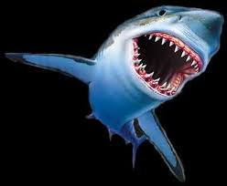
Det matematisk-naturvitenskapelige fakultet
PHD DAY 2015
The Story of Press Release

Slide 2
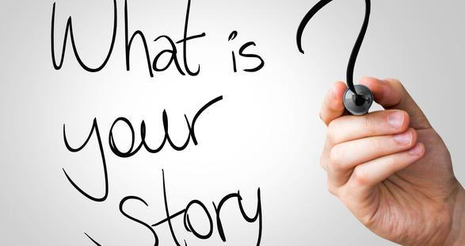

Slide 3
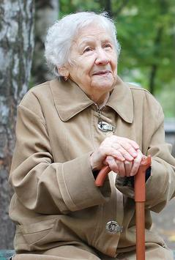

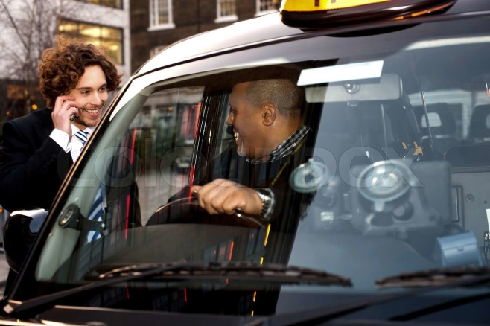

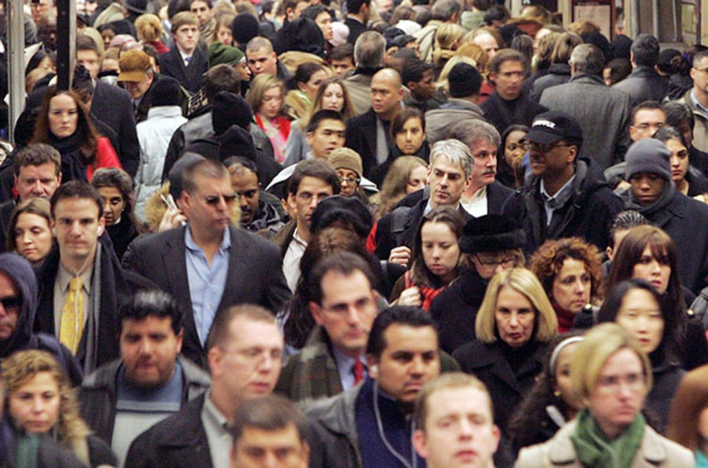

Slide 4
What do you do for a living?

Slide 5
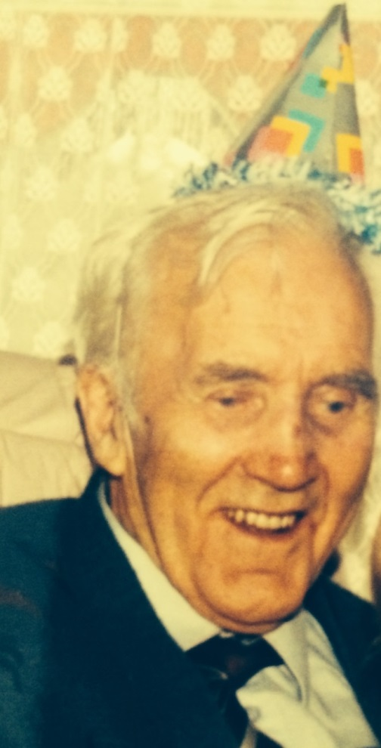
Bengt P. Haugnes (1905-1997)
Educated
Farmer
Mayor
My granpa
Technology entusiast

Slide 6
Have a story ready for granma, schoolmates and everyone else!

Slide 7
PHD – Press Release
WHAT
Not an abstract of the abstract of the thesis
But a short popular story of your science – spread through media.
FOR WHO
Not your supervisor or collegaues
For ordinary people

Slide 8
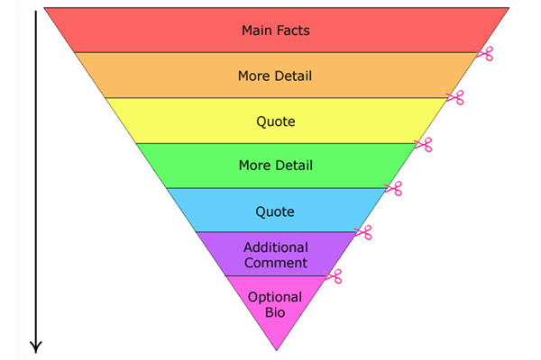
Structure pressrelease
Title: Short, inspiring
Ingress: 1-2 lines. Tell the key point
Text: ½ page of text that explaines the story in a simple way. A quote or two from central people.
Illustrations: Photos, graphics
Contact data, links to resources etc.

Slide 9
Science shows…….
Ingres
Title
Picture and text
No one starts here!
Subtitles
Notes:
Samme på nett. På forsiden

Slide 10
Structure: Act like a SHARK
Take a bite in the reader an hold it to the end of the story.
If you dont get the reader from the start you never get him/her.
Start with conclusion or a good metaphor
Slimplify, use examples.
Finish with a «tale swing»
Notes:
Found a good story. Will not be read if you dont tell it well. Start sith a structure.

Slide 11
IR-UWB Transmitter for Ranging Application and IR-UWB MIMO Radar-Based Imaging Array
This work investigates the design of an Impulse Radio Ultra Wide Band (IR-UWB) transmitter used in a ranging transceiver based on the time-of-flight measurement. The presented transmitter employs a calibrated clock burst generator with immediate start-up and stop time, hence it has a constant processing time, which is a key function of the continuous-time time-of-flight measurement system.

Slide 12
Characterization of a novel mouse model lacking the lysosomal membrane protein GLMP
Lysosomes are cellular organelles responsible for degradation and recycling of macromolecules. This process is dependent on the correct function and regulation of a myriad of proteins.

Slide 13
A fruitful affair: speciation by hybridization in Passer sparrows
House sparrow central in origin of species
With his doctoral work, Jo Skeie Hermansen has shed important light on the origin of species – a fundamental problem in biology once deemed no less than the “the mystery of mysteries”.
Hermansen and his colleagues have demonstrated that the world’s most widespread bird species, the ubiquitous house sparrow, is at the centre of a poorly understood, but potentially vital generator of biological diversity – hybrid speciation.

Slide 14
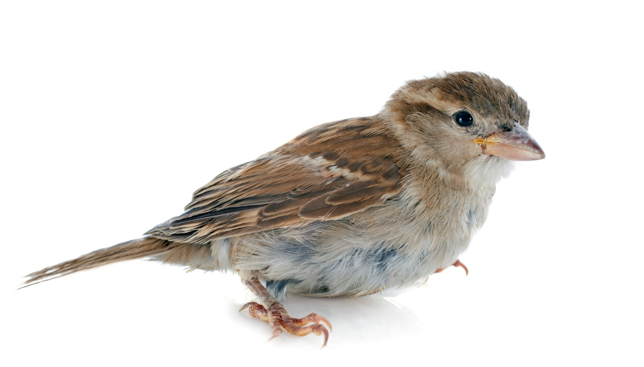
Find something people know
House sparrow
What to tell
Useful for society? How?
Find somthing people can relate to
USE MYSTERY-CARD
People love mysteries
Science is mystery-solving
Lift the head from the PC. See the bigger picture

Slide 15

Keypoint for a good story
Surprice
Identification,
Important
Useful
Conflict
Actuality
WOW-effect
Notes:
ABOUT ACTUALITY: Let say your PHD-work is about climate: A new report is released and it is a lot about itin the news. A lot of politician an other come forward with theirs views. You as a scientist on this Knows better – you should come forward and tell it, you have credibility!!!!

Slide 16
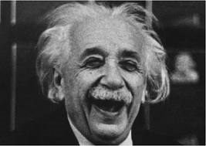
Write with passion…….
That spills over to the reader
Use your scientific joy,
«Ten reasons for
loving particlephysics»
Create scenes/draw pictures in the readers mind,
use cases from daily life
Dare to let loose. Have punch. Personal style
Do not be afraid to be corny, you can not simplify enough
Enthusiasm!

Slide 17
More writing-tip……..
FLOW!
Vary sentence length, minimum clauses.
Short, direct, personal
Use verbs, preferably present - NOW
Use examples/funny things
Read text aloud
Full package: Photo, text, video, subheadings
Feedback from non-academics, text-experienced
Don`t use technical terms! (if you have to- explain them)

Slide 18


How to spread it
Widely: Send it to a lot of news medias.
  (Likely result: Nothing or many short notes)
Exclusive: Contact one journalist/media and give possibility to have the story exclusive. Use the pressrelease as a teaser and hopefull get interviewd afterwards.
  (Likely result: A visible bigger story in one media)
Hide bad news:
  Send press release Friday night, the night before Christmas eve.
  Do not pinpoint the news in header.
  Cloaded language.

Slide 19
Why communicate
Granma gets proud
Tax-payers deserve to get something back. New knowledge!
Autorities expect you to communicate
Good for reputation for University of Oslo
The society-debate gets smarter if you join
You and your science get visible. Easyer to get job, money for new projects, new partners, more students.
It`s FUN

Slide 20
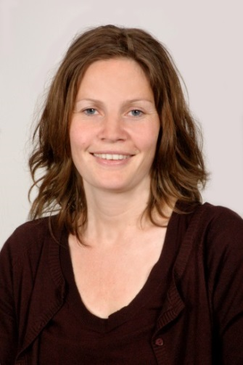
Fun and lucrative----
Quote from Marianne Hiorth
(Professor at the School of Pharmacy, UiO)
(AP Viten writer)
It was a super article. I have received lots of positive feedback after it was
published. I also see that it has many positive effects going forward to the public.
Several scientists have contacted me because they will cooperate with me and more students have also said they want to be a master student with me (and we've really struggled with recruitment to my field).
The moral is, “stå på”, it pays finally:)

Slide 21
What can faculty do
Text-coaching, advice on media, help find channels
Make the story visible at our pages, SoMe
Planning launch of our own news-site «Titan»
Questions, comments?
Contact:
Gunhild M. Haugnes,
ghaugnes@uio.no
97526462

Slide 22
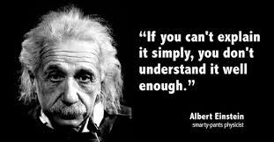
To difficult to explain? NO!!

