Slide 1
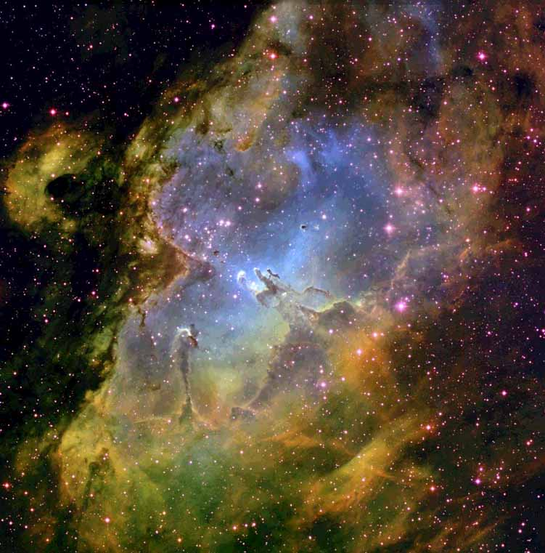
Making, baking and breaking: Dust in the interstellar medium (ISM)
Anja C. Andersen
Dark Cosmology Centre
Niels Bohr Institute
University of Copenhagen
http://www.dark-cosmology.dk/~anja

Slide 2
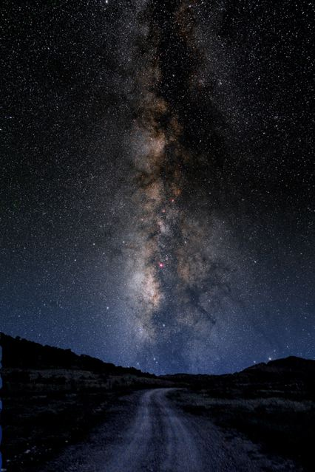
Interstellar
Matter
Matters !
The centre of the Milky Way would be a billion times brighter if not for cosmic dust...
Notes:
Figure 18-1. Milky Way Mosaic The Milky Way Galaxy photographed almost from horizon to horizon, thus spanning nearly 180°. This band contains high concentrations of stars, as well as interstellar gas and dust. The gray box shows the field of view of Figure 18.5. (Axel Mellinger)

Slide 3
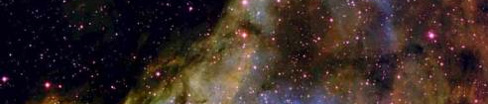
Dust effects
Dust drives the mass loss of cool red giant (AGB) stars.
Dust is an important coolant during star formation, possibly essential for low mass star formation.
Dust plays a crucial role for molecule formation in the interstellar medium.
Dust is an ingredient of planet formation.
Dust determine “the weather” of Brown Dwarfs.
Dust can be really irritating for certain observations!
Notes:
Put in references. What can we tell about dust from observations?

Slide 4
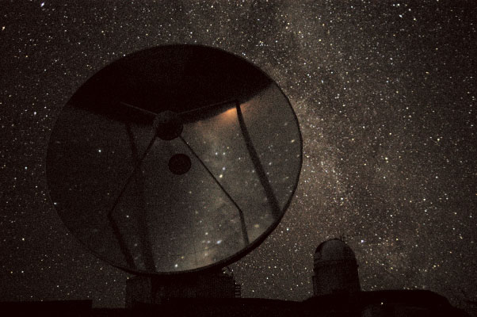
Cosmic Dust - ”basic facts”
1/5 of the part of the Milky Way consisting of stars, planets and other “baryonic matter” is present as gas and dust. Of this 1/5 then 99% is gas and 1% is dust.
Smoke particles consisting of C, O, Si, Mg, Al, Fe.

Slide 5
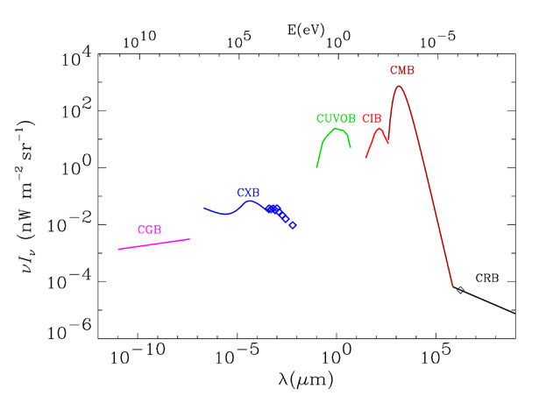
Cosmic background radiation
microwave
gamma
X-ray
optical
IR
radio
Flux
Dust
Wavelength
Hauser & Dwek 2001
Notes:
Spectrum of the cosmic background radiations. The radio background (CRB) is represented by a I ^{0.3} spectrum, normalized to the Bridle (1967) value at 170 cm. The cosmic microwave background (CMB) is represented by a blackbody spectrum at 2.725 K. The UV-optical (CUVOB) and infrared (CIB) backgrounds are schematic representations of the work summarized in this review (see Figure 5). The data for the X-ray background (CXB) are taken from Wu et al. (1991), and the curves are analytical representations summarized by Fabian & Barcons (1992). The -ray background (CGB) is represented by the power law given by Sreekumar et al. (1998).

Slide 6
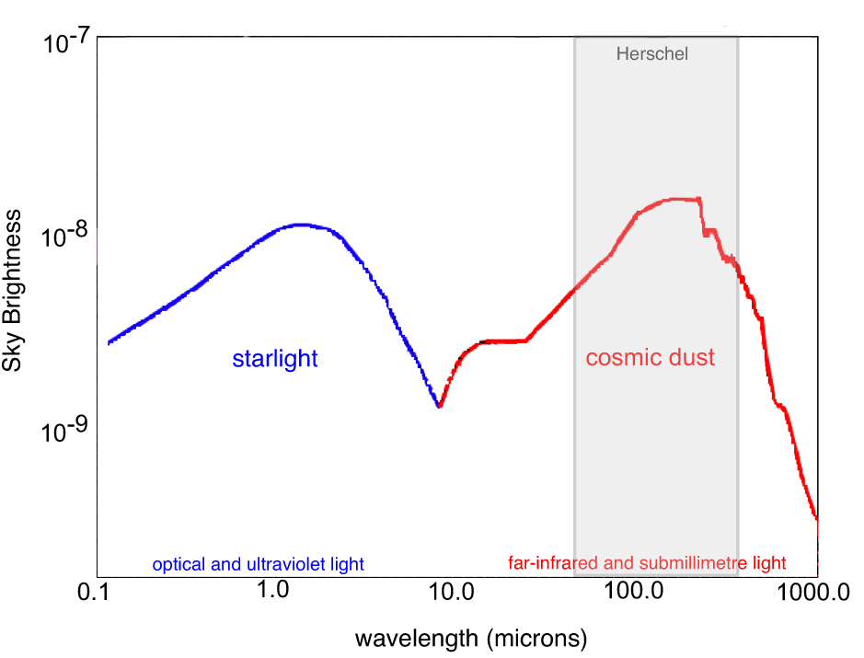
a surprising result…
optical
infrared
Notes:
half the energy bduget in IR

Slide 7
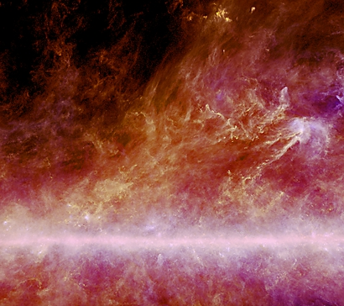

Star formation in Aquila
Planck + IRAS
100/350/540 μm
Notes:
----- Meeting Notes (20/04/2012 08:35) -----
two other satellites have mapped dust in our Galaxy but at much poorer resolution. Herschel's larger mirror makes sharper, more detailed images.

Slide 8
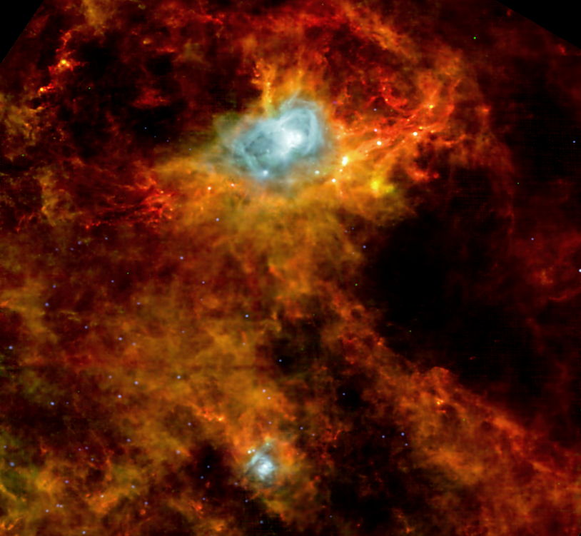
Star formation in Aquila
Herschel
70/160/500 μm
Planck + IRAS
100/350/540 μm

Slide 9
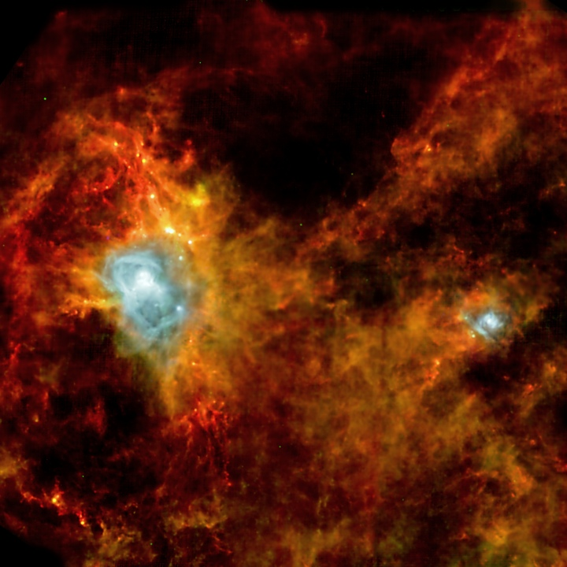
Credit: ESA and the SPIRE & PACS consortia, Ph. André (CEA Saclay) for the Gould’s Belt Key Programme Consortia
Notes:
Here we see Herschel’s view of the Aquila star forming region, located about 1000 light years away in our Galaxy. The image shows the combination of 70, 160 and 500 micronsand the bright regions are areas where large newborn stars are heating up hydrogen gas. Aquila is a stellar nursery completely invisible to optical telescopes (in fact, this is the first time its been seen in the infrared) and the image shows some pretty neat stuff. Firstly, in this image alone, astronomers have detected 700 candidates for stellar embryoes (stars which are about to be born). 100 of these candidates are in the protostar phase and are just waiting for the final step to start before they become a fully-fledged star - all they need is for nuclear fusion to ignite in the core and they are ready. The rest are likely to be in the stage before this. Secondly, we can clearly see that stars form in clumps along larger filaments of dust and gas (much like pearls on a necklace); these filaments are probably following magentic fields in the region. Gould’s Belt discovered by John Herschel. attributed to an american astronomer who published it. giant ring of stars that circles the night sky because the solar system just happens to lie near the centre of the belt.

Slide 10
What we want to know
What type of dust is it?
  Elements
  Mineralogy
  Morphology
  Sizes
Where is it formed?
When was it formed? Lifetime?

Slide 11
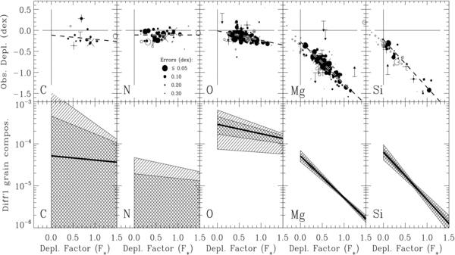
Gas-phase element depletions in the interstellar medium
Jenkins 2009
Notes:
Top row of panels: measured depletions (points) and the linear trends defined by the parameters A_{X}, B_{X}, and z_{X} in Equation (10) (dashed lines), as listed in Table 4, shown as a function of the generalized depletion parameter F* for the elements C, N, O, Mg, and Si. The solid points have N(H)>10^{19.5} cm^{–2}, while open ones have N(H) values below this range. The gray points represent sightlines that had only three elements to define their F* parameters, while the black ones represent those that had four or more elements. Upper and lower limit measurements are depicted with the arrows (and were not included in any analysis). Sight lines that crossed the galactocentric limits R_{GC} < 7 kpc or R_{GC} > 10 kpc are overlaid with crosses (+) or x's (×), respectively, to indicate that they were not used to define the linear trends for the elements. Bottom row of panels: differential consumptions of elements by number (relative to hydrogen) by dust grains for small changes in F*, again plotted as a function of F*. The trend lines that follow Equation (21) with the best values of A_{X} and B_{X} are shown with dark lines, while the allowable changes that can arise from the uncertainties in A_{X} and B_{X} are shown by the shaded regions. Uncertainties at the 1σ level are shown by the cross-hatched areas, while the envelopes for 2σ deviations have simple line shading in only one direction.

Slide 12
Concept of dust depletion
The depletion of an element X in the ISM is defined in terms of (a logarithm of) its reduction factor below the expected abundance relative to that of hydrogen if all of the atoms were in the gas phase,
[Xgas/H] = log{N(X)/N(H)} − log(X/H)
which is based on the assumption that solar abundances (X/H)are good reference values that truly reflect the underlying total abundances. In this formula, N(X) is the column density of element X and N(H) represents the column density of hydrogen in both atomic and molecular form, i.e., N(HI) + 2N(H₂). The missing atoms of element X are presumed to be locked up in solids within dust grains or large molecules that are difficult to identify spectroscopically, with fractional amounts (again relative to H) given by
(X_{dust}/H) = (X/H)(1 − 10^{[Xgas/H]}).
Jenkins 2009
Notes:
The line-of-sight depletion strength factor, which we denote as F∗, represents how far the depletion processes have progressed collectively for all elements for any given case, i.e., a larger F∗ implies a stronger depletion for all elements.

Slide 13
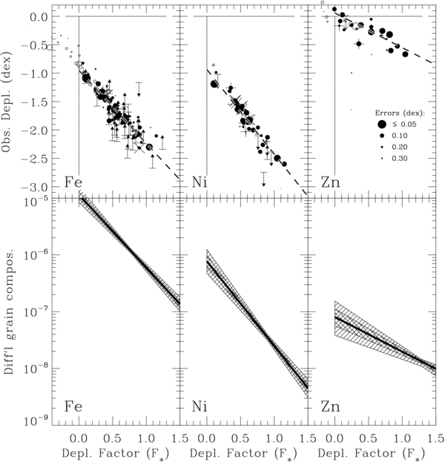
Jenkins 2009

Slide 14
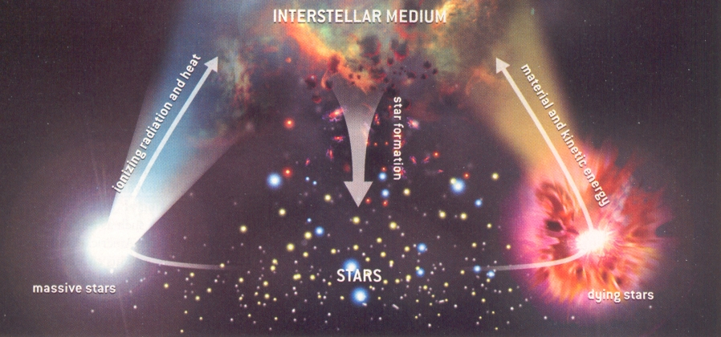
Recycling
Stars > 8 M_{sun}: Short lived (< 1 Gyr)
Produce most of the heavier elements, especially all rapid neutron capture elements
Stars < 8 M_{sun}: Long lived (> 1 Gyr)
Produce mainly C, O and N but also slow neutron capture elements
Notes:
Where can dust form?

Slide 15
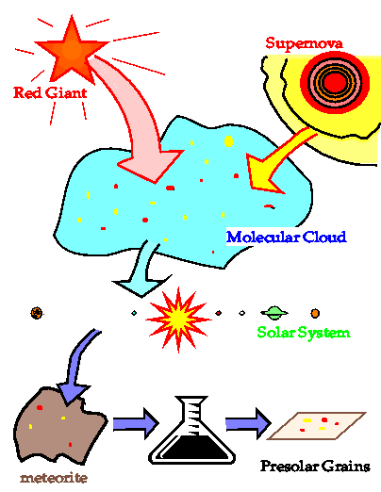
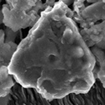
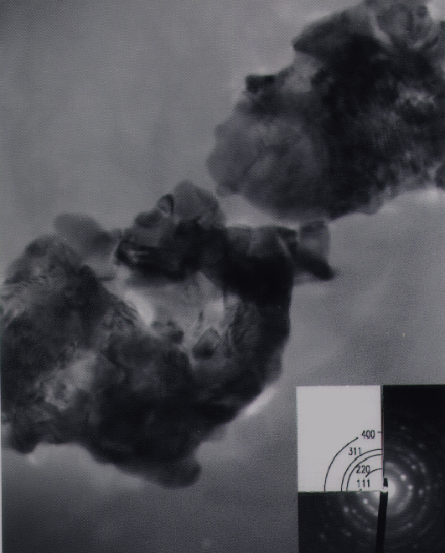
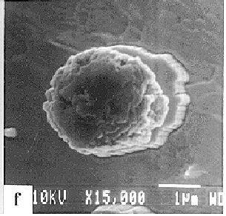
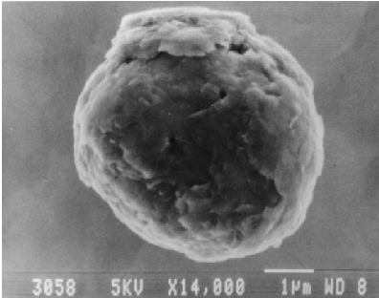
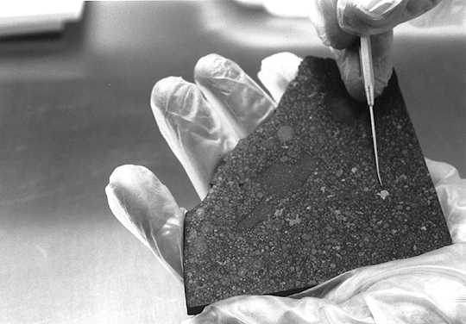
Presolar grains
Discovered in 1987 that primitive meteorites contain small quantities of presolar grains.
SiC
10 parts per million
0.1-10μm
Diamond
1000 parts per million
Size ~ 1-5 nm
Allende
Al₂O₃
0.1 parts per million
1-5μm
Graphite
2 parts per million
1-10μm

Slide 16
How do we know?
>99.99% of Solar System
>99.99% of Solar System

Slide 17
How do we know?
SiC Stardust
O-rich Stardust
Isotopic ratios in grains extremely unusual and distinct from ranges found in solar system material

Slide 18
How do we know?
SiC Stardust
C-rich Stars
O-rich Stardust
Isotopic variations require nuclear processes.
Origin in STARS

Slide 19
Presolar Stardust
Each presolar grain is a solid piece of a single star at a given time in its evolution
  Isotopic/elemental composition is fossil record of nucleosynthesis
Laboratory measurements of grains provide detailed information about stellar/interstellar/ early solar system processes
  Such analyses possible by modern techniques despite small sizes of grains (<1μm)

Slide 20
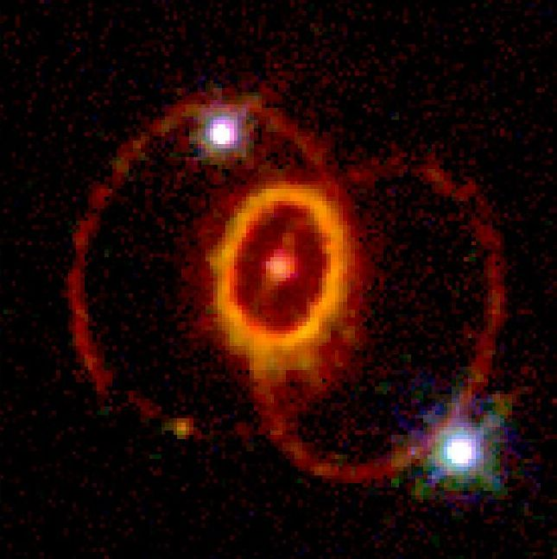
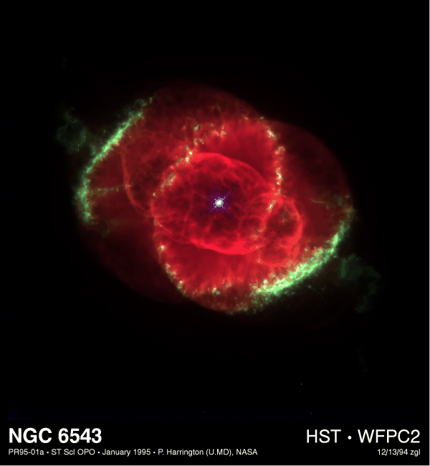
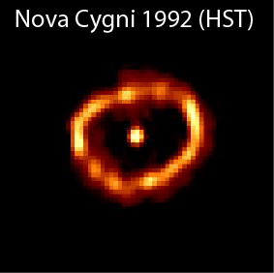
Sources of Presolar Stardust Grains
Type II Supernovae
<10% of SiC, Silicates, Oxides, <50% Graphite, 100% Si₃N₄
Asymptotic Giant Branch (AGB) stars:
>90% of SiC, Silicates, Oxides
Classical Novae
<1% SiC, Silicates, Oxides, Graphite

Slide 21
Overview
We have from presolar grains an idea of:
  Grain types (mineralogy and crystalstructure).
  Grain sizes.
  Grain morphology.
We have from Standard Abundance Distribution (SAD) an idea of:
  The relative (solar) abundance of elements.
  From nuclear physics and explanation for the r, s and p-proceses.
We have from stellar evolution an idea of:
  Which stars produces the different elements (and isotopes) in their interior through nuclear fusion and neutron capture.
We have from depletion patterns of the ISM an idea of:
  Which elements are locked up in dust grains.

Slide 22
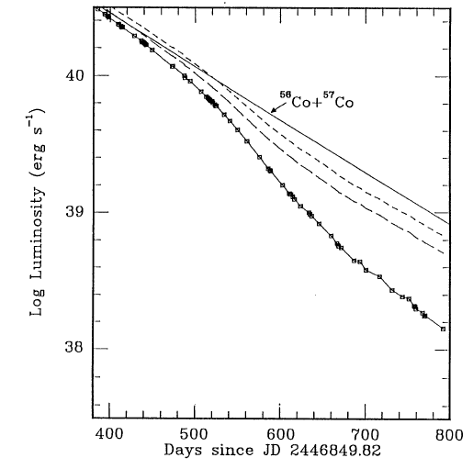
Dust formation in 1987A
Theoretical light curve (⁵⁶Co+⁵⁷Co decay only)
Observed light curve
Dust extinction
Whitelock et al. 1989

Slide 23
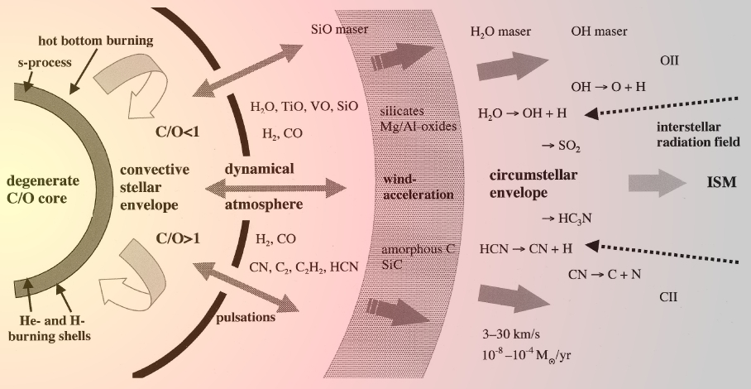
AGB star: not to scale!
Habing & Olofsson, 2003, Asymptotic Giant Branch Stars, Springer

Slide 24
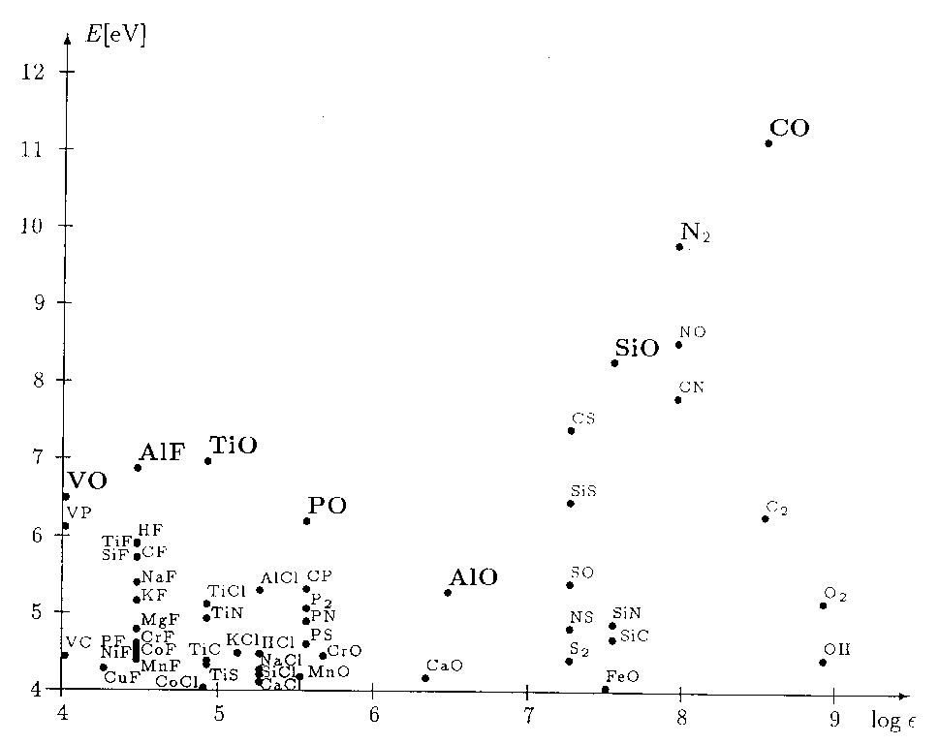
Bond energies of abundant elements

Slide 25
AGB star: not to scale!
Habing & Olofsson, 2003, Asymptotic Giant Branch Stars, Springer

Slide 26
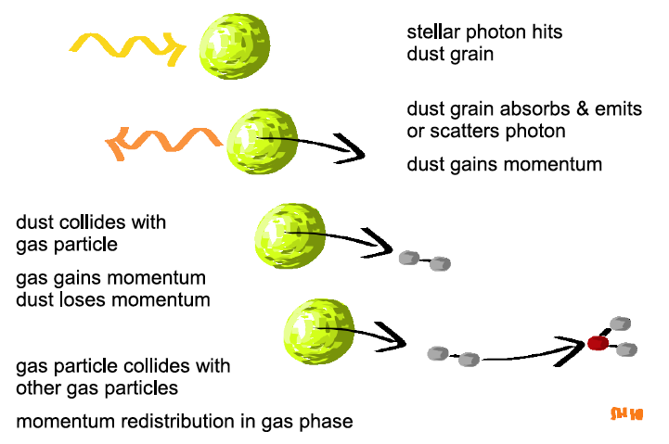
Microphysics of dust-driven winds
Dust grains acquire momentum from stellar photons and transfer it to the surrounding gas via collisions.
Höfner 2011

Slide 27
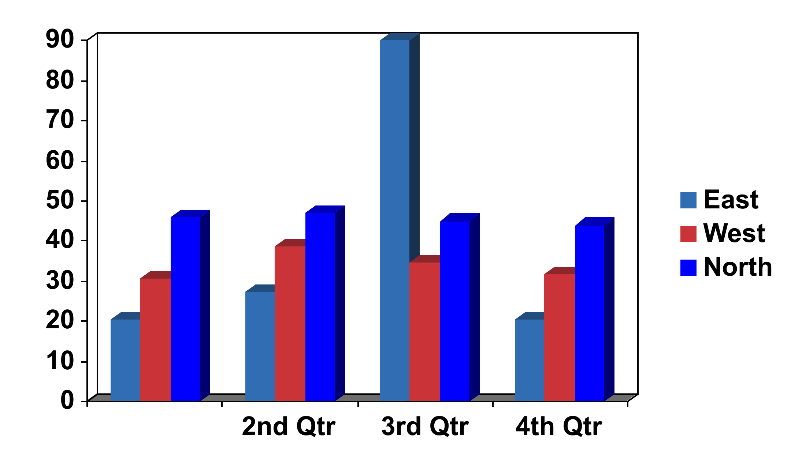
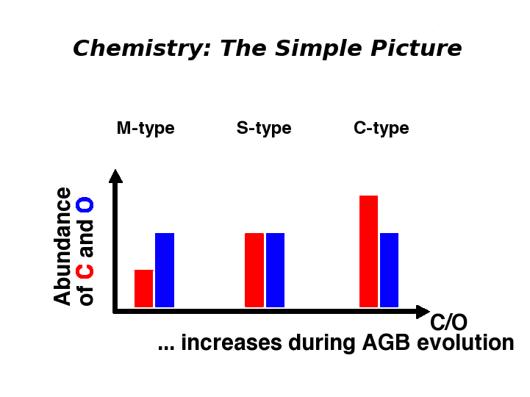
AGB star chemistry – the simple picture
CO
CO
CO
after Susanne Höfner 2008

Slide 28
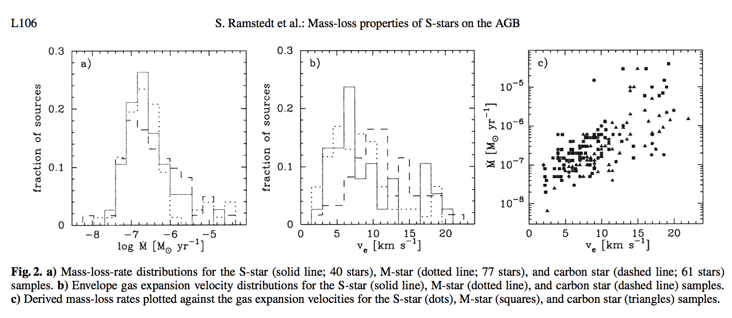
Dust driven mass loss of AGB stars Observations
Mass loss rates
Wind velocity distribution
S-stars (solid line), M-stars (dotted line), C-stars (dashed line)
Ramstedt et al. (2006)

Slide 29
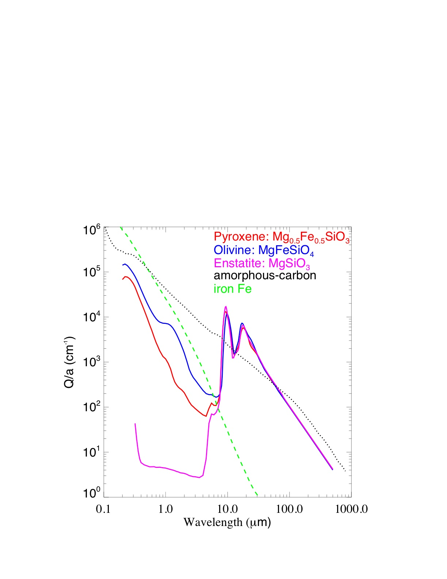
Extinction efficiency of Silicates
Calculated extinction efficiency for different types of silicates (Dorschner et al. 1995, Jäger et al. 2003), amorphous carbon (Jäger et al. 19989, iron (Palik 1985).

Slide 30
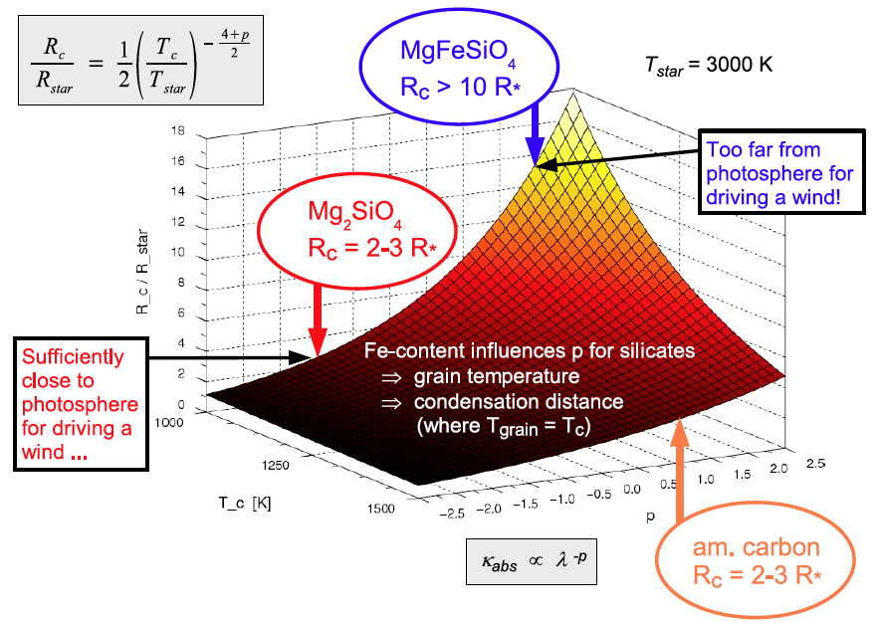
Dust condensation distances in AGB stars
Höfner 2011
Condensation distance R_{c} (in units of the stellar radius R) as a function of the power law index of the absorption coefficient p for a range of condensation temperatures Tc (assuming a stellar temperature of T= 3000 K.

Slide 31
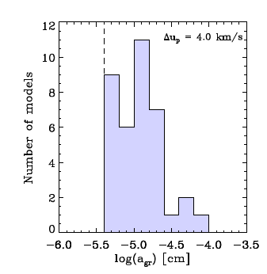
Theoretical models of dust in AGB stars
At best 30 − 50% dust efficiency
Grain size distribution
  C-rich stars ~0.1 μm
  O-rich stars ~1 μm
  or larger
Very large grains!
Mattsson & Höfner 2011

Slide 32
Implication on dust from AGB stars observations and theory
AGB stars have intense mass loss.
If dust driven is it then C-dust that drives all mass loss of C, M and S stars? Or is it scatter on micron-sized Fe-free silicates? Or something else?
Fe bearing dust is difficult to form due to the high opacity which makes the grains very warm compared to the gas. Such dust cannot drive the mass loss in AGB stars.

Slide 33
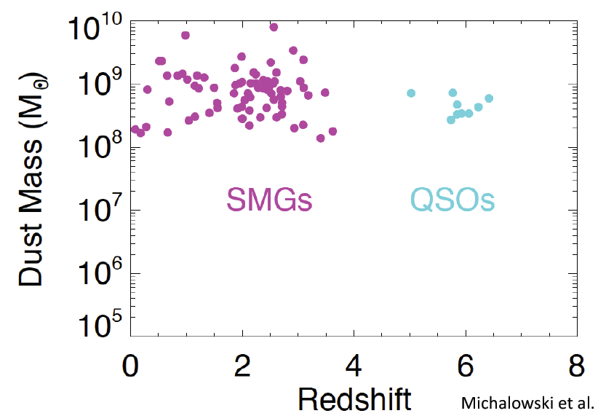
Large amounts of dust at high redshift
Bertoldi et al. 2003 and many others note especially SCUBA. Michalowski et al. 2011
Notes:
SMGs = submilimeter galaxies

Slide 34
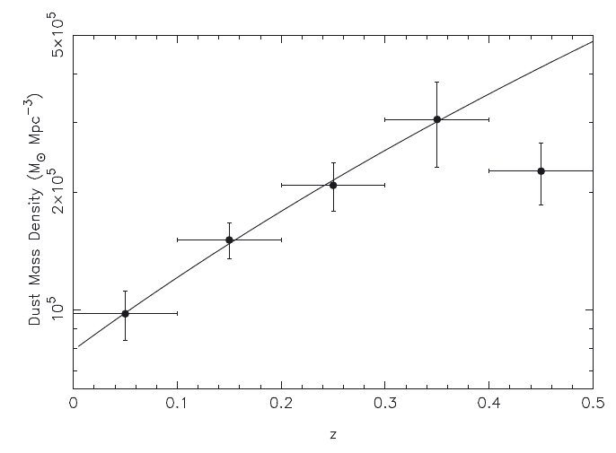
Rapid evolution of dust in galaxies over the last 5 billion years
Integrated dust mass density as a function of redshift for Herschel ATLAS
Dunne et al. 2011
Notes:
The DMF and dust mass density shows strong evolution out to z = 0.4–0.5. In terms of pure mass evolution this corresponds to a factor of 4–5 increase in the dust masses of the most massive galaxies over the past 5 billion years. (iii) Similar strong evolution is found in the ratio of dust-to-stellar mass and V-band optical depth – Herschel-selected galaxies were more dusty and more obscured at z = 0.4 compared to today. (iv) In order to account for the evolution of the dust content we need to radically alter chemical and dust evolution models. We cannot reproduce these trends with Milky Way metal or dust yields or star formation efficiencies.

Slide 35
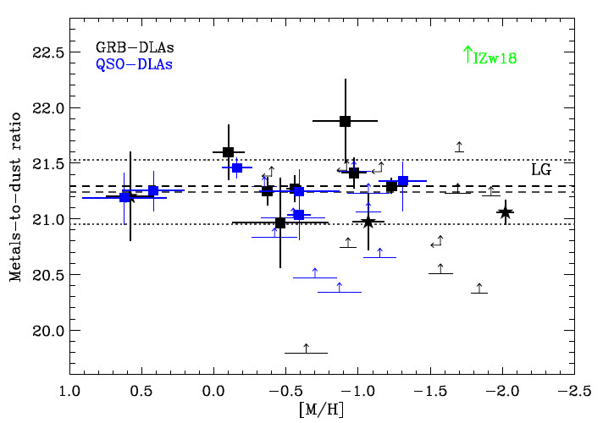
Metal-to-dust ratio vs. metallicity
There seem to always be the same fraction of metals locked up in dust.
Zafar & Watson 2013
Notes:
The DMF and dust mass density shows strong evolution out to z = 0.4–0.5. In terms of pure mass evolution this corresponds to a factor of 4–5 increase in the dust masses of the most massive galaxies over the past 5 billion years. (iii) Similar strong evolution is found in the ratio of dust-to-stellar mass and V-band optical depth – Herschel-selected galaxies were more dusty and more obscured at z = 0.4 compared to today. (iv) In order to account for the evolution of the dust content we need to radically alter chemical and dust evolution models. We cannot reproduce these trends with Milky Way metal or dust yields or star formation efficiencies.

Slide 36
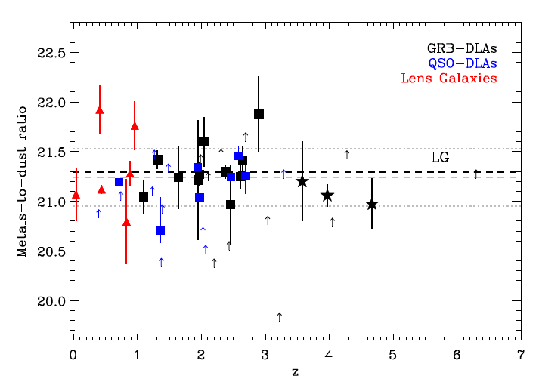
Metal-to-dust ratio vs. redshift
There seem to be a more or less constant metal-to-dust ratio with cosmic time.
Zafar & Watson 2013
Notes:
The DMF and dust mass density shows strong evolution out to z = 0.4–0.5. In terms of pure mass evolution this corresponds to a factor of 4–5 increase in the dust masses of the most massive galaxies over the past 5 billion years. (iii) Similar strong evolution is found in the ratio of dust-to-stellar mass and V-band optical depth – Herschel-selected galaxies were more dusty and more obscured at z = 0.4 compared to today. (iv) In order to account for the evolution of the dust content we need to radically alter chemical and dust evolution models. We cannot reproduce these trends with Milky Way metal or dust yields or star formation efficiencies.

Slide 37
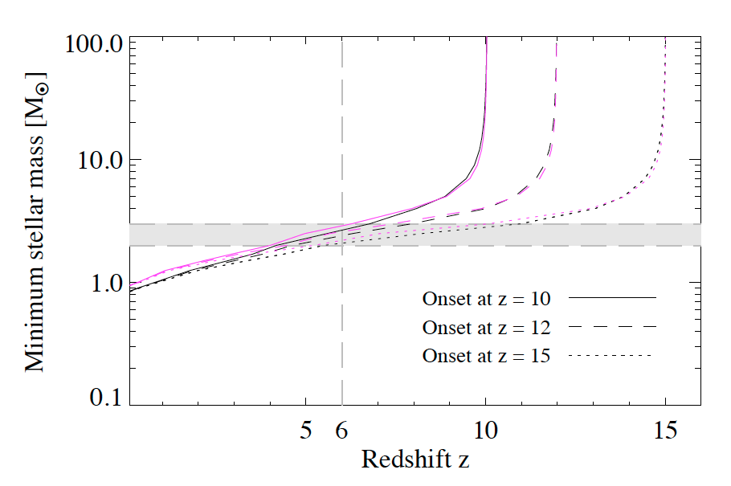
Stellar lifetimes vs. redshift for different onset of star formation and metalicities
High-z QSO
Metalliciteis: Z=0.001 (black) and Z=0.040 (magenta)
Gall et al., 2011
Notes:
Relation between stellar mass, stellar lifetime and redshift in the early Universe. The graphs show the minimum ZAMS mass of a star dying at a given redshift for an onset of star formation at three different epochs: z = 15 (dotted curves), z = 12 (dashed curves) and z = 10 (solid curves). The colour coding corresponds to different metallicities: Z = 0.001 (black) and Z = 0.040 (magenta). The vertical dashed line marks a star dying at z = 6, similar to the highest-redshift QSOs known. The grey shaded region indicates stars with masses between 2–3 M⊙. The metallicity dependent lifetimes are taken from Schaller et al (1992) Schaerer et al (1993) and Charbonnel et al (1993). The cosmological model used is a ΛCDM Universe with H0 = 70 km s−1 Mpc−1, Ωm = 0.3 and ΩΛ = 0.7.

Slide 38
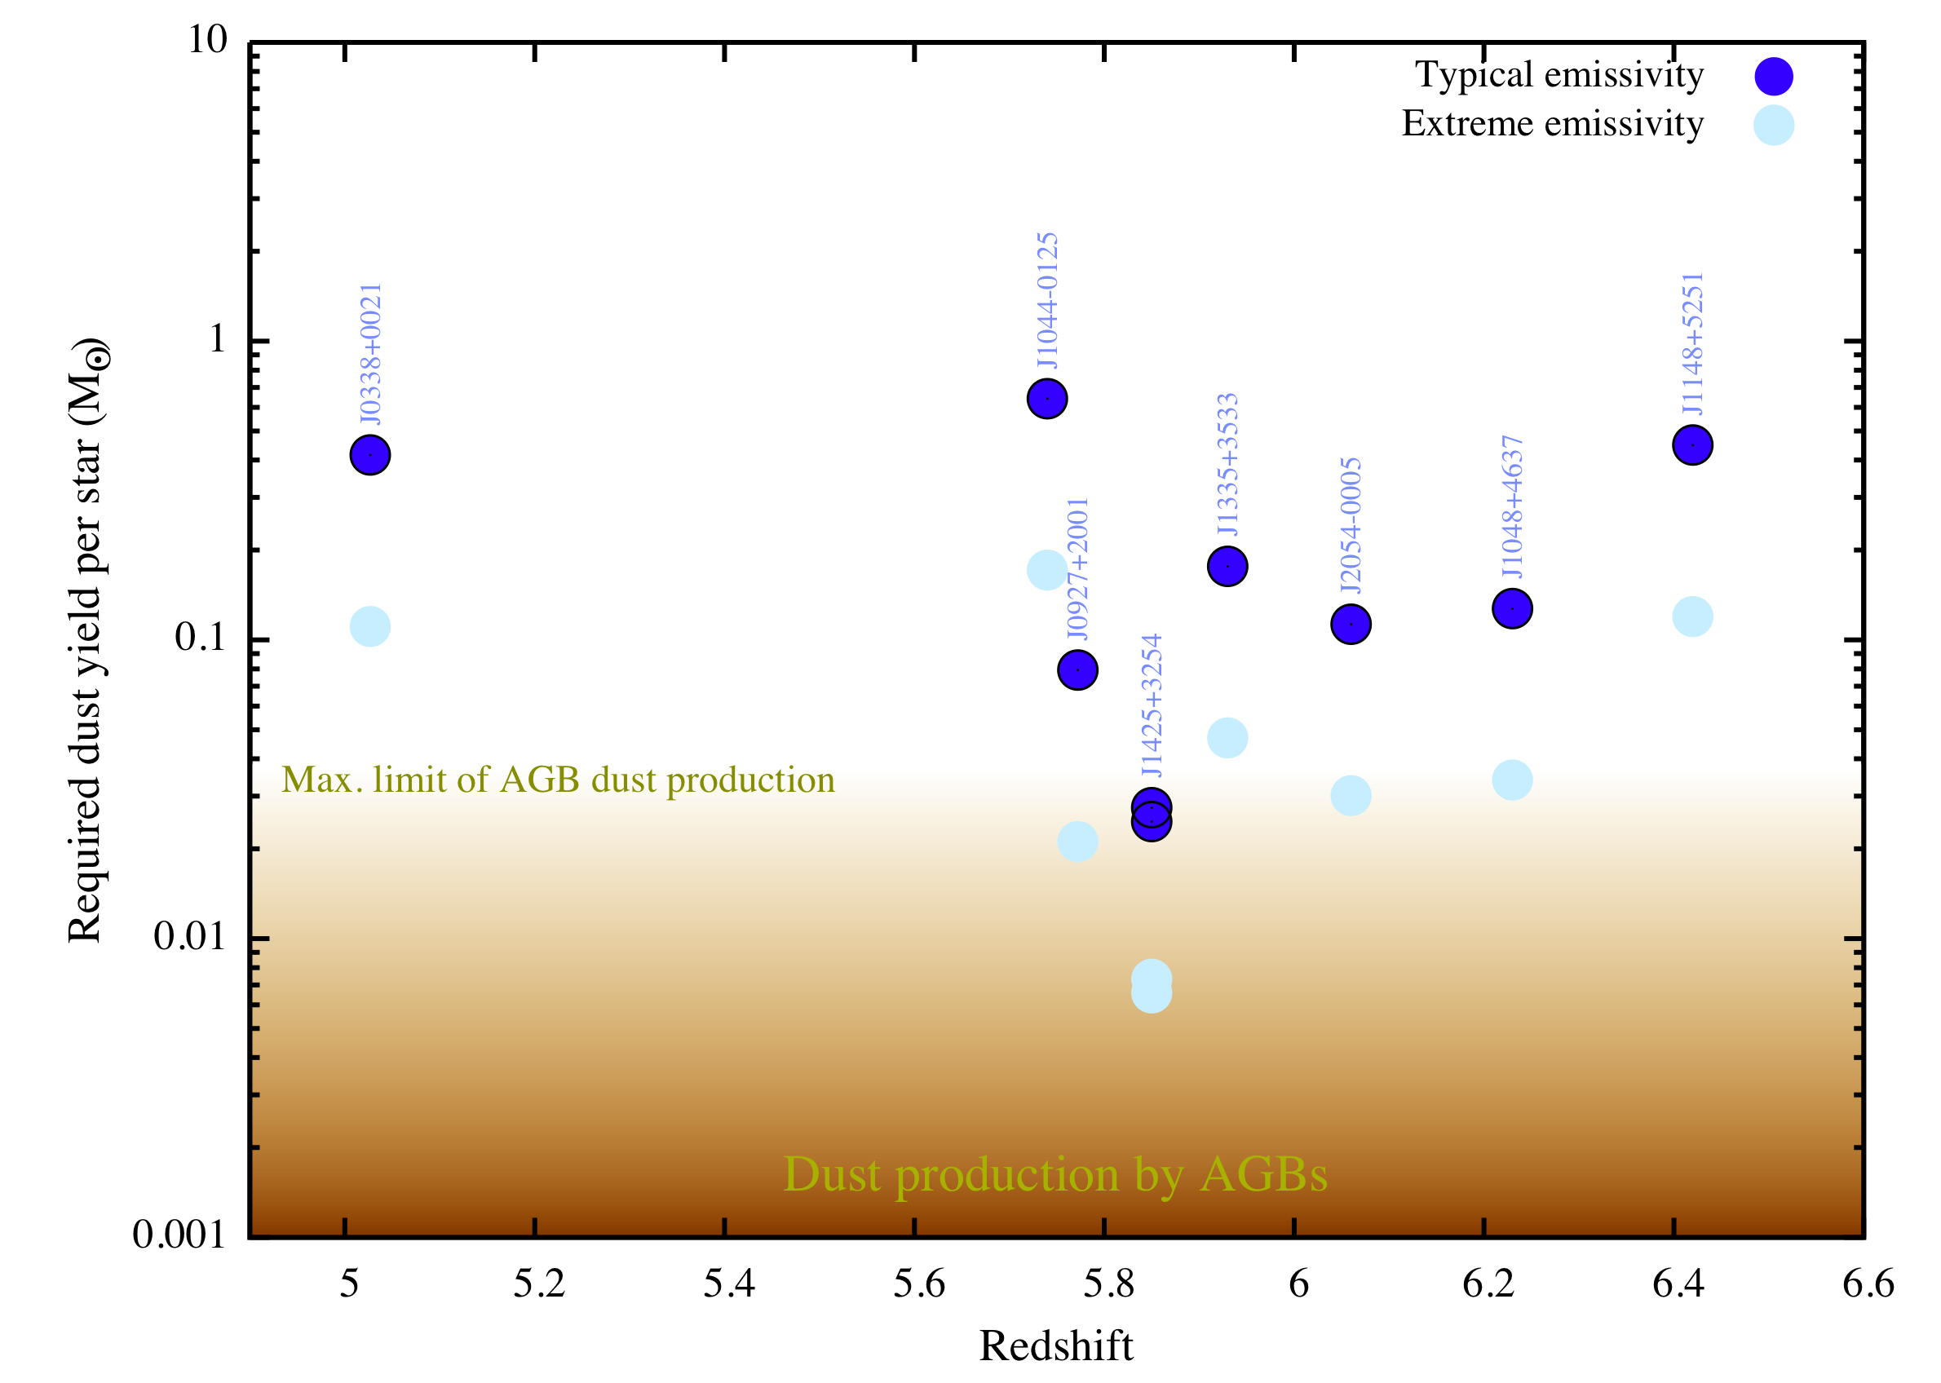
Mystery: what are the dust sources?
Large dust masses in high-z QSOs – mm/submm
Hot dust scales with BH masses (z≈6) – MIR with Spitzer
Dusty BALQSO (J1048+4637; z=6.23) – peculiar extinction curve
GRB071025; z≈5 – extinction curve
Michalowski et al., 2010
Notes:
Remember to add an extra y-axis with stellar lifetimes
The required dust yield in order to explain the dust mass in those quasars

Slide 39
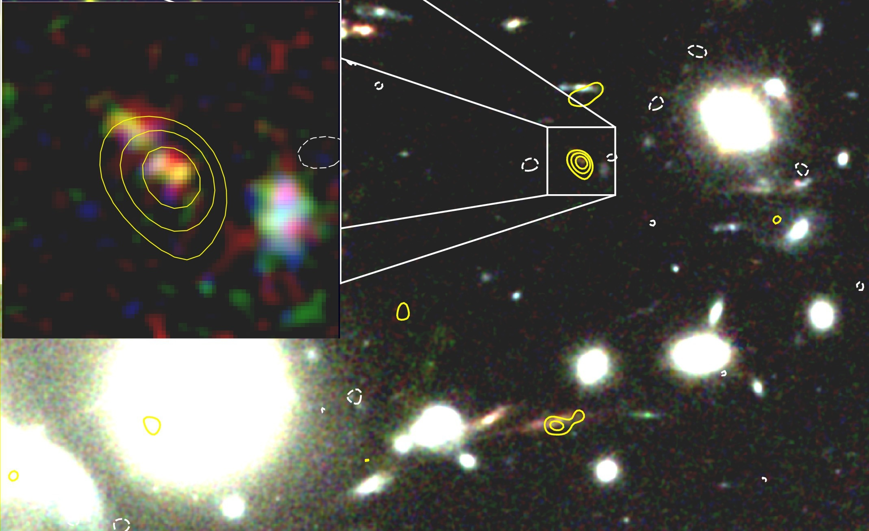
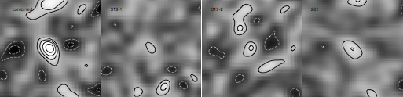
ALMA and VLT observations of the cluster lensed dust galaxy at z=7.4. Dust mass 4x10⁷ M_{sun}
Watson et al. 2015 GHz

Slide 40
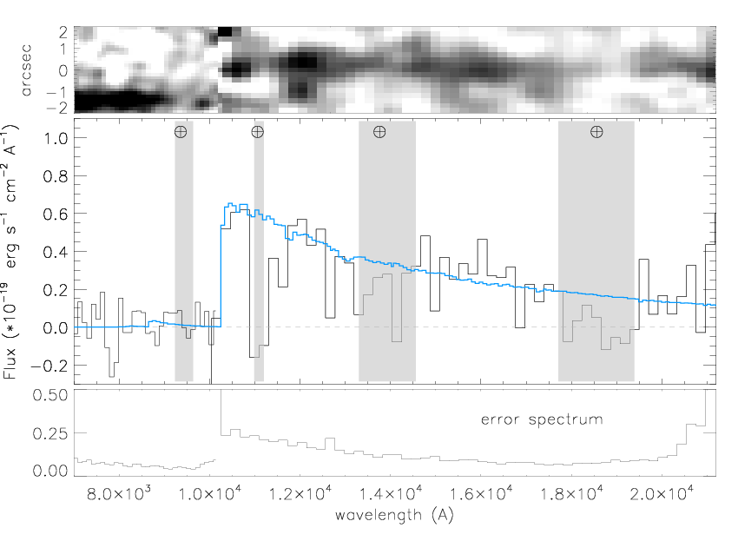
Spectroscopic redshift – so properly OK!
Watson et al. 2015

Slide 41
Implications of the observations
The maximum time available to build up large dust masses is at most ∼400–500 Myr, and possibly less.
The universe have been at least as dusty and possibly even more dusty at earlier epochs.

Slide 42
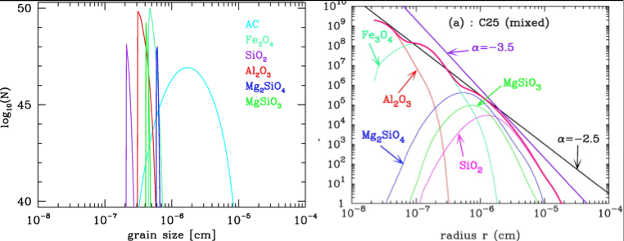
Supernova grain size predictions
Grain sizes 0.001 – 0.008 μm
assuming a lattice spacing of 2-3 Å
=> few hundred to 1000 atoms per grain.
Nozawa et al. 2003

Slide 43
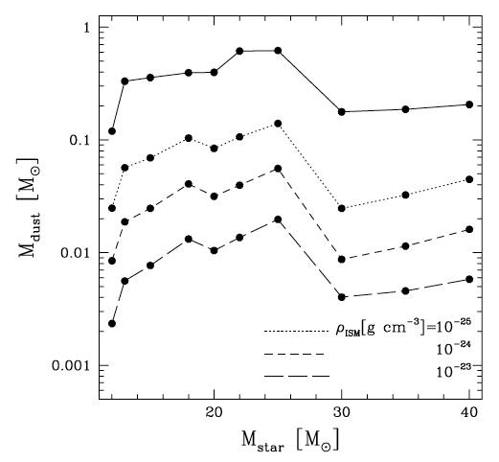
Supernova dust production efficiency
Bianchi & Schneider 2007
Mass of dust that survives the passage of the reverse shock in the ejecta, as a function of the mass of the progenitor star and of the density of the surrounding ISM.

Slide 44
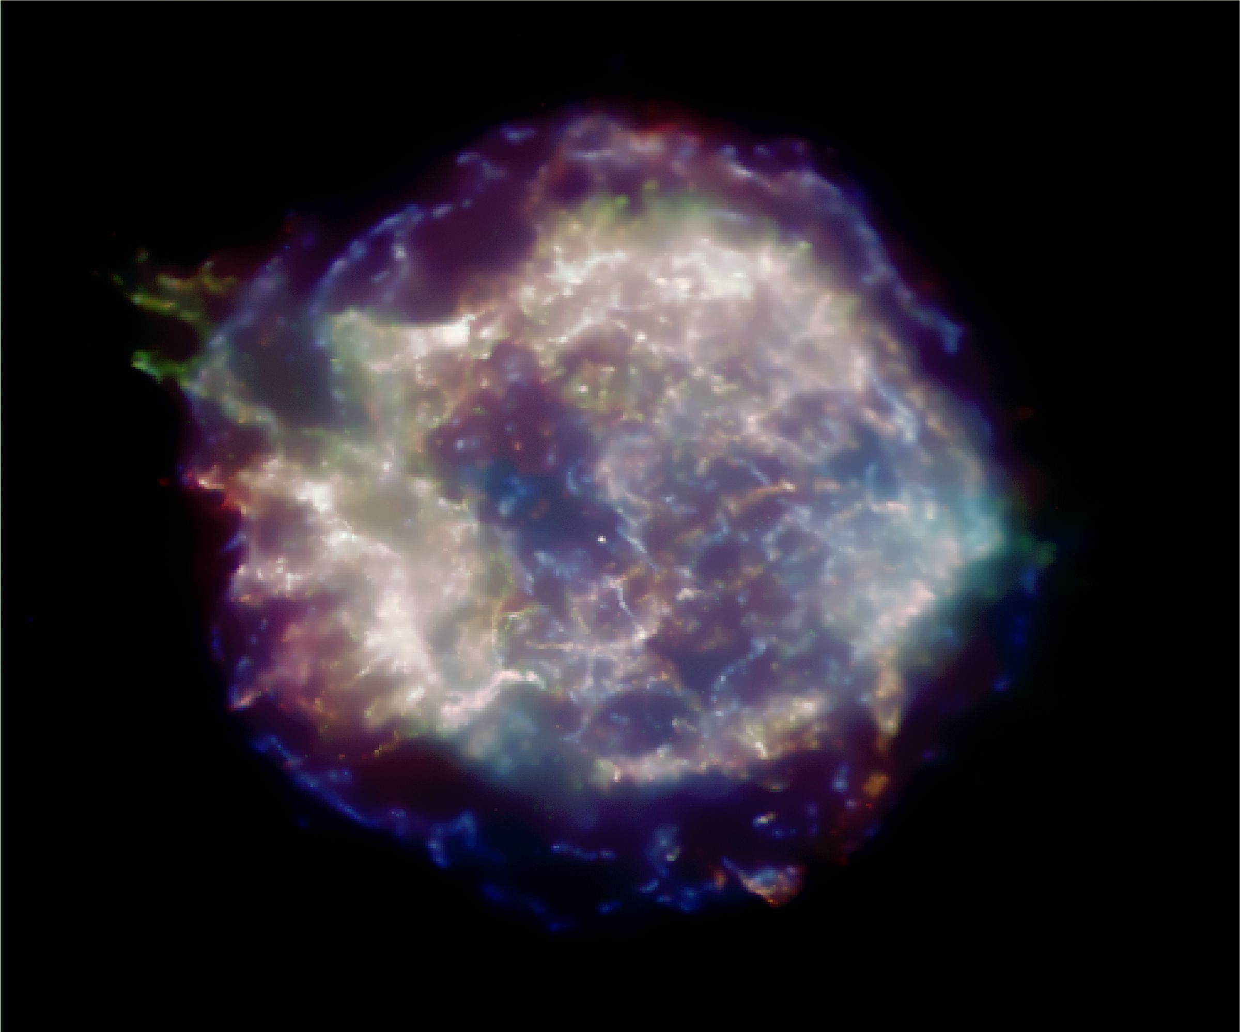
Observations of dust in supernova Cas A
Dunne et al. (2003) estimated ~2–4M_{sun} dust from observations ith SCUBA on JCMT.
Krause et al. (2004) could not confirm this with Spitzer observations.
Picture from Chandra
Notes:
About 300 years old. Maybe a ~20 Msun progenitor

Slide 45
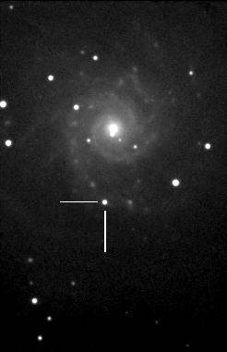
Type II SN 2003gd in NGC 628
One of three cases where the progenitor (~9M_{sun}) of a supernova could be identified (the other two are SN1987A in LMC and SN1993J in M81).
Sugerman et al. (2006); estimates 0.02M_{sun} of dust.
Meikle et al. (2007); cannot confirm this.
Photo Ted Dobosz

Slide 46
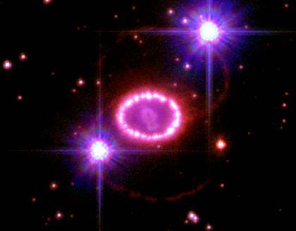
Herschel looked at supernova 1987A
Nearest supernova explosion detected in 400 years
  Only 50 kpc – the Large Magellanic Cloud
Relatively well-isolated from ISM gas/dust
  C.f. Galactic supernova remnants
Type II (core-collapse supernova)
  high-mass star in origin

Slide 47
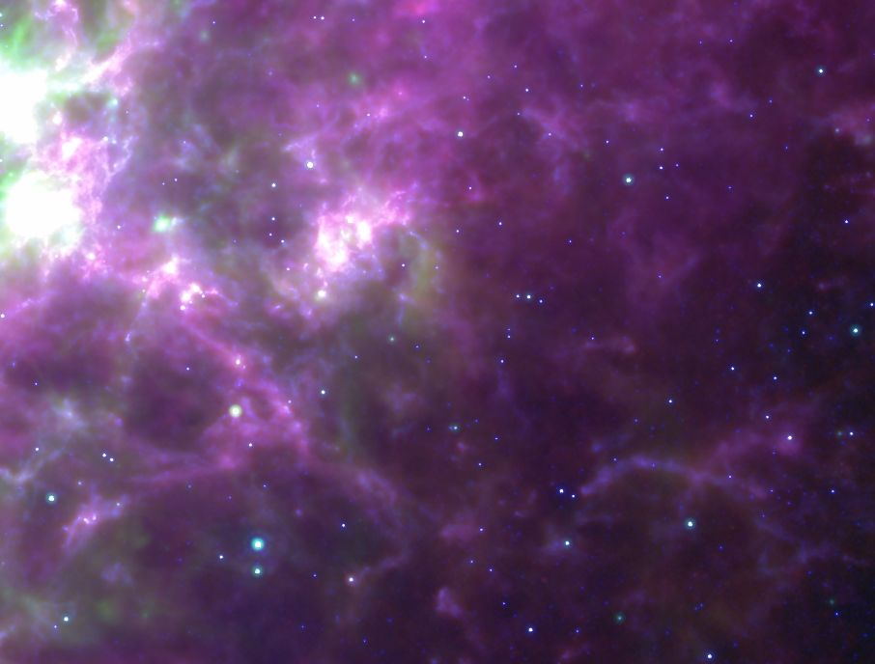
Herschel detection of cold dust
Herschel 250 micron from HERITAGE
(Meixner et al 2013)
Spitzer 8 micron + 24 micron
Matsuura et al. (2011, Science 333, 1258)
Notes:
In total, Herschel detected SN 1987A from 100 to 350 micron. This is very well isolated point source, and just avoiding molecular clouds nearby.

Slide 48
Dust mass in SN 1987A
Significantly large dust mass:
  0.4-0.7 M of dust
    Previously reported dust mass: 10⁻⁶ -10⁻⁴ M
    Progenitor star: 20 Msun
  T=17-25 K depending on dust grains
Luminosity (Lsun)
Wavelength (micron)
Matsuura et al. (2011, Science 333, 1258)

Slide 49
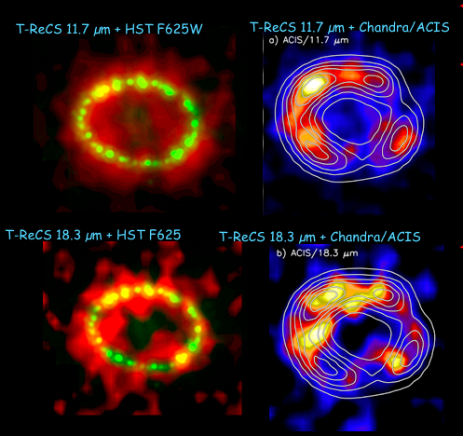
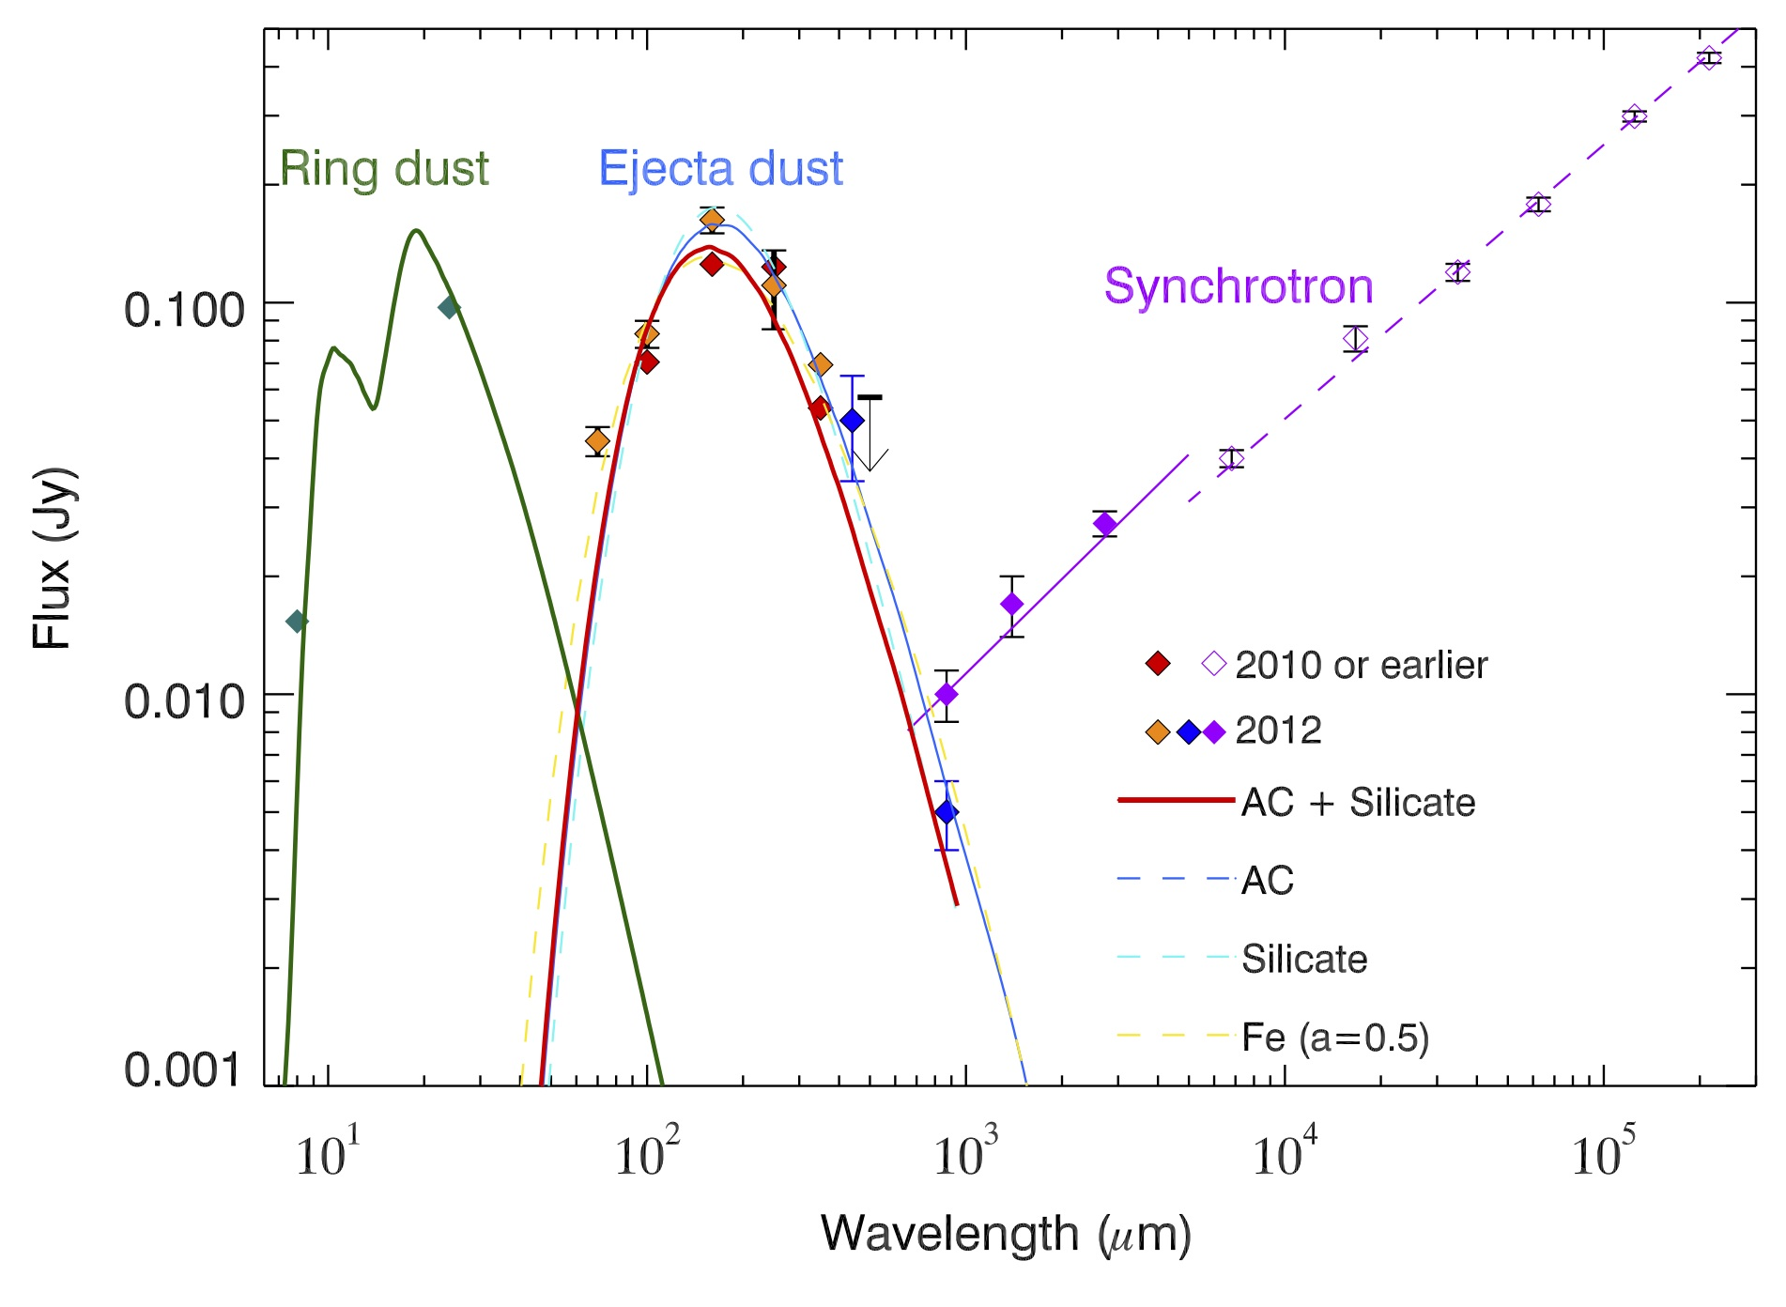
The locations of dust within SN 1987A
Bouchet et al. (2006)
10 μm: dust from the ring
~10⁻⁶ M of dust
Ejecta
  0.4-0.7 M of dust must have formed from SN ejecta
Ring: progenitor
Notes:
Circumstantial evidence:
Red supergiant phase: 20,000 years before the explosion (Woosley et al. 1997, astro-ph)
Ambient ISM dust: SN sweeps up dust in the ambient ISM; 3x10⁻⁶ Msun of dust
Rd-supergiant phase: 0.03 Msun of silicate -> 2.4 silicate required

Slide 50
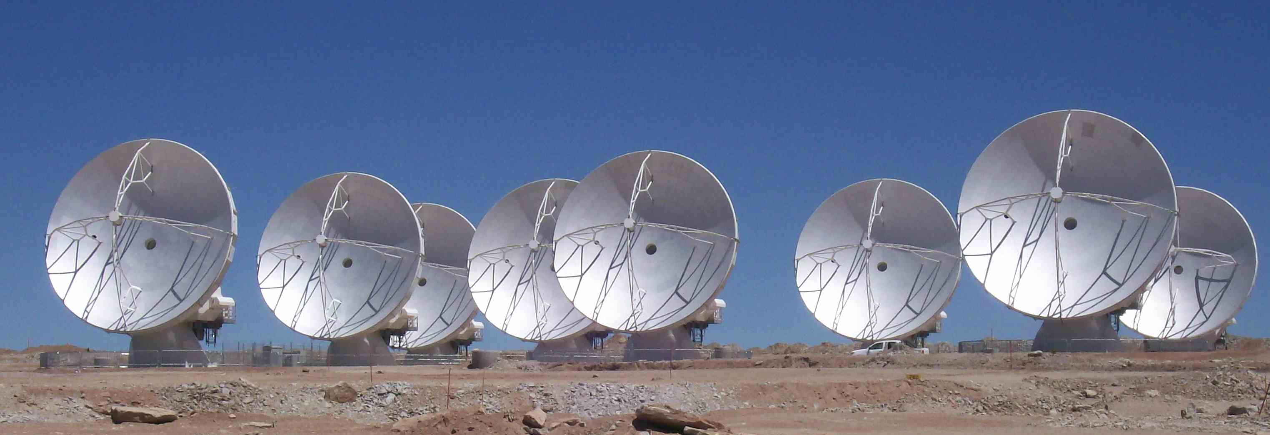
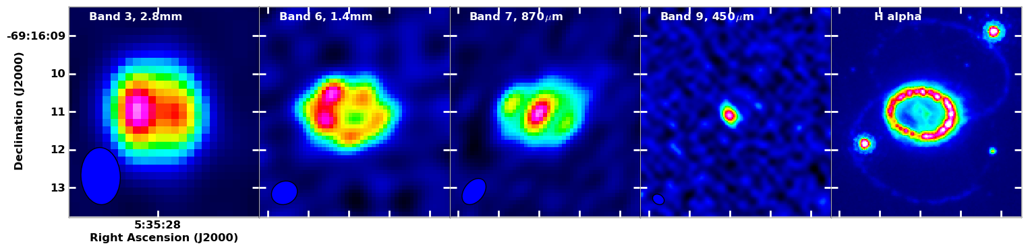
ALMA confined the location of cold dust
450 micron
Dust
1.4 mm
Synchrotron
H alpha
Cold dust in ejecta
SN ejecta
Ring: progenitor star
Indebetouw, Matsuura et al. (2014, ApJ, 782, L2)
Notes:
Expanding shell:
Ring; 100 km s-1
SN ejecta: ~2000 km s-1
Shocks heat the ring / X-ray illumination
Ejecta cools down radiatively in 25 years; temperature below 100K

Slide 51
ALMA photometric points
ALMA (ejecta)
Herschel

Slide 52



Shock destructions in future?
Shocks: largely depending on the presence of ambient ISM gas
Cassiopeia A (AD 1681?)
Crab Nebula (AD 1054 )
Supernova 1987A
Forward shocks
Dust
Reverse shocks
Gotthelf et al. (2001)
No shock detected
Reverse shocks in 2011

Slide 53
Implication on dust from SN theory and observations
SNe forms most of the elements.
Theoretical models predict (significant) dust formation to occur in the remnant around year 2.
Theory predicts small grain sizes. Presolar SN grains are large. Recent observations might indicate large (Gall et al. 2014, SN2010jl).
Dust efficiency unclear as it depends on the harsh environment, reverse shock, clumps.
Observations indicate insufficient amounts of warm dust to explain the high-z observations. While cold dust currently holds a lot of promises.

Slide 54
Dust from SNe
Large amounts of dust (>10⁸M_{sun}) discovered in high red-shifts quasars (e.g. Bertoldi et al. 2003) and galaxies (e.g. Hughes et al. 1998) when the Universe was 1/10 its present age.
AGB stars are not believed to be able to produce dust on timescale <1Gyr.
Theoretical models of SN predict around 0.2 - 4 M_{sun} of dust per SN (e.g. Kozasa et al. 1989; Todini & Ferrara 2001). Reverse shock?
Observational evidence difficult as SN explosions are rare.

Slide 55

Dust shell around high mass star found by the Spitzer telescope
Gvaramadze et al. 2010
Wachter et al. 2010

Slide 56
General dust facts
Nucleation – requires supersaturation pressure
Change of dust mass:
  Growth – when smaller dust particle increase its size
  Destruction – when dust grain evaporates into gas phase
No change of dust mass:
  Shattering – when larger grain is spilt into smaller dust grains
  Coagulation – smaller grains form larger grains
Elements available for dust: C, O, Mg, Si, S and Fe
Notes:
ratio of the actual partial pressure of the monomers in the gas phase to the vapor saturation pressure with respect to the dust temperature.

Slide 57
Is interstellar dust mainly stardust?
We observe dust forming in stellar outflows and entering the ISM.
Two types:
  Silicate dust in outflows from stars with O/C > 1
  Carbonaceous dust in outflows from stars with O/C < 1
Interstellar grains – we see two principal materials:
  Silicate grains
  Carbonaceous grains
Conclusion: Interstellar Dust is Stardust.
Bruce Draine 2009:
  Stardust is present in the ISM, but it accounts for only a small fraction (<10%) of the total mass of interstellar dust.

Slide 58
Grain growth in the ISM
Silicate stardust found in meteorites is ~20% crystalline (Keller 2008).
Interstellar silicates are < 2% crystalline (Kemper et al. 2005).
These two observations might indicate that ≤ 10% of the interstellar silicate material is stardust, while ≥90% is grown in the ISM, since (≤ 10%) × 20% → ≤ 2%

Slide 59
Implications from grain theory
Nucleation of dust grains can only happen in stellar environments where densities are high enough for supersaturation pressures to occur. Dust seeds – the first tiny mineral that condense out of the gas phase – can most likely only form in stellar environments.
Grain growth can happen both in stellar environment and in the ISM.

Slide 60
Dust Sources
Dust sources
  SN
    seem plausible after Matsuura et al. 2011 that SNs are major dust produces, it is certain that they provide very relevant elements (i.e. Si).
  AGB
    They should certainly not be ignored, as they provide both very relevant elements (C) and specific dust types.
  ISM
    The SN and AGB just needs to provide the seeds and the metals for grain growth in the ISM.

Slide 61
Conclusions
Dust sources at high-z still not clear, but SN seems a likely source while AGB stars are minor contributions at best. Grain size distribution an issue? Stars need to provide the seeds.
However, ISM dust growth can easily occur as any galaxy that is able to convert H to H₂ (via catalysis on grain surfaces) has densities that allow conversion of C, Mg, Si, Fe in gas to solid material (these atoms will also collide with grain surfaces).
Grain mass may be grown in the ISM with grain size distribution maintained by balance between grain growth (surface growth, coagulation) and destruction (sputtering, shattering in grain-grain collisions,…)

Slide 62
Can we distinguish between the SN vs. ISM scenario?
High-SN dust efficiency – supernova produce all the dust
  Crystalline dust?
  Both C-dust and silicates?
  Grain size distribution?
High ISM growth efficiency – supernova provides the seeds and the metals, but most is grown in the ISM
  Amorphous dust?
  Dirty silicates?
  Grain size distribution?

Slide 63
CO divides dust nucleation and growth into two different chemical paths
C/O > 1 Carbon chemistry (molecules: C₂, CN, CH, C₂H₂, C₃, HCN). Possible dust types: graphite (C), amorphous carbon (C), diamond (C), silicon carbide (SiC),…
C/O < 1 Oxygen chemistry (molecules: OH, SiO, TiO, H₂O, TiO₂, VO, ZrO, ScO, YO, LaO). Possible dust types: enstatite (MgSiO₃), olivine (MgFeSiO₃), ferrosilite (FeSiO₃), pyroxene (MgFeSiO₄), forsterite (Mg₂SiO₄), fayalite (Fe₂SiO₄),…

Slide 64
Magnesium-iron silicates
The most stable condensate formed from the abundant elements O, Si, Mg and Fe.
Mg_{2x}Fe_{2(1-x)}SiO₄ with x∈[0,1]
x=1 → fosterite, x=0 → fayalite, 0<x<1 → olivine
Pure fosterite is stable up to much higher temperatures, than pure fayalite.
Mg_{x}Fe_{(1-x)}SiO₃ with x∈[0,1]
x=1 → enstatite, x=0 → ferrosilite, 0<x<1 → pyroxene
Notes:
Magnesium is a zoo of materials.

Slide 65




Dust Extinction Curves with GRBs
Notes:
050401
090926A
You can only get the absolute extinction curves when you have xray or mid IR data, but even with just UV-vis-nearIR one can determine relative extinction curves
Where is the power law, what are the lines? You need to know what is on that spectrum.
Do not show anything that you do not understand
Make a cartoon which shows power law of extinced and unextinced spectrum,

Slide 66


Template of synthetic extinction curves
.
Notes:
Galaxy mass
metallicity
age
IMF

Slide 67
General dust facts
Nucleation – requires supersaturation pressure
Change of dust mass:
  Growth – when smaller dust particle increase its size
  Destruction – when dust grain evaporates into gas phase
No change of dust mass:
  Shattering – when larger grain is spilt into smaller dust grains
  Coagulation – smaller grains form larger grains
Most abundant elements available for dust:
  C, O, Mg, Si, S and Fe
Notes:
ratio of the actual partial pressure of the monomers in the gas phase to the vapor saturation pressure with respect to the dust temperature.

Slide 68

Dust formation in cool red giants
Courtesy Peter Woike

Slide 69

Spectroscopy of stellar dust analogues - what can be characterised
- influence of chemical composition and bonding
- influence of lattice structure (crystalline - amorphous)
- influence of morphology (shape, agglomeration)
- influence of grain sizes
Thomas Posch with the near-IR spectrometer in the Jena laboratory
Notes:
We are after the optical properties

Slide 70



Cosmic dust analogous
SiC with SiO₂
FeO
Attempt to identify the 21μm feature observed in C-rich proto-planetary nebulae.
Posch et al. 2005
Notes:
Mantels can mimic pure grains

Slide 71
Some magic
10,000
1.5 billion light years
1000
5 billion
100
8 billion
Brightness
12 billion
10
13 billion
1
0.1
10
100
1,000
10,000
Wavelength (micrometres)
Notes:
the universe is helping us out. that’s beacuse usually when you look at distant objects they are fainter and harder to see. In this wavelength range though, most of the light emitted by galaxy at say, a redshift of 5, starts off at 70um say, but as the universe expands, the light is redhsifted pushing the peak towards longer wavelengths and closer to 1000um which is what herschel is sensitive to. So the galaxy doesn’t fade whether it’s at 5 billion or 13 bilion light years away. This wavelength is amazing at picking up high redhsift distance galaxies.

Slide 72
Summary
Dust drives the mass loss of cool red giant (AGB) stars.
Dust is an important coolant during star formation, possibly essential for low mass star formation.
Dust plays a crucial role for molecule formation in the ISM.
Dust is an important ingredient for planet formation.
Dust determine “the weather” of Brown Dwarfs.
But we are currently less certain on:
Site(s) of formation.
Dust sizes, morphology, mineralogy, survival rates.
Notes:
Put in references. What can we tell about dust from observations?

Slide 73





The smoky Universe
Notes:
What used to be considered a hole in the sky is now known to astronomers as a dark molecular cloud. Here, a high concentration of dust and molecular gas absorb practically all the visible light emitted from background stars. The eerily dark surroundings help make the interiors of molecular clouds some of the coldest and most isolated places in the universe. One of the most notable of these dark absorption nebulae is a cloud toward the constellation Ophiuchus known as Barnard 68, pictured above. That no stars are visible in the center indicates that Barnard 68 is relatively nearby, with measurements placing it about 500 light-years away and half a light-year across. It is not known exactly how molecular clouds like Barnard 68 form, but it is known that these clouds are themselves likely places for new stars to form.

Slide 74

Molecule formation on dust grains

Slide 75



Shock destructions in future?
Currently, ejecta dust has not interacted with shocks
Future shocks: circumstellar ring & ambient ISM
  Most dust can avoid reverse shocks in future?
Efficiency of dust destruction:
  largely depending on the angle of ejecta-ring interaction
  Clumpiness : defecting impact of shocks
Real time astronomy
Clumpiness
Viewing angle
Ejecta
1994
Ring
Most ejecta dust could escape reverse shocks?
Ha images
2006

Slide 76



Importance of supernova dust to galaxies' dust budgets
Global dust budget in the Magellanic Clouds
  Caveat
    AGB dust: dust injection rate from AGB stars x Dust lifetime (estimated to be 4-8x10⁸ yrs; Jones et al. 1994)
    Lifetime of dust is uncertain; effects of SN shocks
ISM dust
2x10⁶ M
AGB dust
(2-9)x10⁴ M
SNe
(0.4-0.8)x10⁶ M
LMC
SNe
(4-100)x10⁴ M
AGB
(3-7)x10³ M
ISM dust
3x10⁵ M
Over (4-8)x10⁸ years
SMC
Matsuura et al. (2009, 2013)

Slide 77

Clearly, NIR spectroscopic confirmation and characterisation very hard — use mm?

Slide 78

Abundance in the Solar Atmosphere compared with CI carbonaceous Chondrites
Solar chemical composition (under debate)
Asplund, Grevesse, Suval (2005 and later)
Z=0.0122 vs. Z=0.0169
(Anders & Gravesse 1989)
CNO lower by 0.15-0.20 dex

