Slide 1
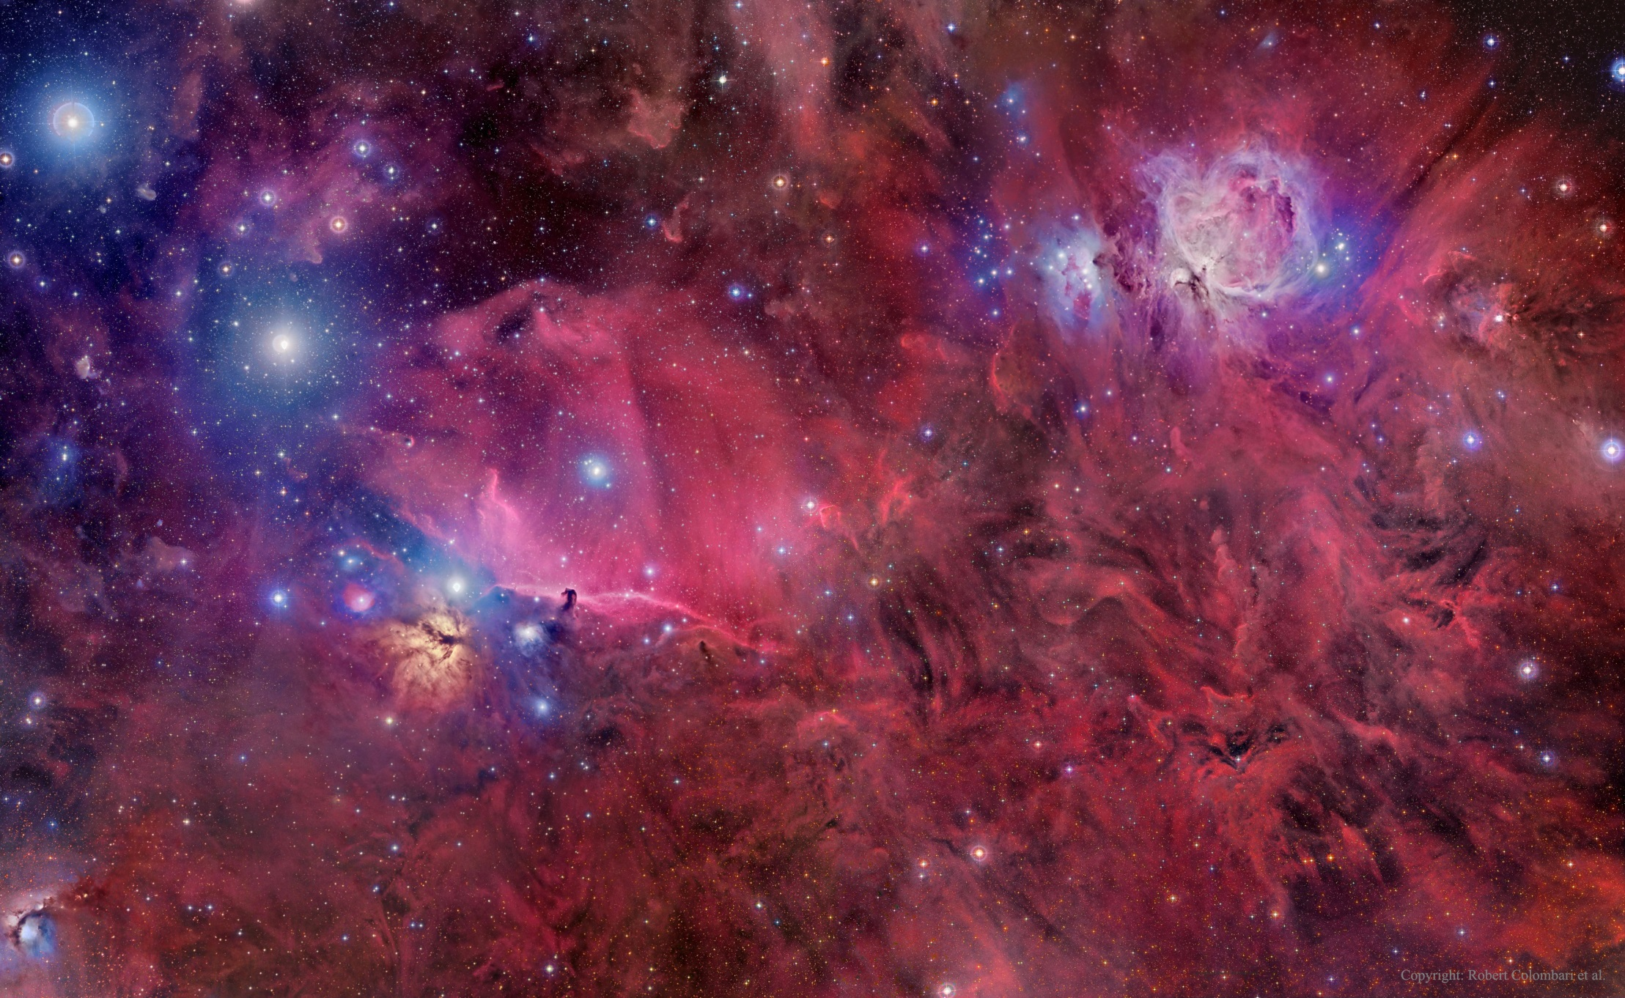
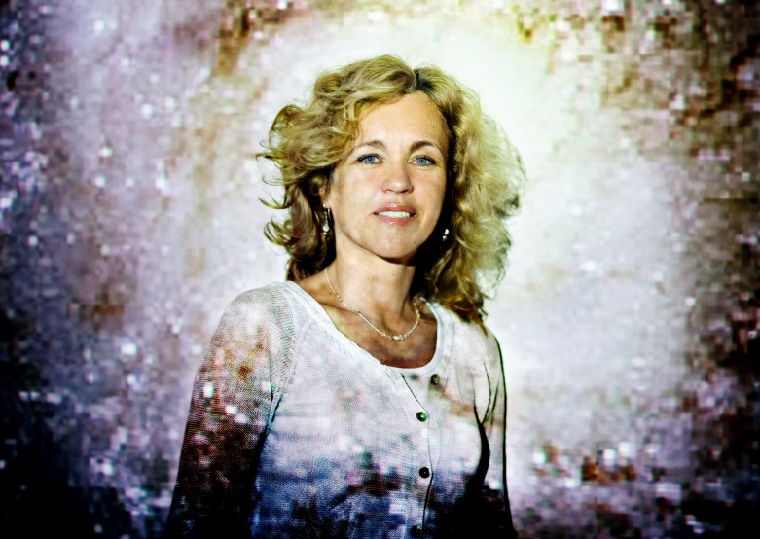

Image copyright: Roberto Colombari, Robert Gendler & Federico Pelliccia
^{Fotograf: Claus Boesen}
^{The Rosseland Lecture 2015}
^{Making, baking and breaking:}
Dust in the interstellar medium
^{Anja C. Andersen,} Associate professor at the Niels Bohr Institute
^{Wednesday April 8th at 15:15}
The Science Library in Vilhelm Bjerknes’ hus

