Slide 1
How humans conquered the world
Prof. Yuval Noah Harari
Department of History, Hebrew University of Jerusalem

Slide 2
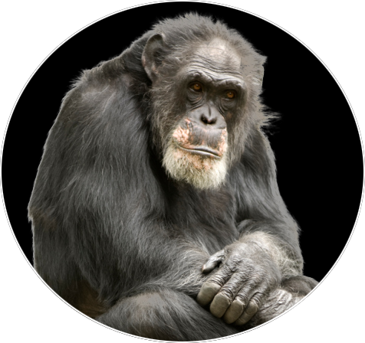
What is the Sapiens’
secret of success ?

Slide 3
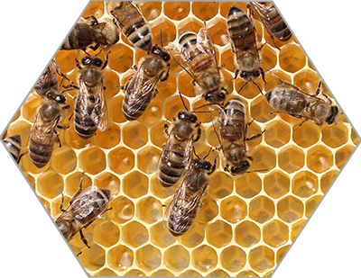
Flexible cooperation
in large numbers

Slide 4
1 vs 1
1000 vs 1000

Slide 5
Chimps don’t give
lectures to strangers

Slide 6
Chimps don’t have prisons.
How do we do it ?

Slide 7
Imagined Reality
Believing
the same story
=
Obeying
the same laws

Slide 8
Imagination enables cooperation

Slide 9
Telling effective stories is not easy
The difficulty is in convincing
everyone else to believe it.

Slide 10
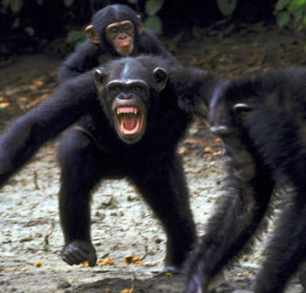
Why do we fight?

Slide 11
Humans live
Objective
Fictional
in a dual reality

Slide 12
Domination = Technology + Cooperation
Cooperation requires an ideological or religious basis.

Slide 13
The Industrial
Revolution
New powers – New problems – New stories

Slide 14
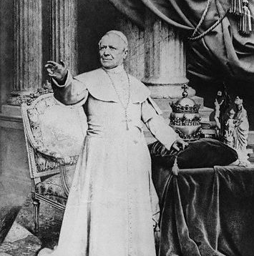
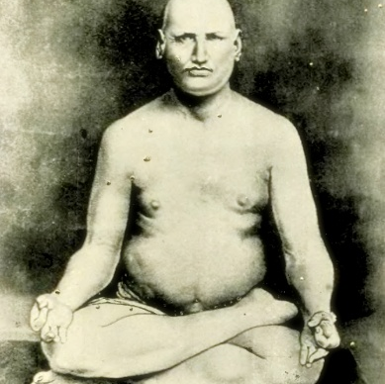
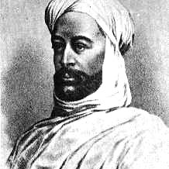
Pope Pius IX
Dayananda Saraswati
The Mahdi
Fundamentalism: Searching for Security.

Slide 15
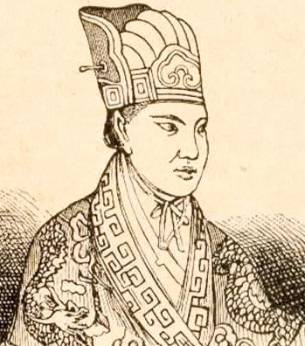
Hong Xiuquan
The Taiping Rebellion 1850-1864
At least 20 million dead

Slide 16
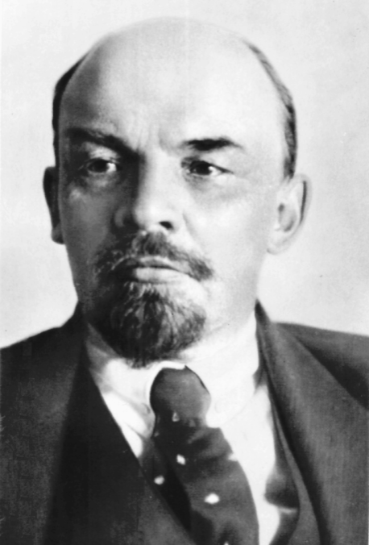
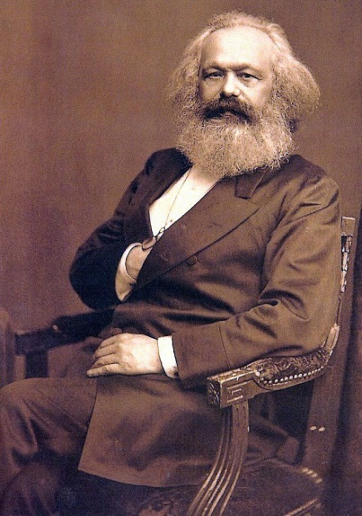
“Communism is power to workers councils plus electrification of the whole country” (Lenin).
Communism – the first techno-religion.
A technological paradise here on earth.

Slide 17
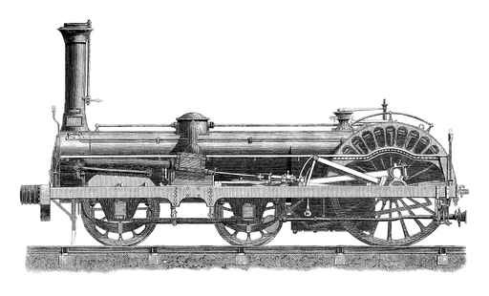
A New
Industrial
Revolution
19th century: steam and oil
Textiles, food and vehicles
21st century: Biotech and algorithms
Bodies, brains and minds

Slide 18
Unprecedented dangers and opportunities:
Upgrading humans into superhumans.
Unprecedented gaps between rich and poor.
New massive class of useless humans.

Slide 19
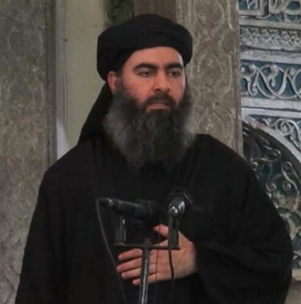
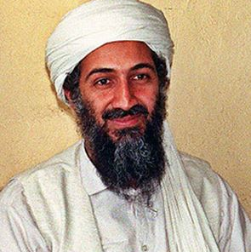
A new wave of fundamentalism
All past and present ideologies and religions are obsolete.
We need new thinking.

Slide 20
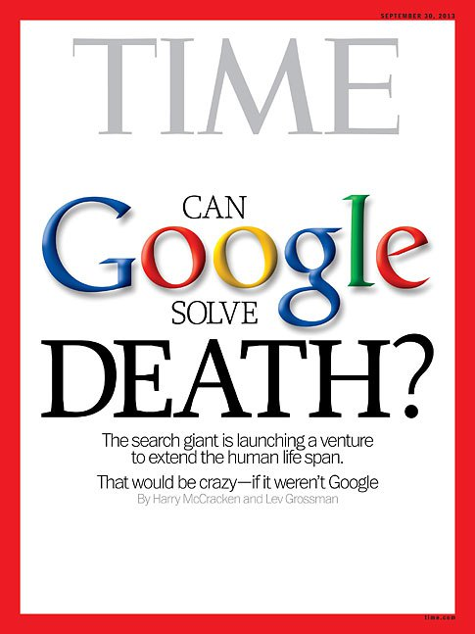
Lenin and Muhammad in Silicon Valley:
Paradise through technology
Justice
Peace
Immortality
Happiness

Slide 21
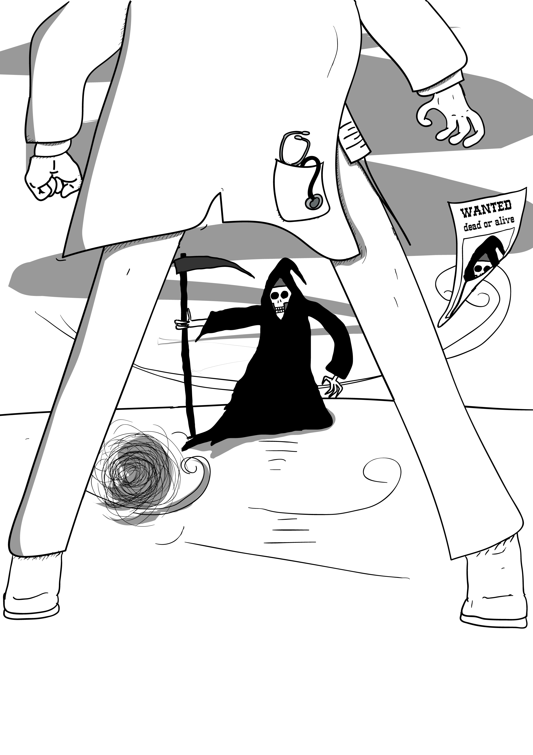
The last days of death

Slide 22
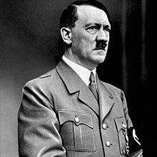
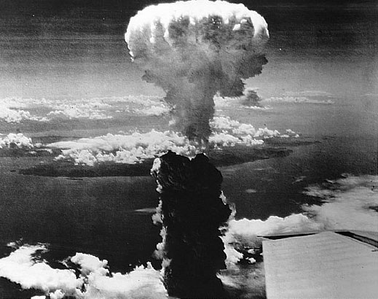
Good technology is not enough
We need new stories, new ethics and new thinking.
Will they be good or evil?

Slide 23
Thank you
ynharari.com

