Slide 1


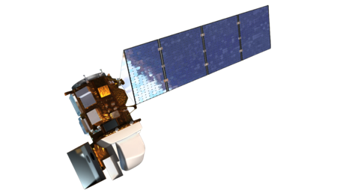

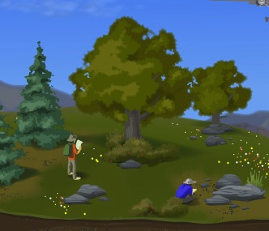


Patterns
Open Data & Open Data Training Materials
#WorkWithData
Leah A. Wasser, Supervising Scientist
National Ecological Observatory Network (NEON) – Boulder, CO - U.S.A.
Processes & Characteristics
LeahAWasser
Notes:
my name is leah wasser. I am a supervising scientist in the education and public engagement group at NEON.
I’m going to talk about our workwithdata suite of programs.

Slide 2

ecological
standardized open data, for 30 years
>
Notes:
Idea for neon spans back to 2000
The project will run from 2017-2046

Slide 3
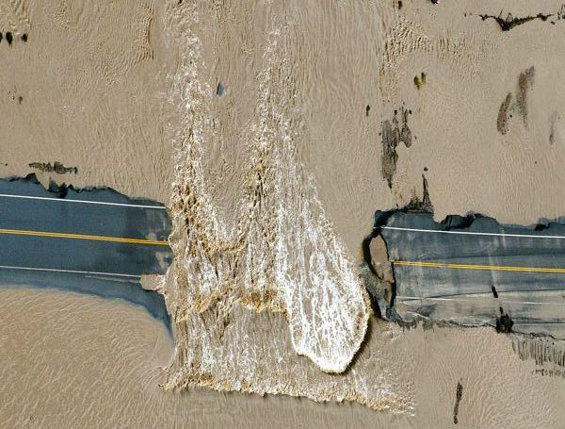
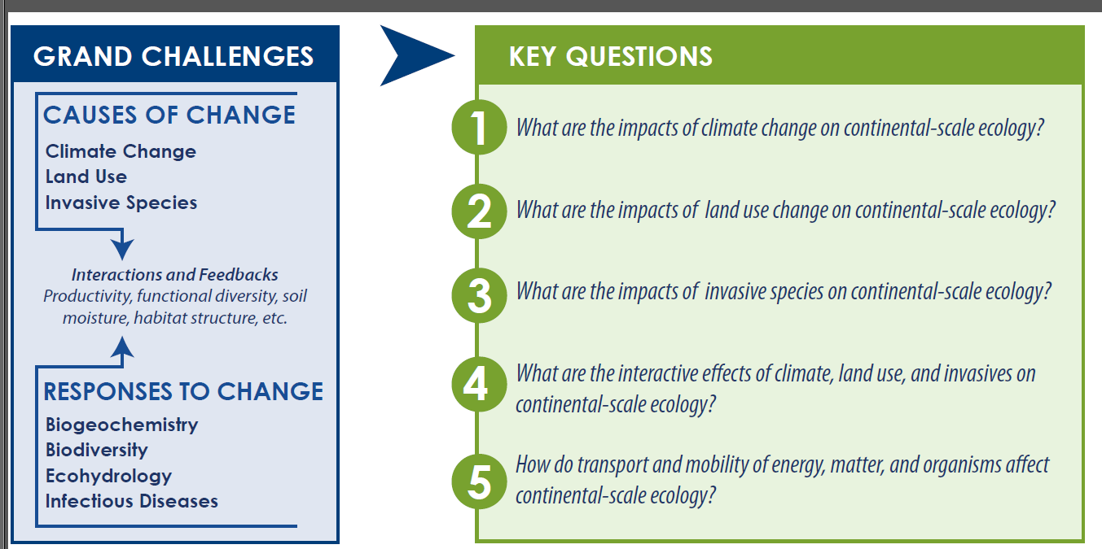
Causes of Change
Climate
Land Use
Invasive Species
Responses to Change
Biodiversity
Biogeochemistry
Ecohydrology
Infectious Disease
AP Photos/John Wark

Slide 4
Ecological Observatory
Notes:
A total of 106 sites are being built across 20 domains (approximately 3 terrestrial and 3 aquatic sites per domain)
60 terrestrial sites that include towers with atmospheric sensors, soil pits, organismal sampling plots
60 aquatic sites with sensors and organismal sampling (XX are co-located with terrestrial sites)
10 STREON sites (co-located with XX aquatic sites)
Each domain represents an eco-climate area of the US

Slide 5
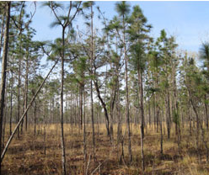
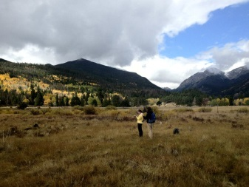
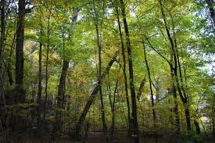
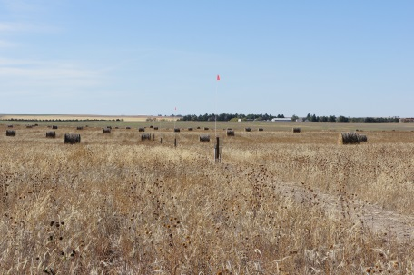
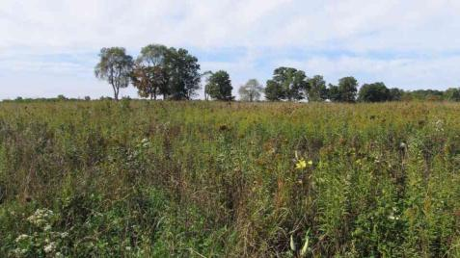
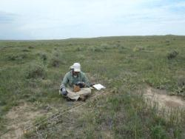
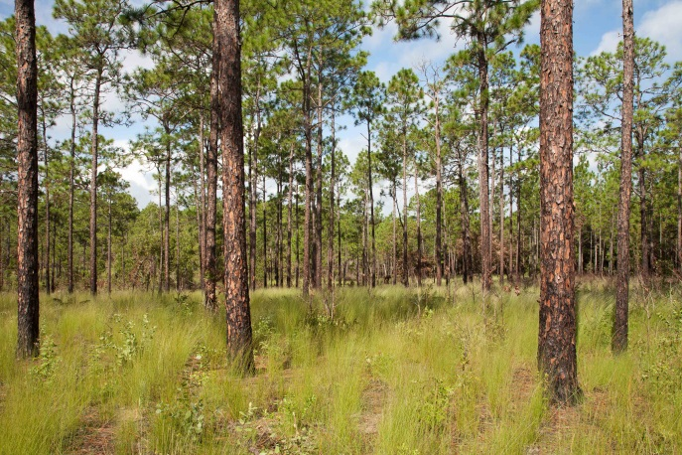
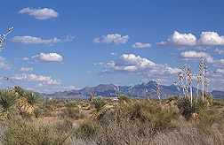
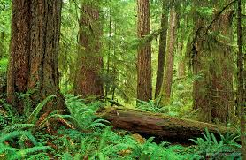
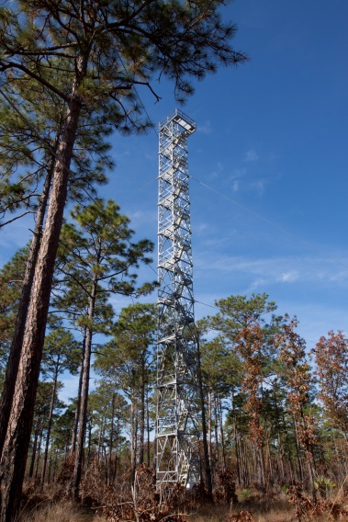
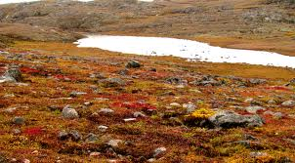
Notes:
How do you design consistent protocols in systems as diverse as this (and more)?

Slide 6
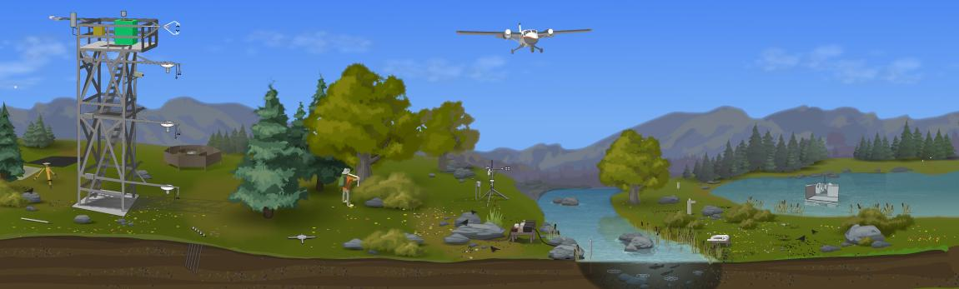
TIS - Terrestrial Instrumented System
AIS – Aquatic Instrumented System
TOS – Terrestrial Observation System
AOS – Aquatic Observation System
AOP – Airborne Observation Platform

Slide 7
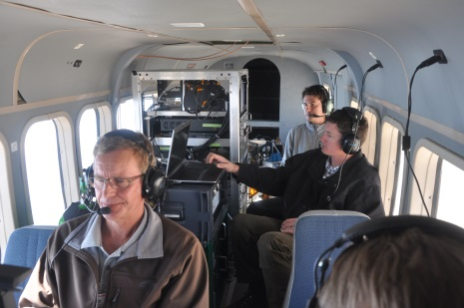
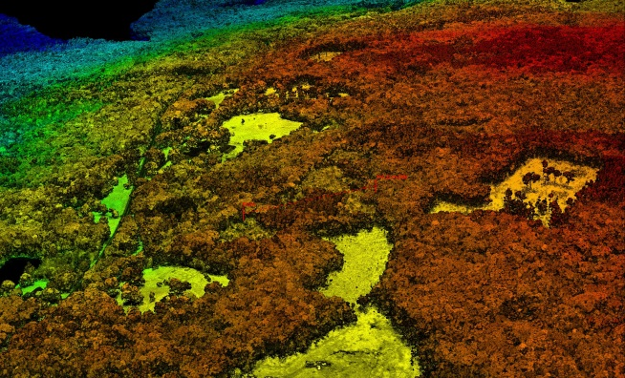

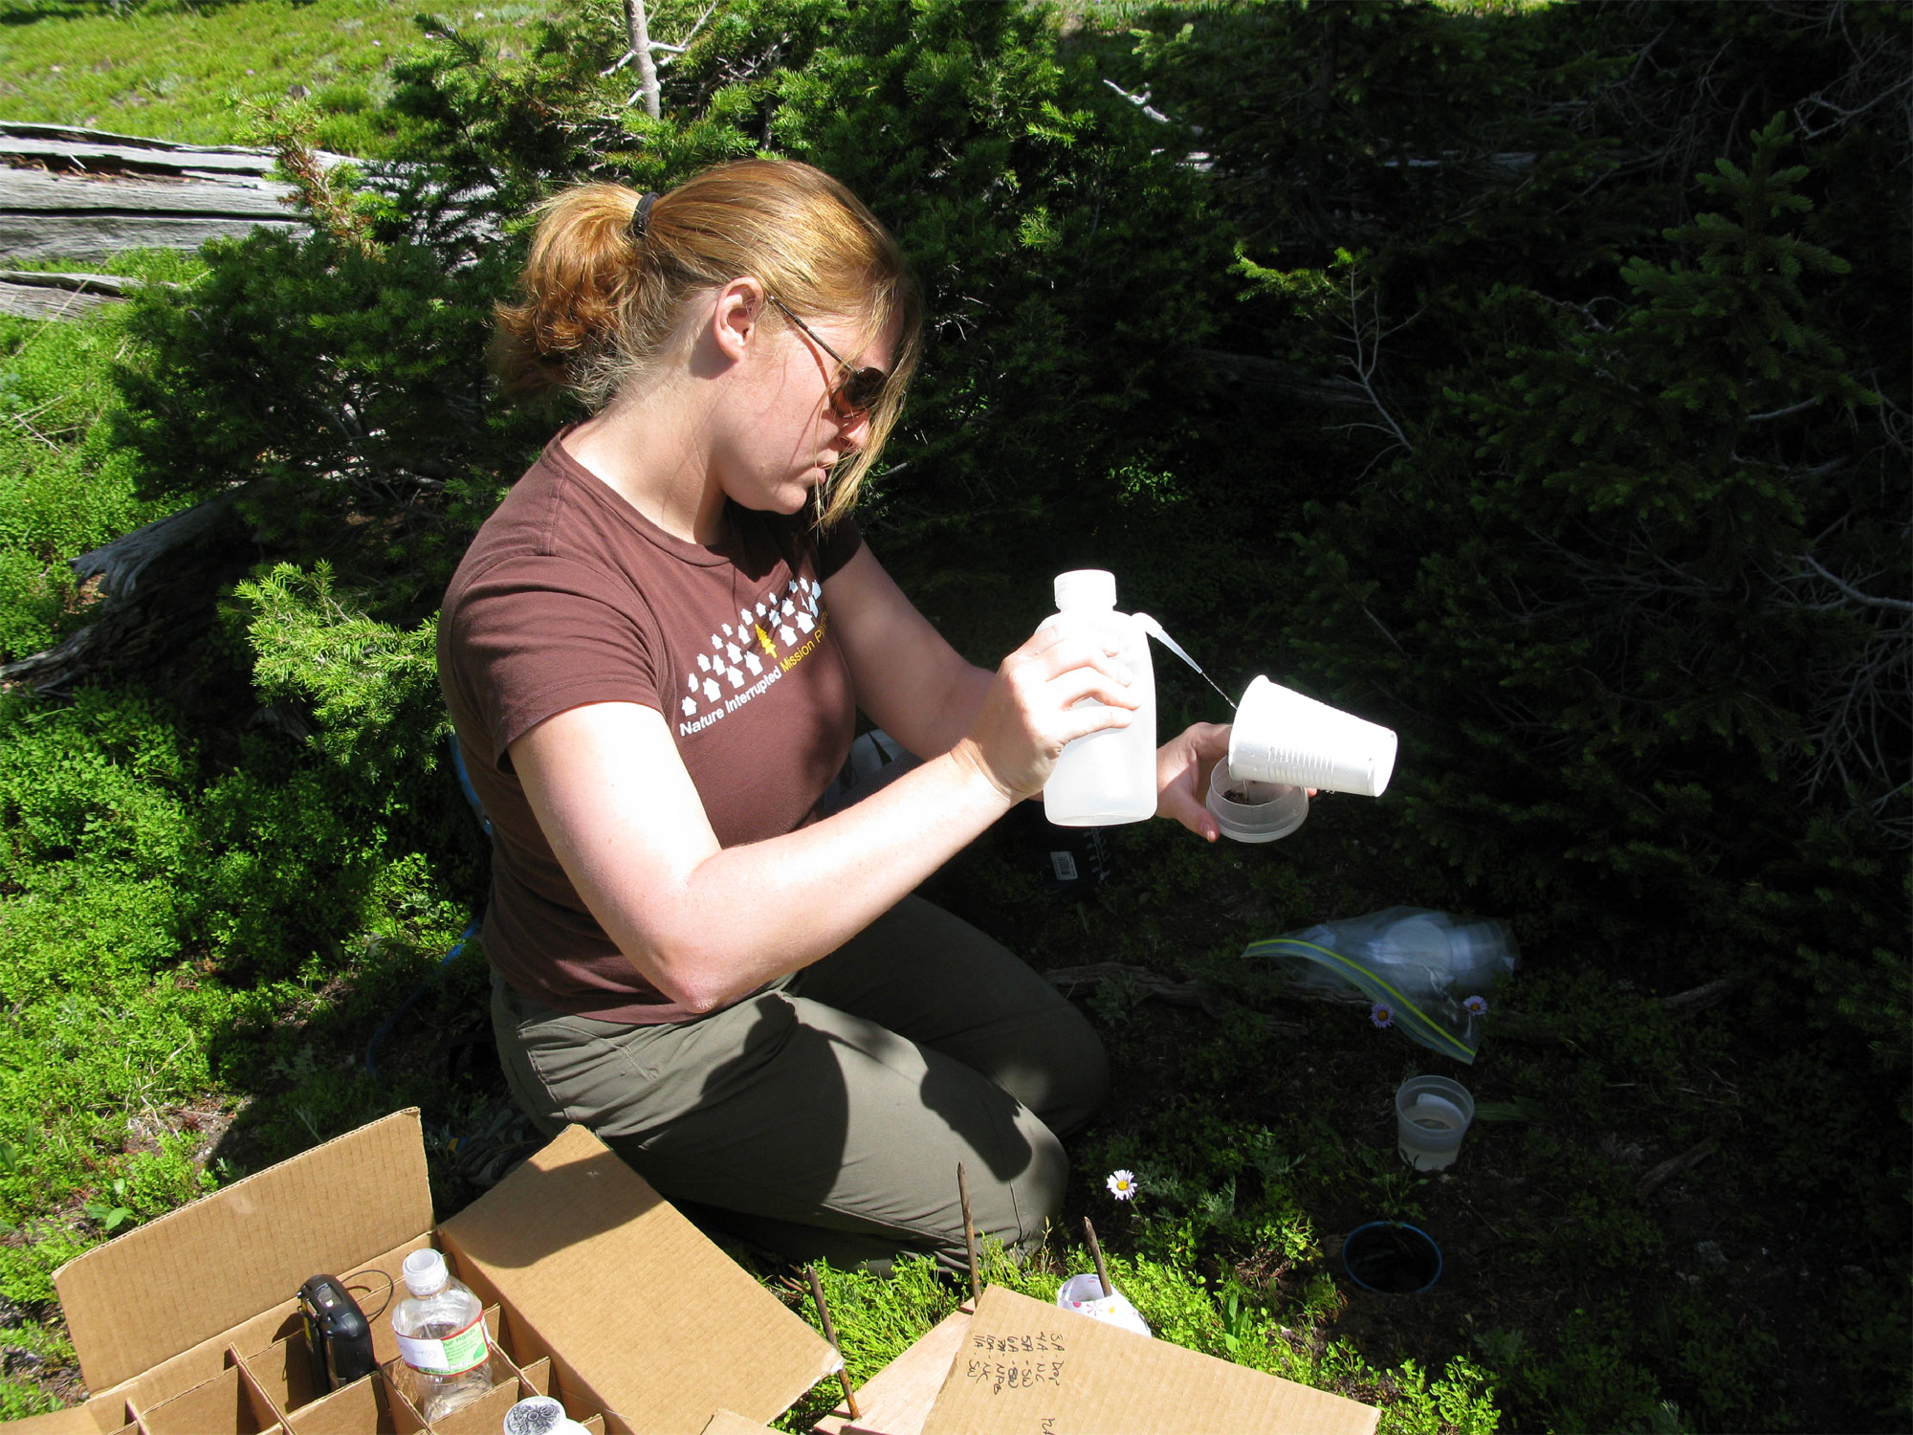
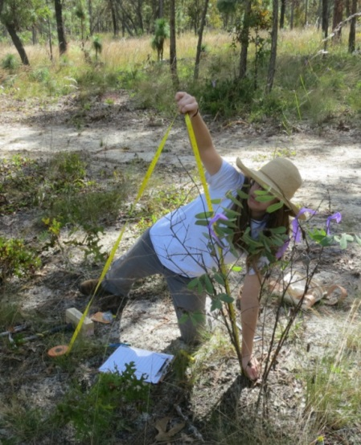
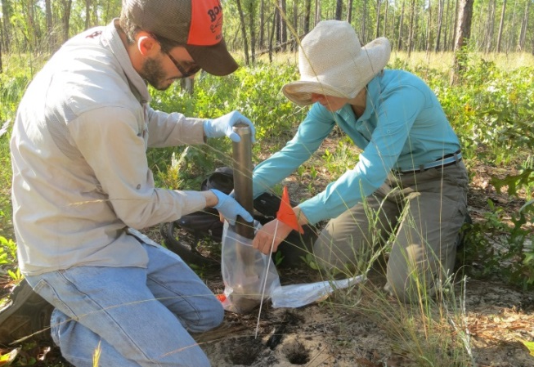
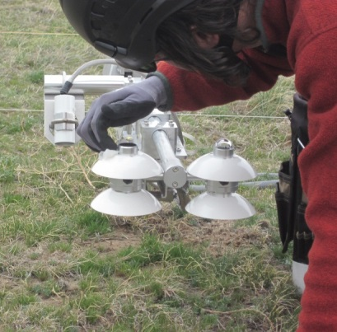
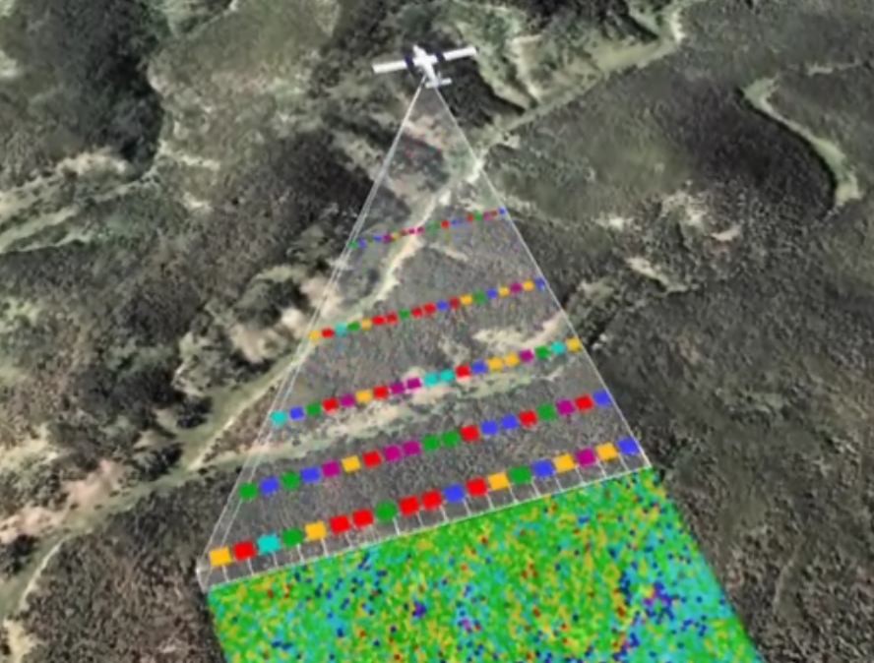
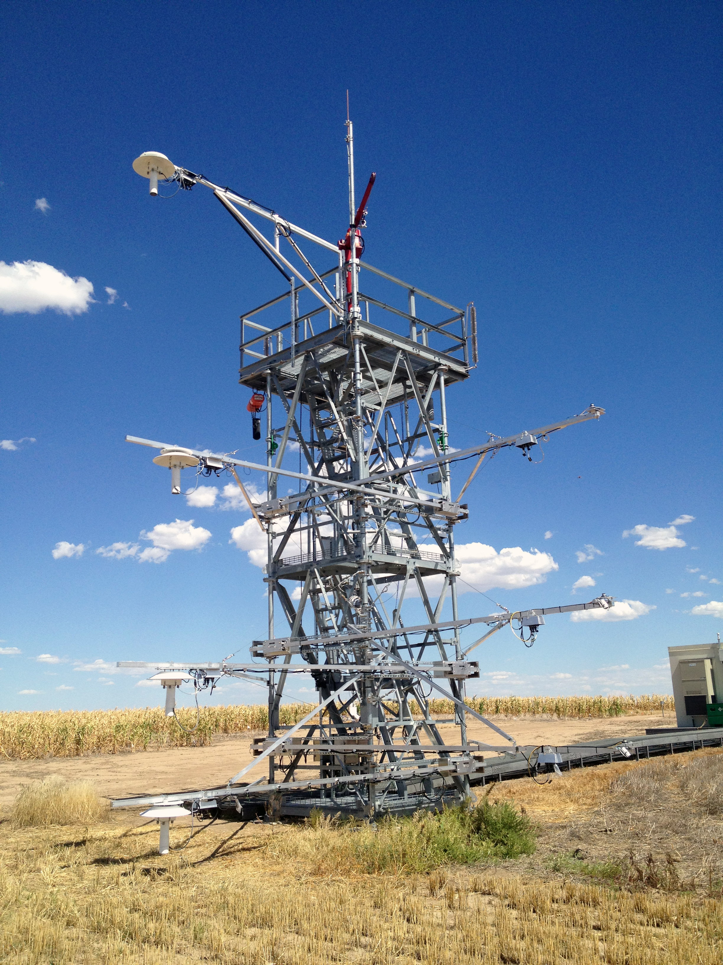
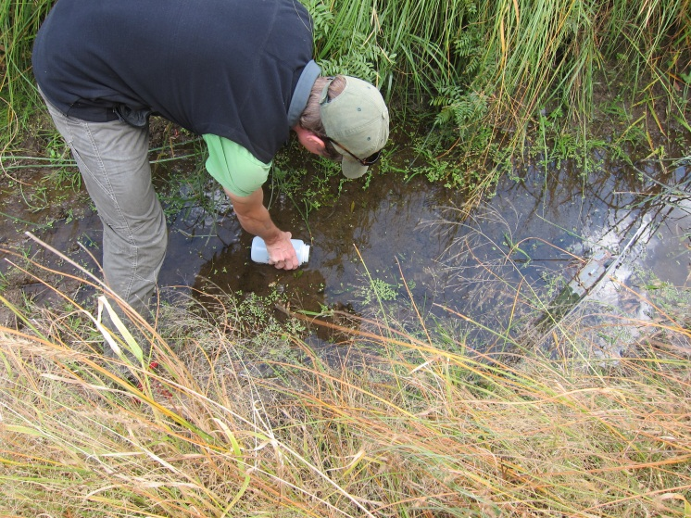
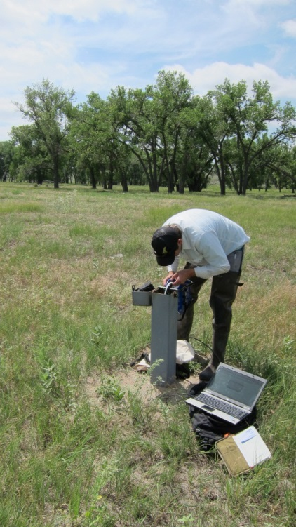

Slide 8
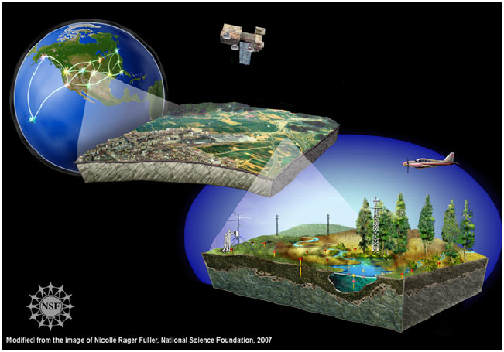
Notes:
NEON collects:
Ground-based observations
Airborne observations
And combines both of the above with existing satellite and other map-based data
To create an essentially 3-D picture of a site.
The full range of scaled data products, collected over 30 years, can be used to describe changes in the nation’s ecosystem through space and time.

Slide 9
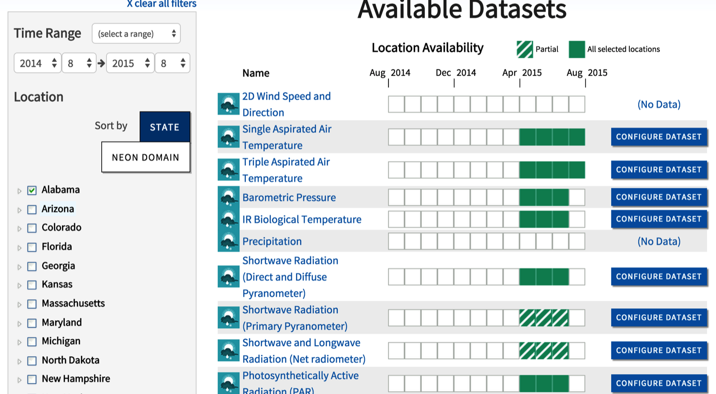
data.neonscience.org
Notes:
We have a data portal where over 20 different data products are available for sites located in 17 states across the US already – with more data on it’s way!
NEON data utilize in situ and sensor based collection methods to cover themes such as landuse change and climate.

Slide 10
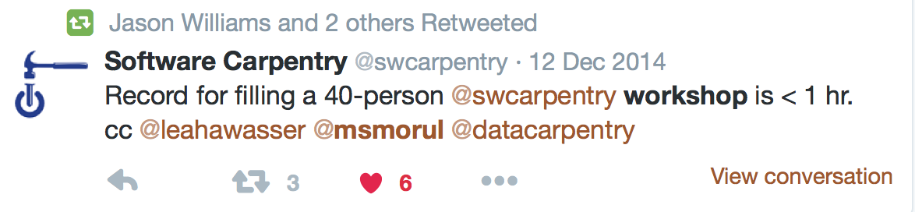
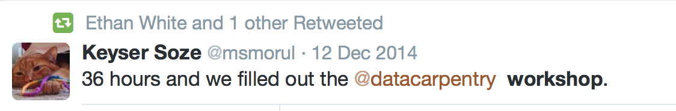


intensive
Significant demand for data skills
>
Notes:
There is a HUGE demand for data intensive training right now – Groups like SWC and DC have emerged to teach these skills outside of the classroom.
Workshops fill up immediately and have waiting lists.
Need to find some stats on the need for training in the US specifically
SWC- over 8200 learners in 20 countries –
DC is on the same track…

Slide 11

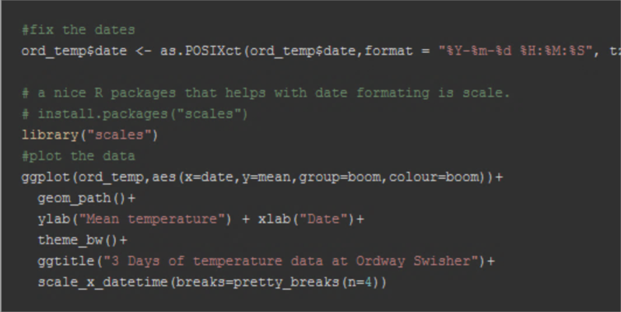
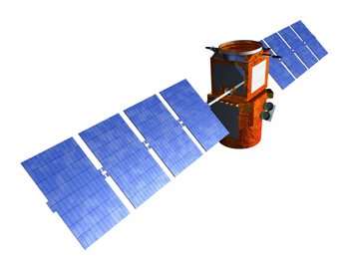
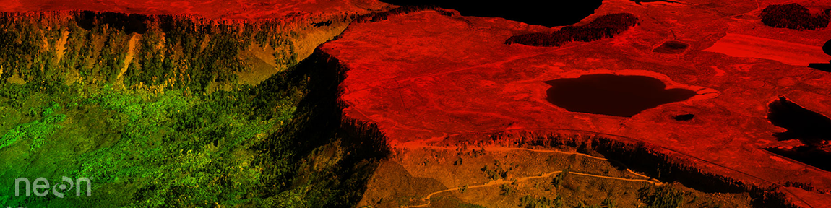
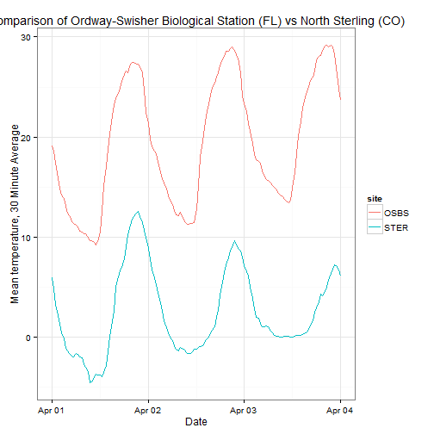
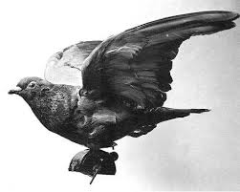
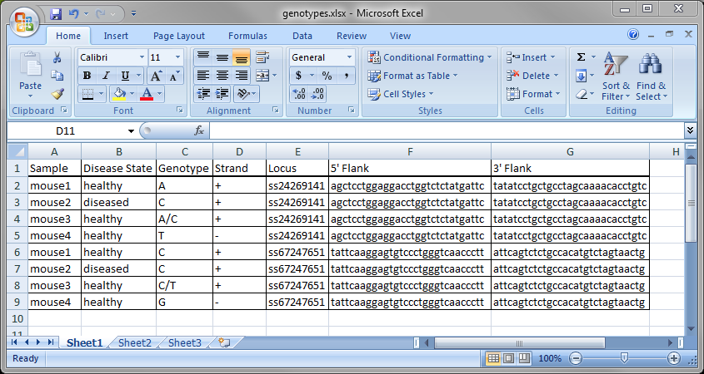

Notes:
However, working with these types of data – require a different set of tools. It requires tools that produce usable, reproducible results.
And tools that can handle processing huge volumes of data.

Slide 12
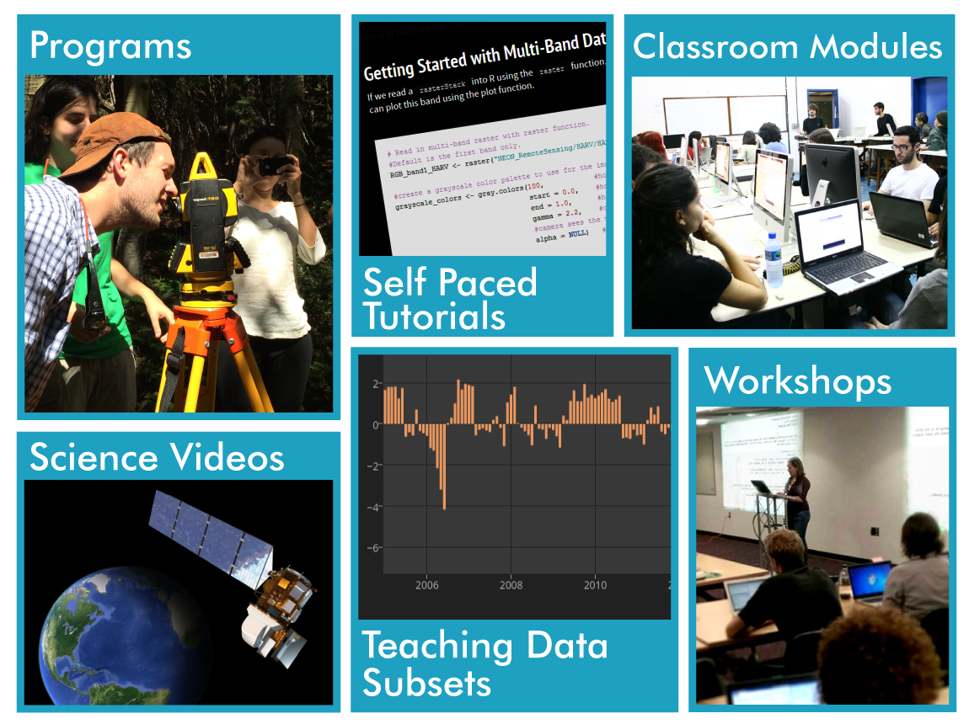
Self Paced Tutorials
Data Workshops
Programs Summer Institute, Internship
Science Videos & Graphics
Teaching Modules
Teaching Data Subsets
Notes:
The NEON #workWithData program is a response to a community need to in facilitate data intensive skills in teaching and science. But specifically focused on spatio-temporal data which
Require a specific and unique set of skills…
Are needed to ask larger scale science questions

Slide 13
Neondataskills.org

Slide 14
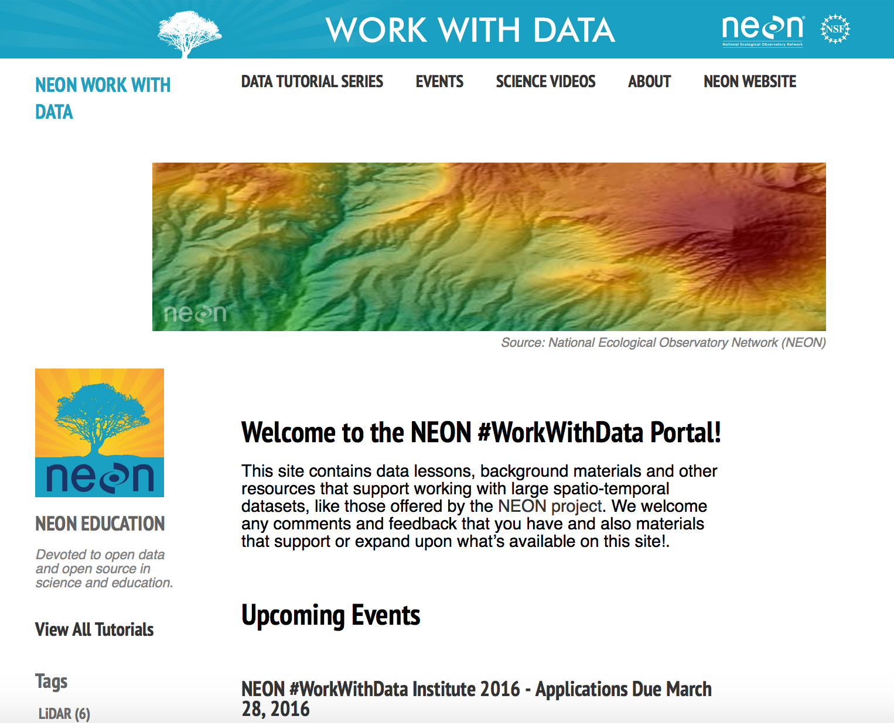
www.neondataskills.org
Notes:
The NEON #workWithData program complementary program that supports and adds to existing efforts addresses strong community need to in facilitate data intensive skills in teaching and science. But specifically focused on spatio-temporal data which
Require a specific and unique set of skills…
Are needed to ask larger scale science questions
A …

Slide 15
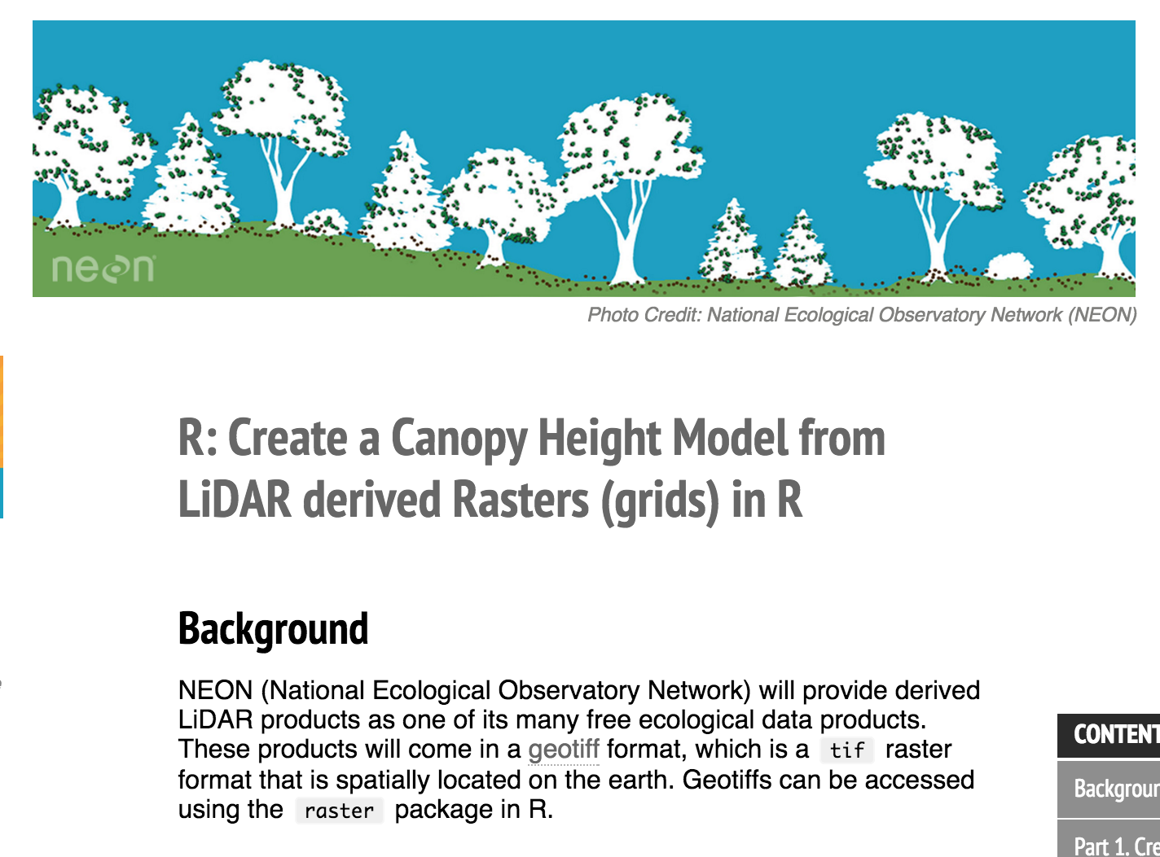
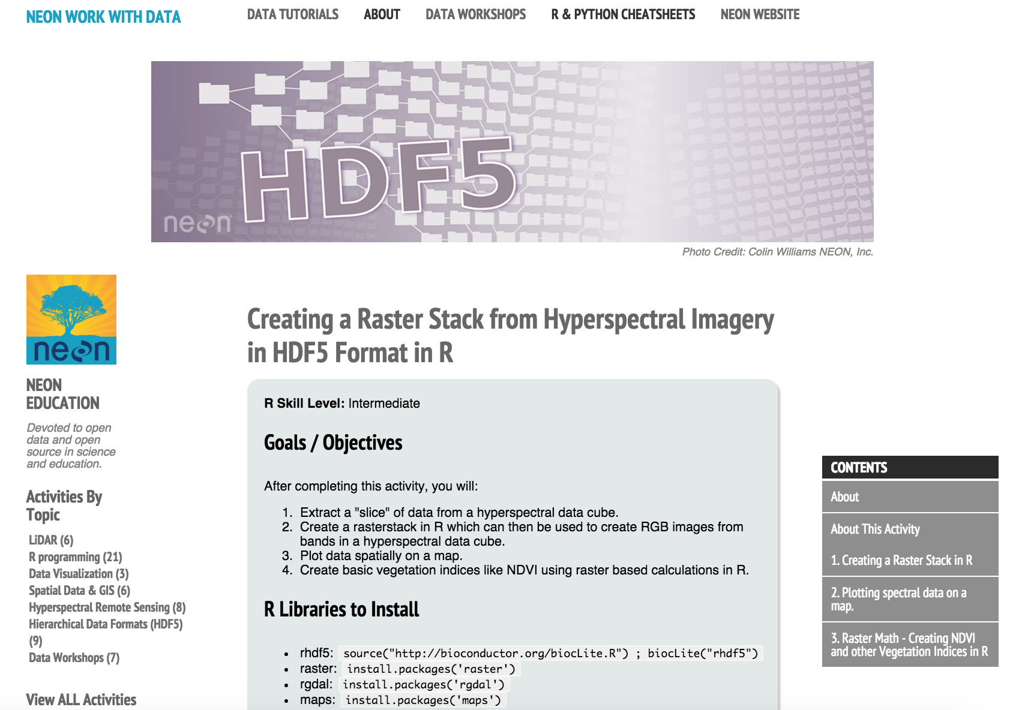
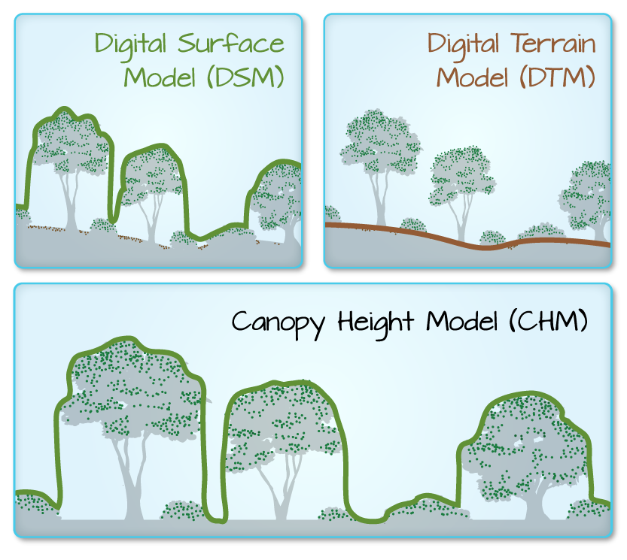
Self-Paced Data Tutorials – neondataskills.org
Notes:
There are many data tutorial resources out there but not ones that focus explicitly on spatio-temporal data. We have been developing lessons at NEON and in collaboration with the community

Slide 16


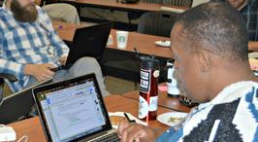
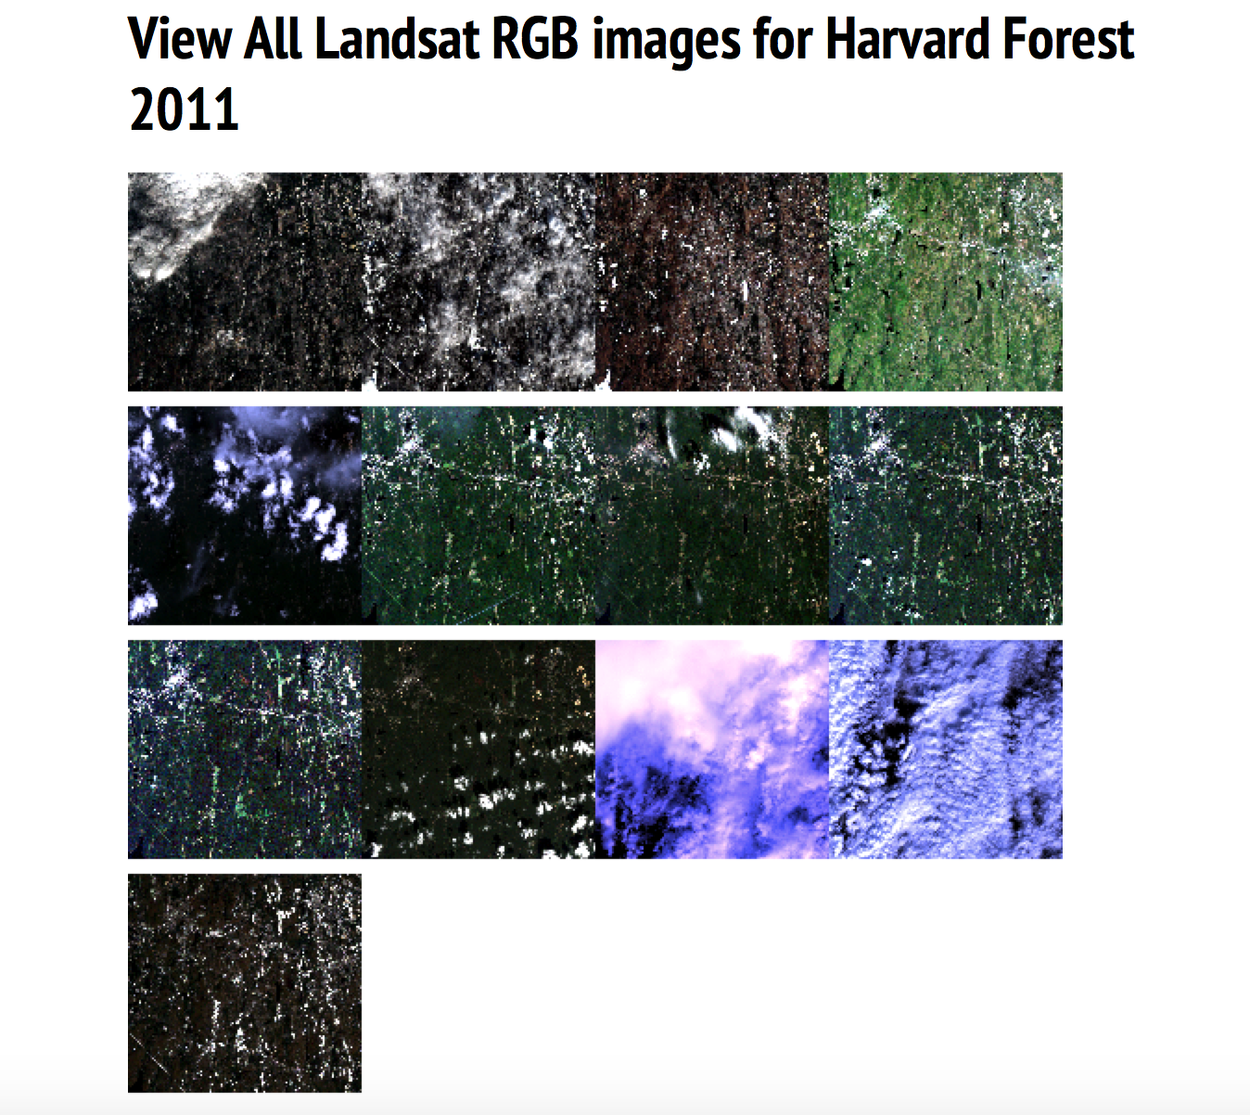
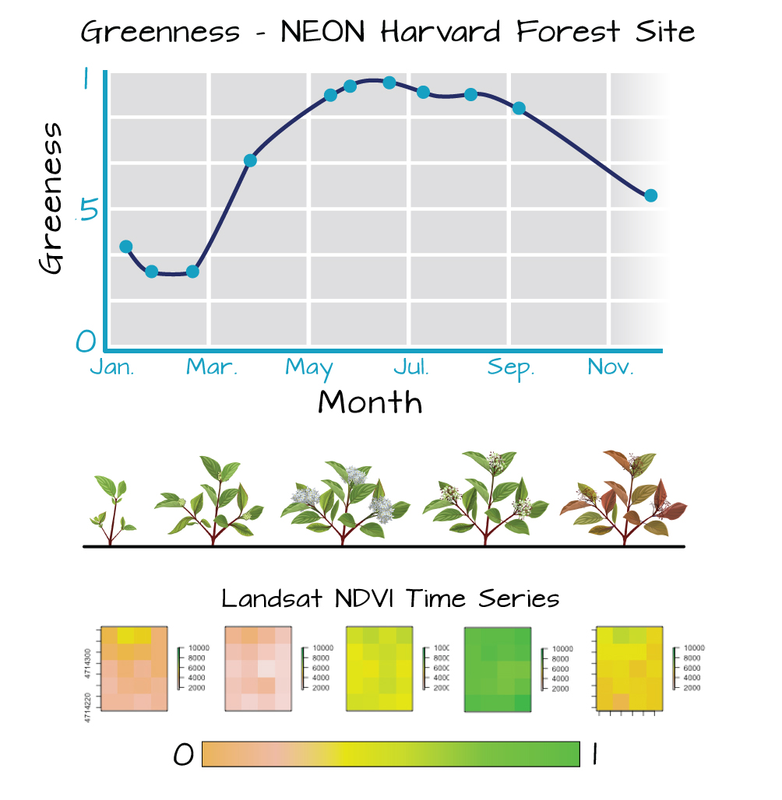
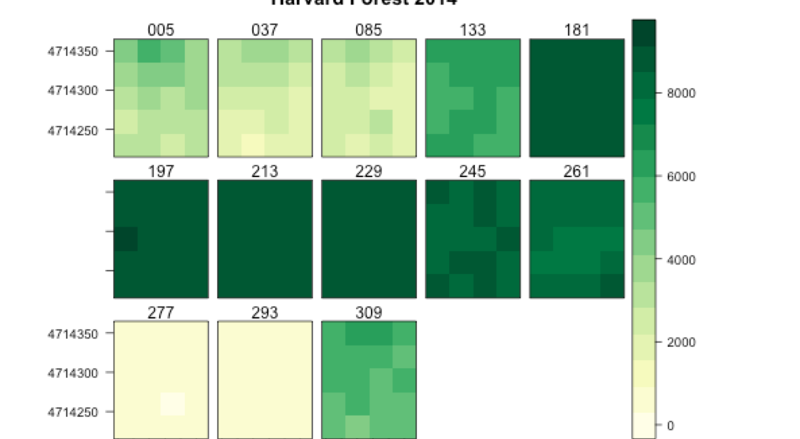
Science Themes – Data Skill Themes
Notes:
We recently partnered with data Carpentry, SESYNC and Iplant – NSF funded biocenters – to generate a new set of workshop materials focused on spatio-temporal data with a phenology theme –
screen shots here from the data and lessons…

Slide 17
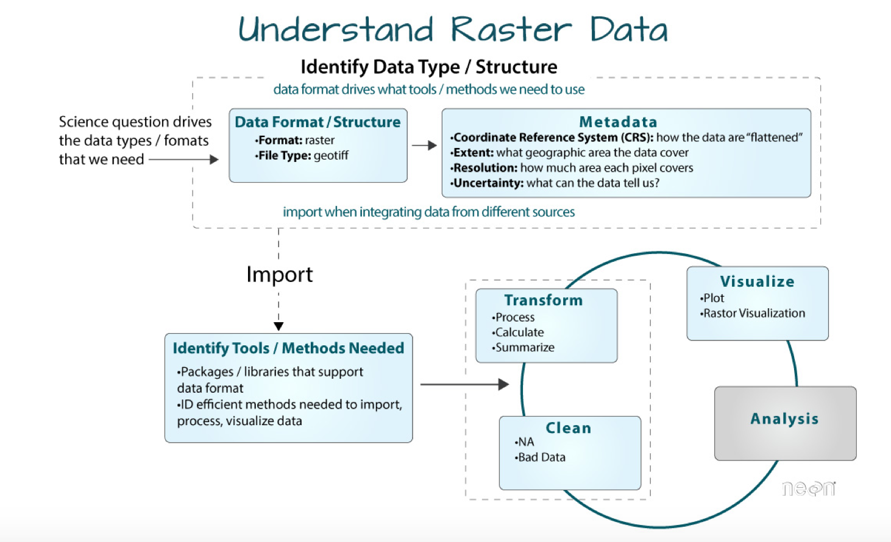

Slide 18
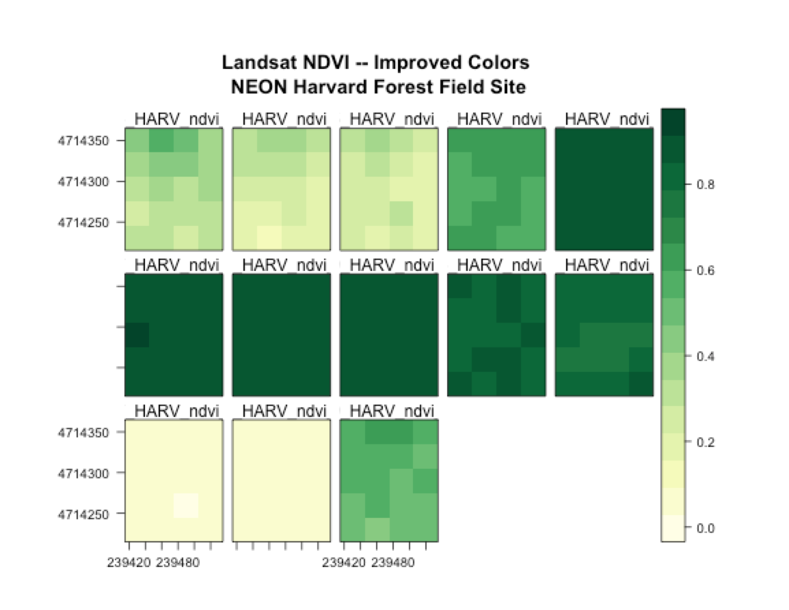
Visualization Raster Data

Slide 19
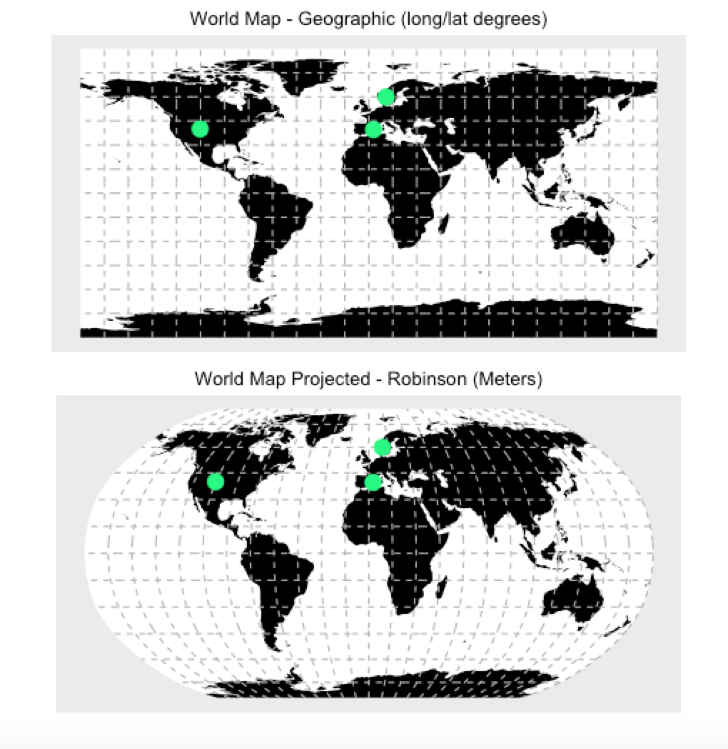
Spatial Data Management - CRS

Slide 20
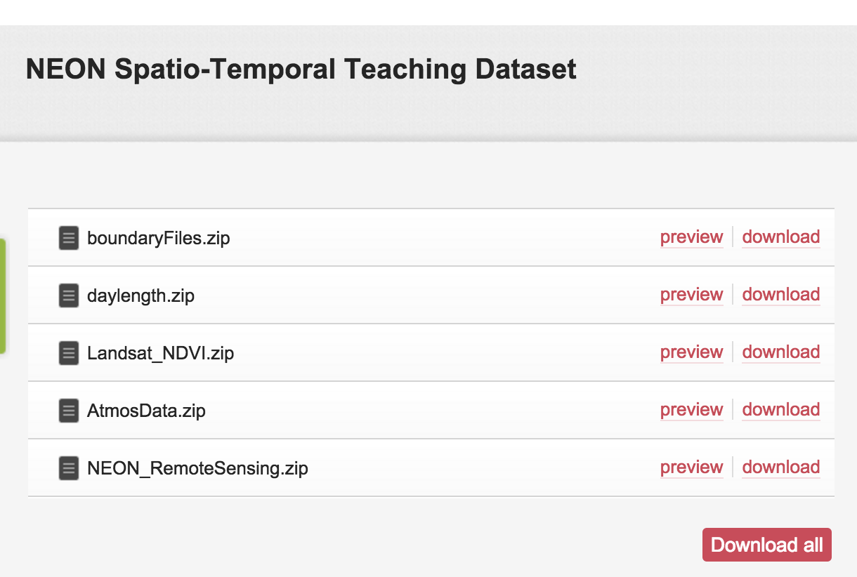
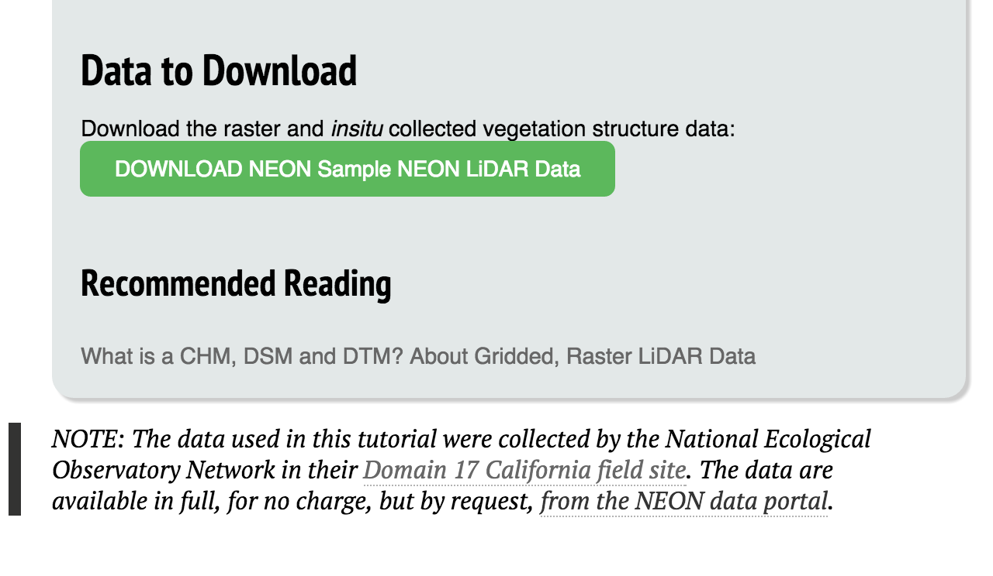
Teaching Data Subsets
Notes:
The skills associated with data intensive training aren’t the only barrier. It’s challenging for instructors to find data that are ready as teaching subsets to use in lessons. We have teaching data subsets available as a resource as well for easy download on FigShare which is a open data repository that is widely used by the scientific community to store data, presentations and other documents. Hosting our data here adds another layer of visibility for our great programs and efforts.
This dataset is one we developed for the data lesson hackathon mentioned previously.

Slide 21


Notes:
Our portal is collaborative, comments at the bottom can be used to ask questions, make suggestions, and interact with other users. We host our materials on github to allow for awesome folks like yourself to contribute in the form of comments and direct edits to the site too.

Slide 22
Neondataskills.org

Slide 23

data intensive workshops
Notes:
We deliver some data intensive workshops, on our own and support community efforts such as Data and Software Carpentry.

Slide 24
feedback
“
“
loved this! great having the helpers around the room. Neon's videos were a nice change of pace and well done, too
“
The instructors are keeping it lively and interesting. Also, they are bringing the workshop materials into focus with respect to real life work.
“
“
… I enjoyed getting an idea of the workflow for working with this sort of data. It is very helpful to have the code there as a reference. Great resources on the website as well!
“

Slide 25

http://neondataskills.org/science-video/
Notes:
The skills associated with data intensive training aren’t the only barrier. It’s challenging for instructors to find data that are ready as teaching subsets to use in lessons. We have teaching data subsets available as a resource as well for easy download on FigShare which is a open data repository that is widely used by the scientific community to store data, presentations and other documents. Hosting our data here adds another layer of visibility for our great programs and efforts.
This dataset is one we developed for the data lesson hackathon mentioned previously.

Slide 26





Workshops & Programs - Internship
Notes:
Workshops and programs
NEON has an internship program

Slide 27


#WorkWithData Summer Institute
  Remote Sensing & Open Science
  Applications Due: March 28, 2016
Notes:
The summer institute will provide participants with the collaboration and informatics skills needed to ask broadscale ecological questions using NEON and other complementary data. We will bring in expert instructors in areas including

Slide 28
www.neondataskills.org
#WorkWithData
lwasser@neoninc.org
Notes:
So visit NEONdataskills.org today to check out our suite of online data tutorials and resources! And get in touch if you have resources to add or share too.

