Slide 1
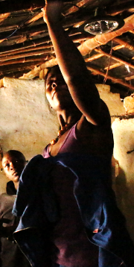
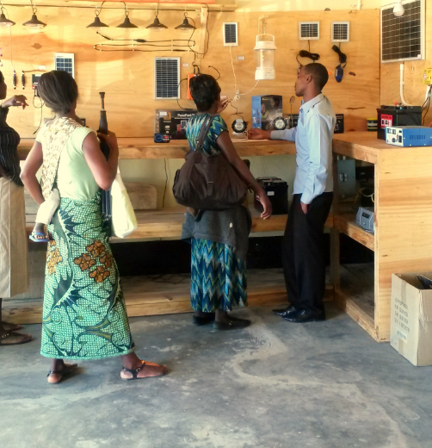
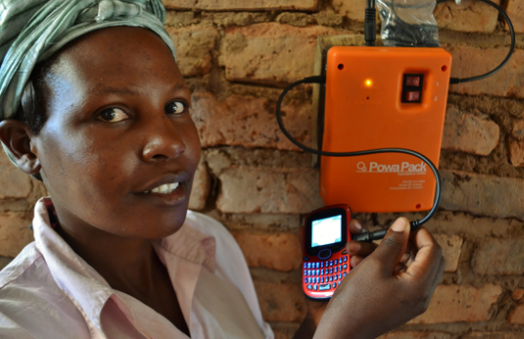
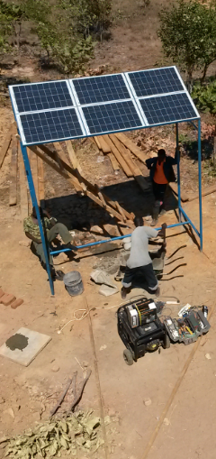
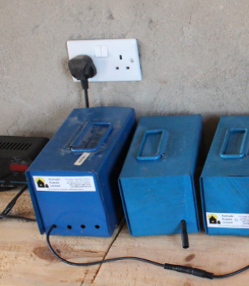
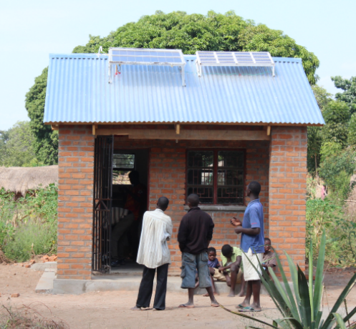


One year in Malawi as a solar energy entrepreneur
Trygve Mongstad
Foton/Realfagsbiblioteket UiO 10/9 2015
Nkhotakota Youth
Organisation

Slide 2
Who are you?
Student?
Not student?
Engineering?
Natural sciences?
Social sciences?

Slide 3
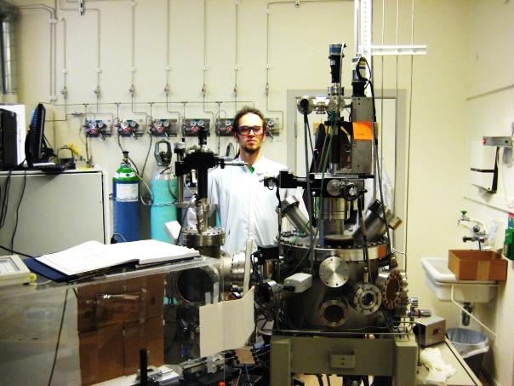
Trygve Mongstad
Status autumn 2013:
Temporary job
Wanted more international exp
Wanted «real world»
32 y o
MSc/PhD in Physics, NTNU/UiO
Favourite colour: Green
Research scientist at Institute for Energy Technology
Studying materials for energy and solar cells

Slide 4





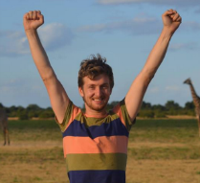
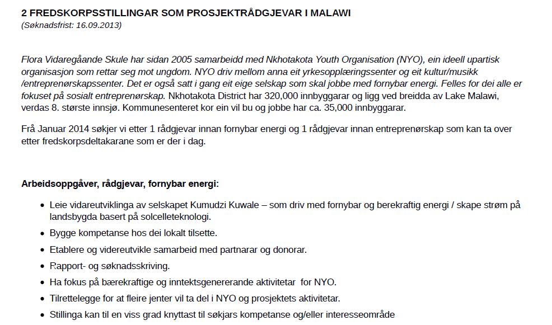



2013
Flora
Upper Sec
High School
Nkhotakota
Youth
Organisation

Slide 5
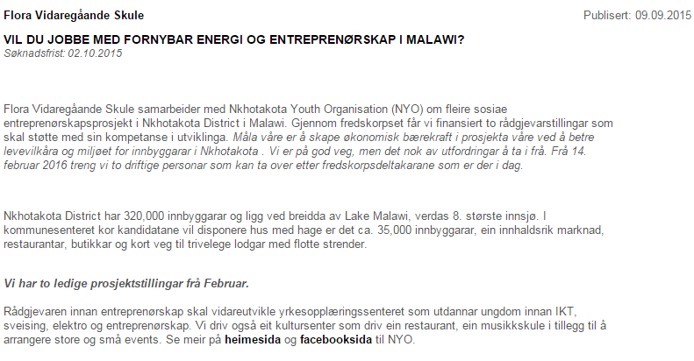
Application deadline:
2 October 2015

Slide 6
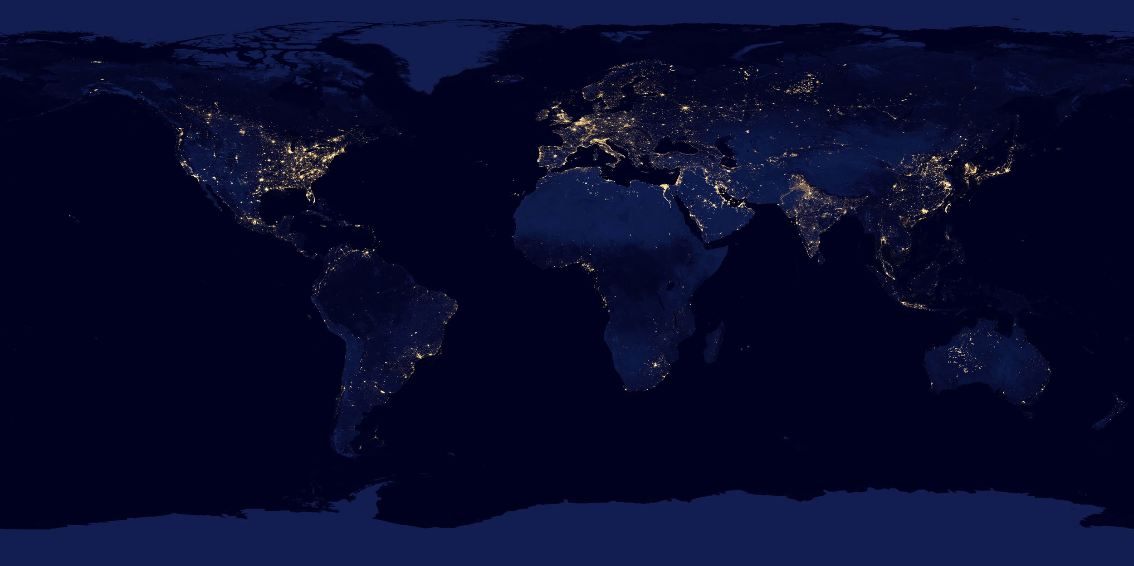
The world

Slide 7
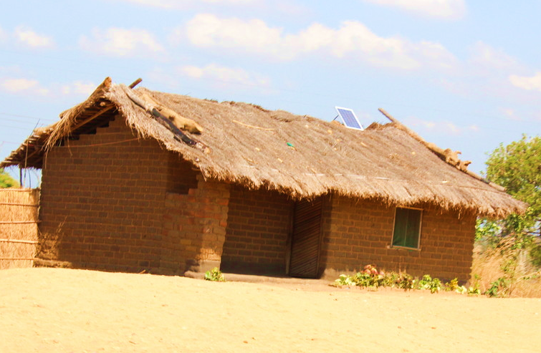
Off-grid solar energy
The end of energy poverty?

Slide 8
Personal impact
X
Number of users
=
Global impact
Global impact of internet access 1990-2015
3,200,000,000
Internet access
X
=
Global impact of electricity access
2010-2035
Electricity access
1,300,000,000
X

Slide 9
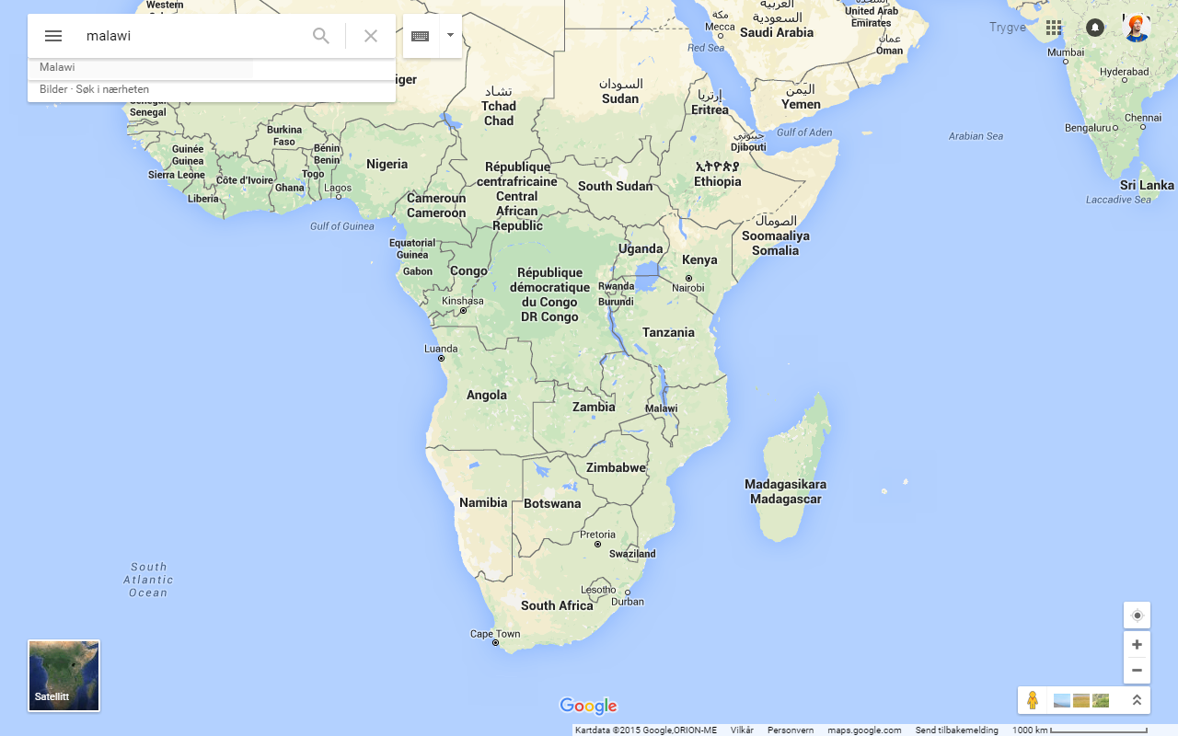

Slide 10
Malawi
90% lack electric power
Grid extention is slow
Generation capacity overloaded
Challenges related to
  Health
  Education
  Business

Slide 11
2013
Flora
Upper Sec
High School
Nkhotakota
Youth
Organisation

Slide 12
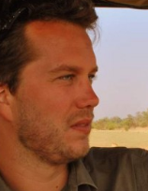

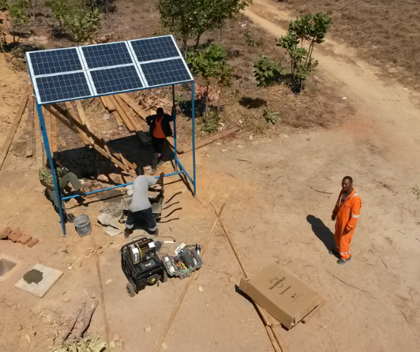
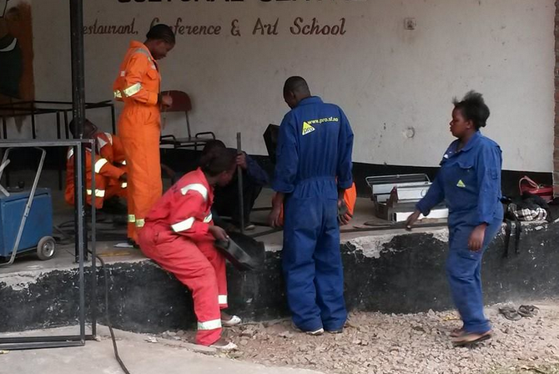
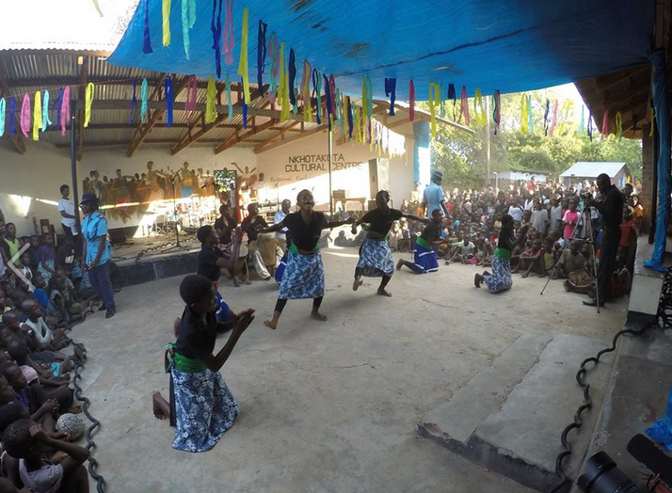
2012
2013
2014
Thomas
Daniel
Trygve
Vocational Skills Training Centre
Nkhotakota
Youth
Organisation
Nkhotakota
Cultural Centre

Slide 13
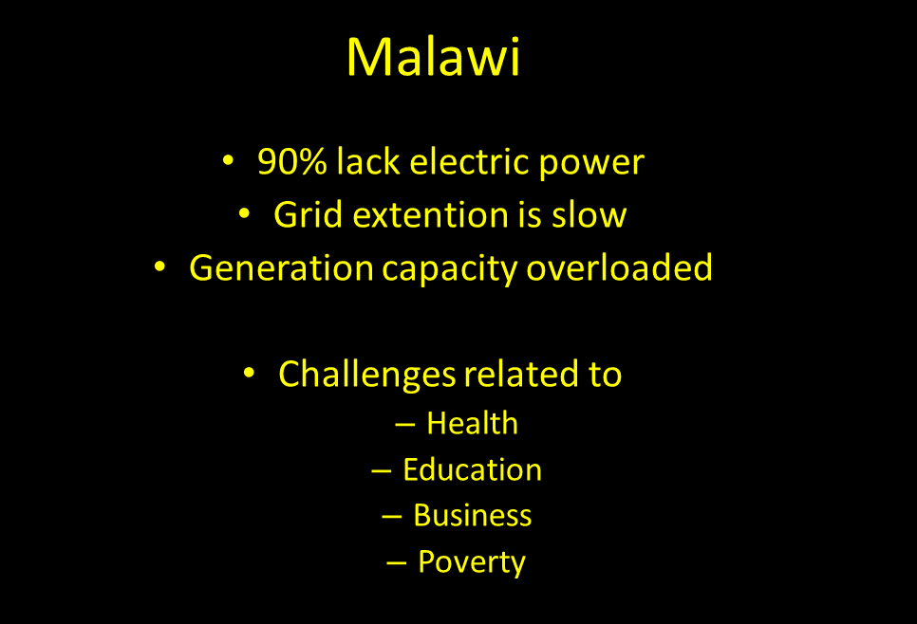
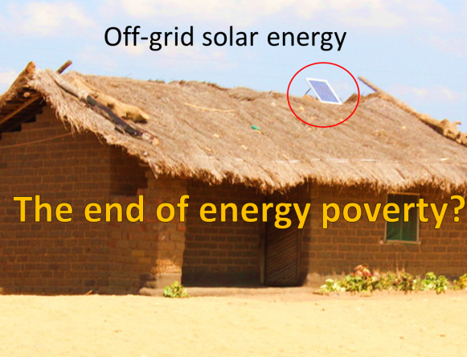
Social enterprise
Commercial business model
Owned by NYO

Slide 14
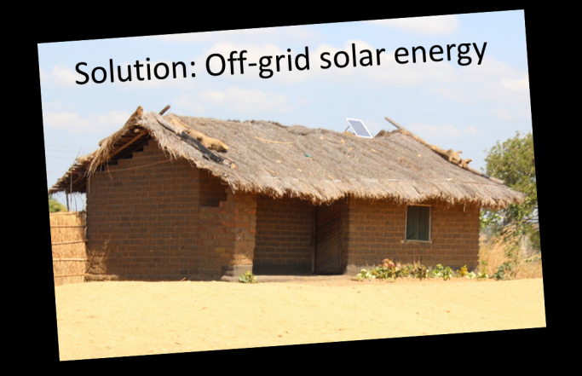
Sales of solar energy solutions
Commercial business model
Village electrificaton
programmes
Installation of solar
power systems

Slide 15
My job in Malawi: START THIS!
Sales of solar energy solutions
Commercial business model
Village electrificaton
programmes
Installation of solar
power systems

Slide 16
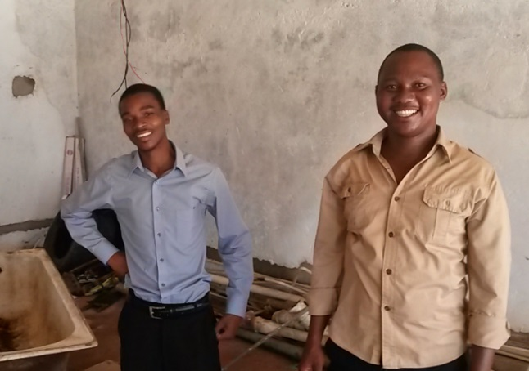
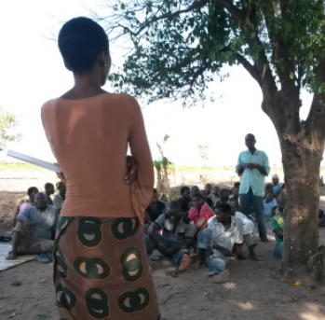
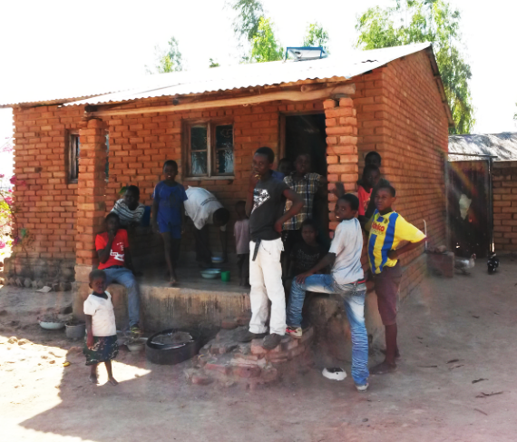
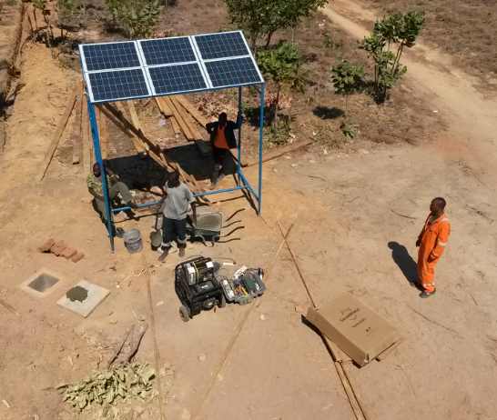
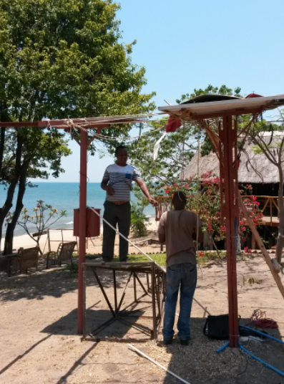
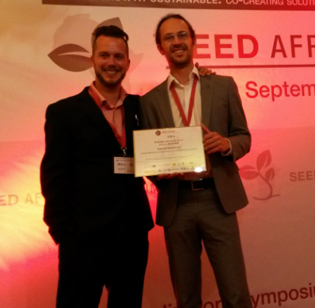
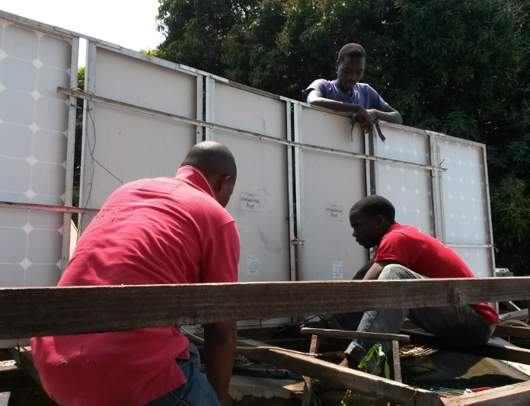
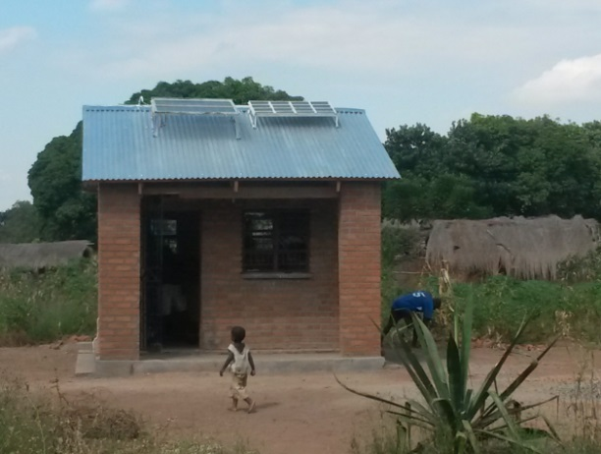
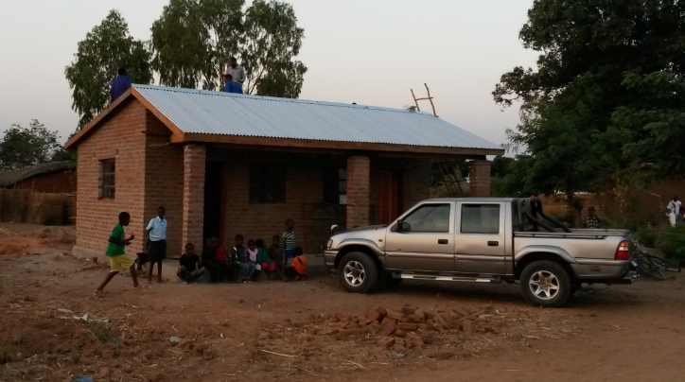
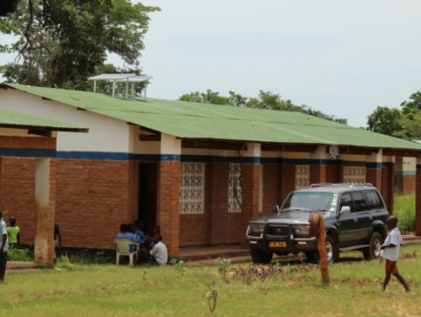
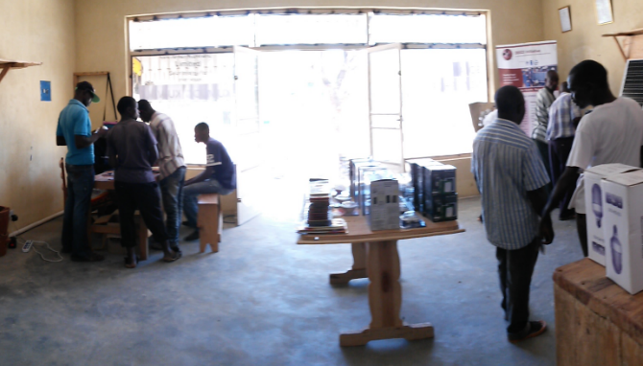
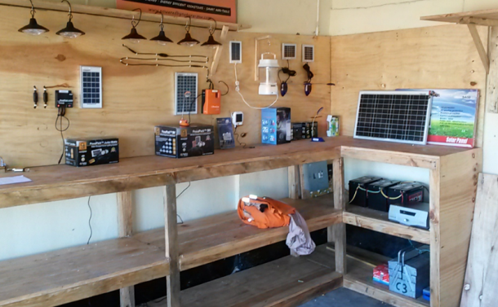
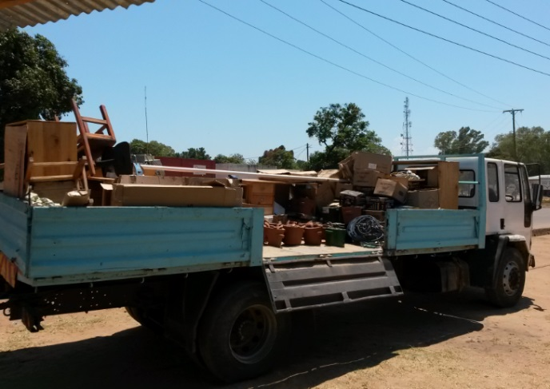
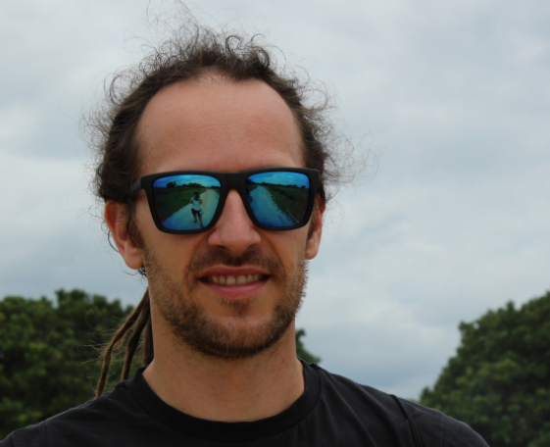
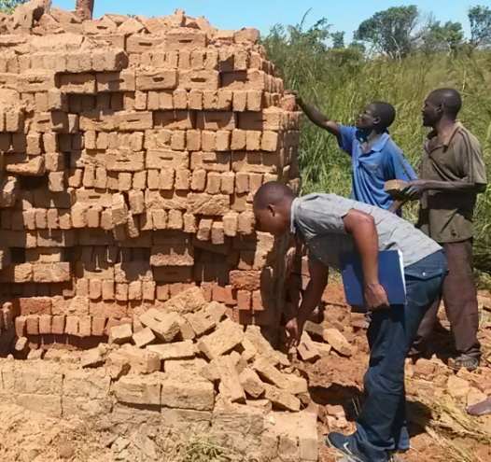
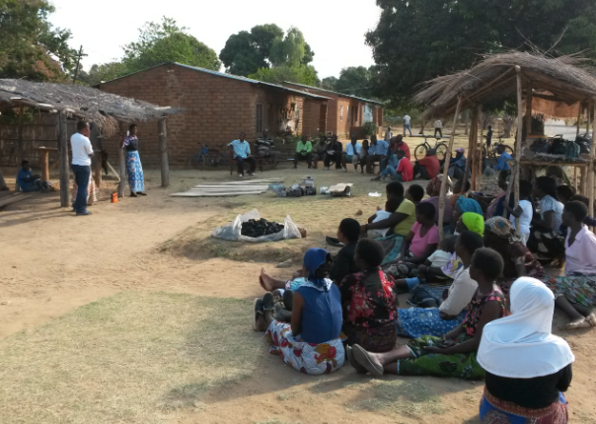
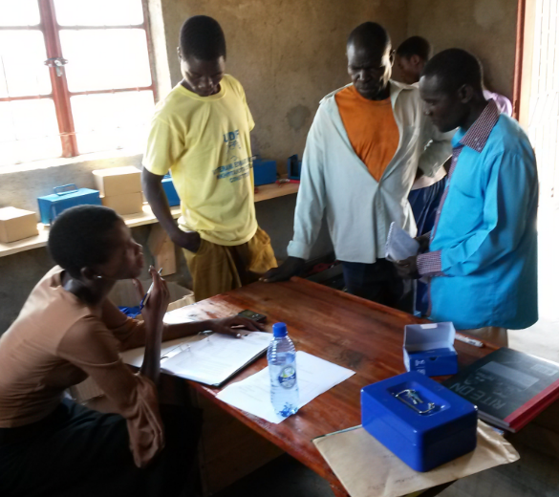
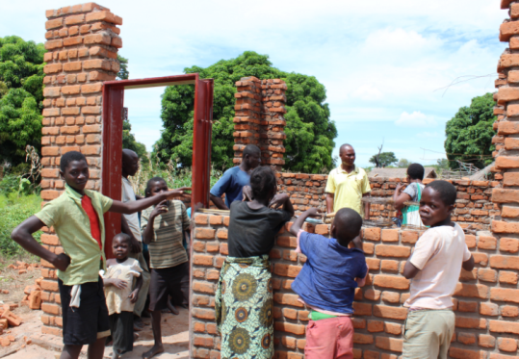
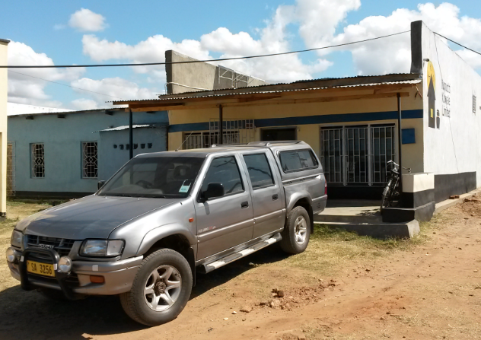
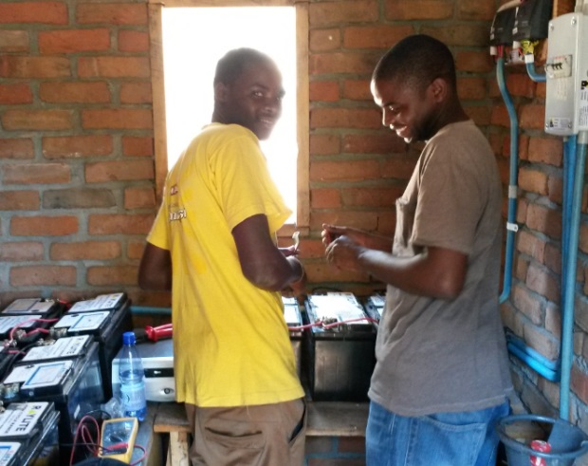
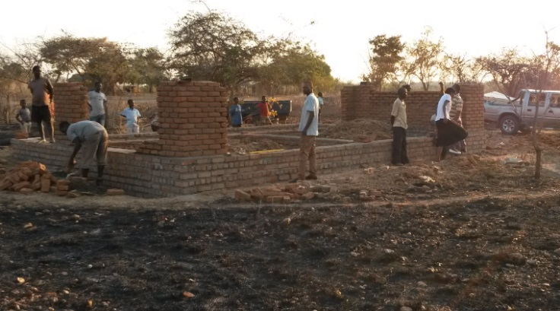
2014 - Timeline
Jan Feb Mar Apr May Jun Jul Aug Sep Oct Nov Dec
Notes:
January – Finalization Chinteche
February – Arrival Trygve
March – Geoffrey & Fumbani
25 March – Start construction in Kazimu
17 April – Opening of shop
7 May – Start of construction in Katengeza
15 May – Opening of Kazimu Charging Station
22 June – Bought car
27 July – THM water pump
8 Aug – Kamange Hire-purchase initiated
30 Aug – Fish Eagle
10 Sept – SEED Award
15 Sept – Mbewa Construction
1 Oct – Opened Katengeza
1 Oct – Bua River Lodge
Oct – Chota Village
3 Nov – Moving to new office
Nov – Finalization Kwathu
15 Dec – Open Mbewa
15 Dec – Sasani Hire-Purchase
Before Christmas – Sales record

Slide 17
…..technical and social challenges related to introducing solar electricity….

Slide 18
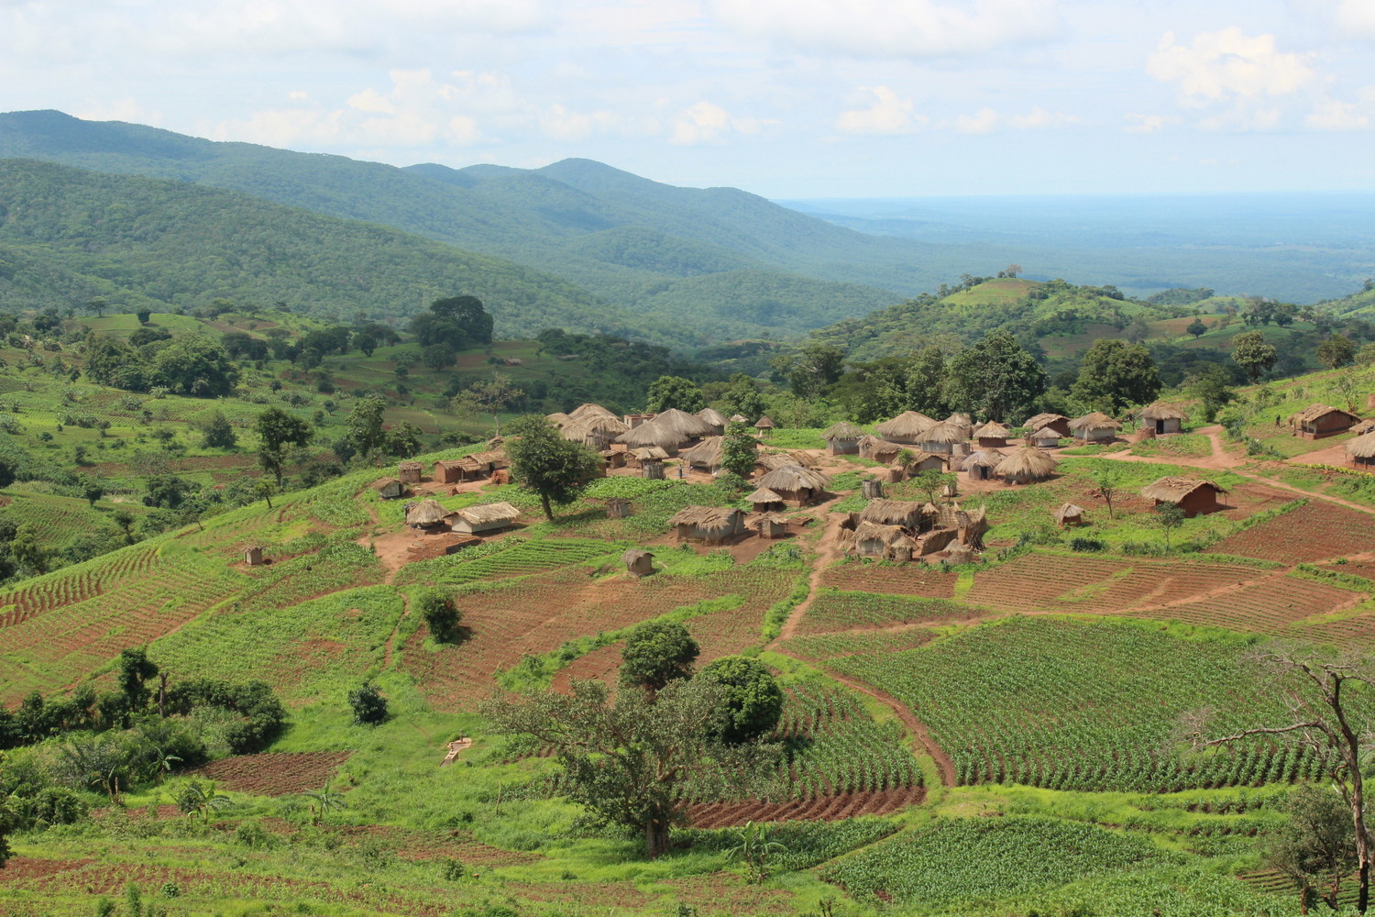
Notes:
Malawi – eit land der folk eig nesten ingen ting…

Slide 19
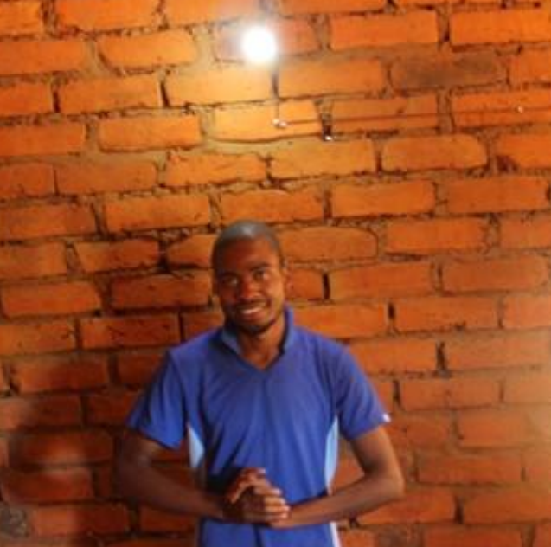
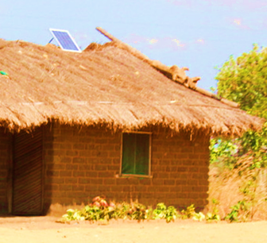
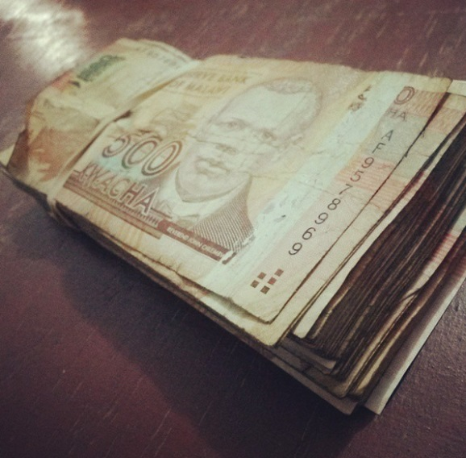
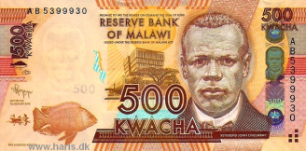

Slide 20

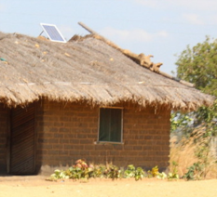




Time
Time

Slide 21
Sales of solar energy solutions
Commercial business model
Village electrificaton
programmes

Slide 23
Village charging station
Village
PV solar panels
Charge controller
Fully charged batteries are rented out
100kr
Fully charged battery units
Charging battery units
Lights
5kr
Phone
charging
Empty batteries are returned

Slide 24
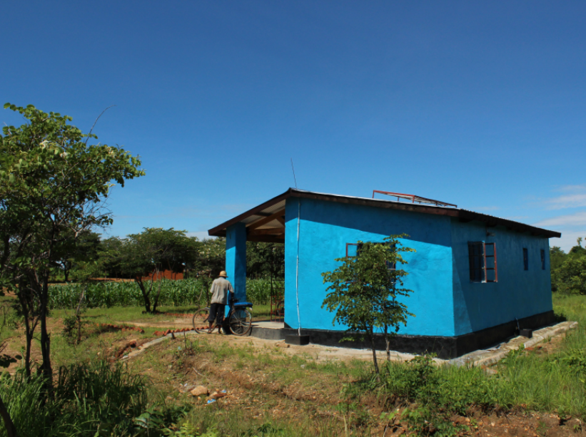
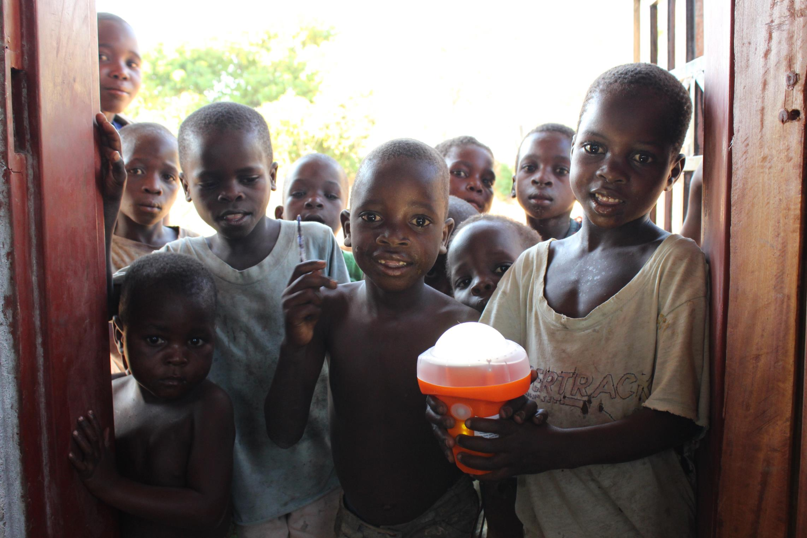
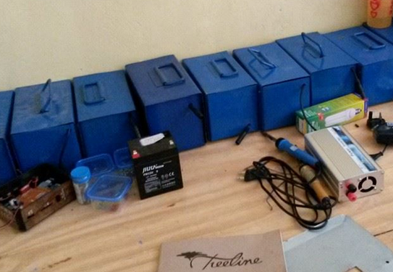

Slide 25
Hire-purchase agreements
Village
100kr
24x40kr
Village energy
committee
Technician crew
Solar panel
Battery
Lights
Solar panel & battery
Phone
charging

Slide 26



Slide 27





Slide 28
Conclusions
What works?
Solar cells/battery/LED/mobile phone
Small better than big
Local maintenance and assembly
What is needed?
A commercial approach
Financing/credit/loans
Local involvement and compentece building

Slide 29

“I must say that I am worried that the Malawian government will not be able to meet the challenges of rising energy demands and rapid population growth. It is in the hands of donors and private businesses like us to make a difference.
Our work is really needed.”
9/9-15 Andreas Dam Lukowski

Slide 30





Thanks to
Nkhotakota Youth
Organisation
Flora
VGS
Royal Norw.
Embassy
Malawi

Slide 31

Be the collegue of these guys next year!
global.no/stillinger

